Slide 1
New York State Climate Leadership
Climate Leadership and Community Protection Act
Mark Lowery
Assistant Director
Office of Climate Change
New York State Department of Environmental Conservation

Slide 2
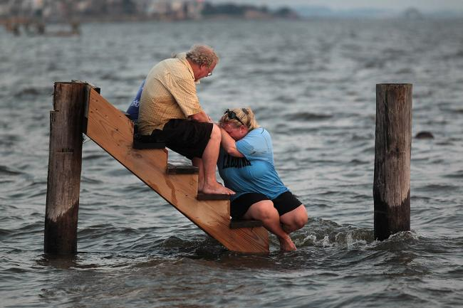
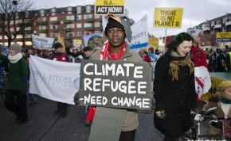
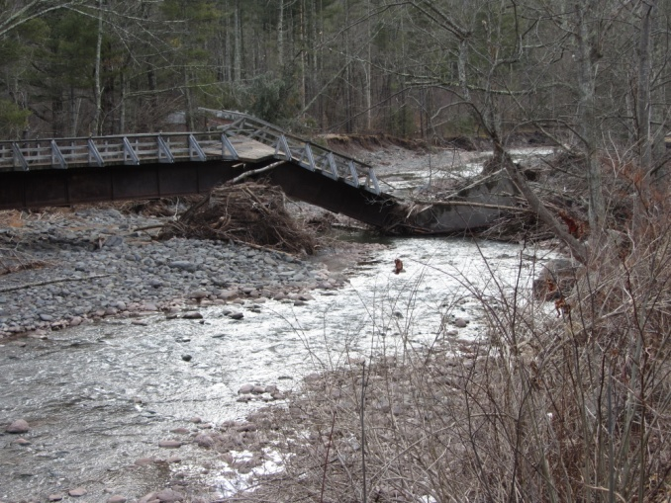
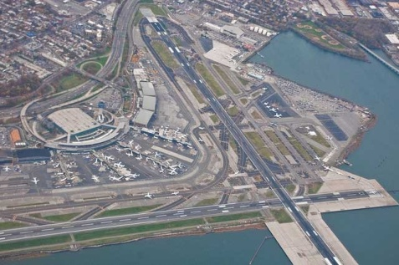
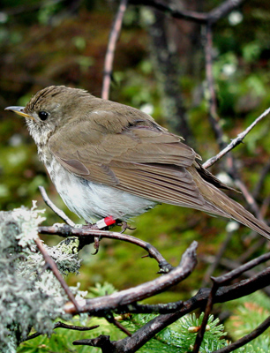
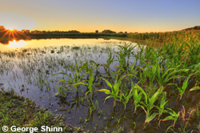
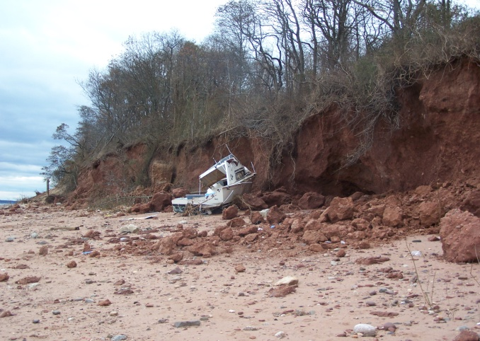
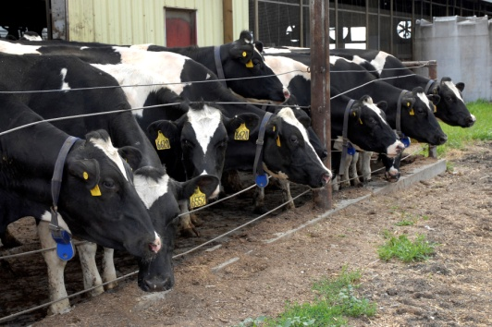
We Have Seen the Effects of Climate Change
Higher temperatures
More precipitation
More frequent drought
Sea-level rise
More extreme events:
Floods
Heat
Ice/snow
Winds
Coastal storms
Disease and pests
Risks to people
Stressed infrastructure
Agricultural and ecosystem effects
Conservation Value Notes
Greenpeace International
NYSDEC
PhillipC/flickr
NYSDEC
T.B. Ryder
NYSDEC
NYSDEC
Notes:
Although NYS adaptation and resilience programs have been largely focused on flooding – SLR, coastal storms and riverine flooding associated with extreme precipitation, we are also concerned about the effects of rising temperatures on aquatic ecosystems and important agricultural crops, including dairy, apples and maple syrup. Expected short-term droughts, punctuated by heavy precipitation will affect agriculture and wetlands, and extreme heat threatens health and infrastructure.
Ocean acidification and collapse of the Long Island Sound lobster fishery, secondary climate change effects, such as diseases and pests, and, have already hit New Yorkers hard.

Slide 3
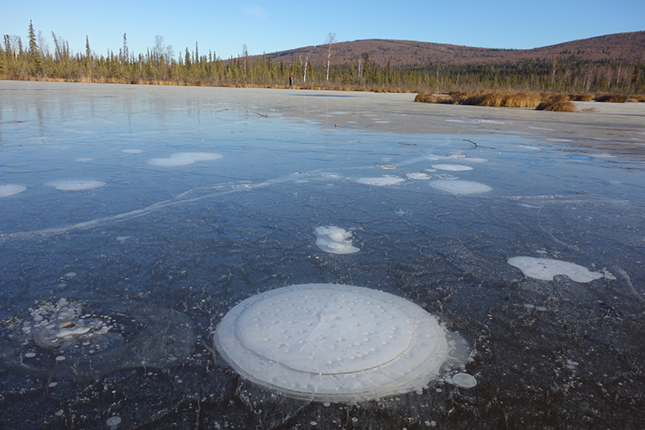
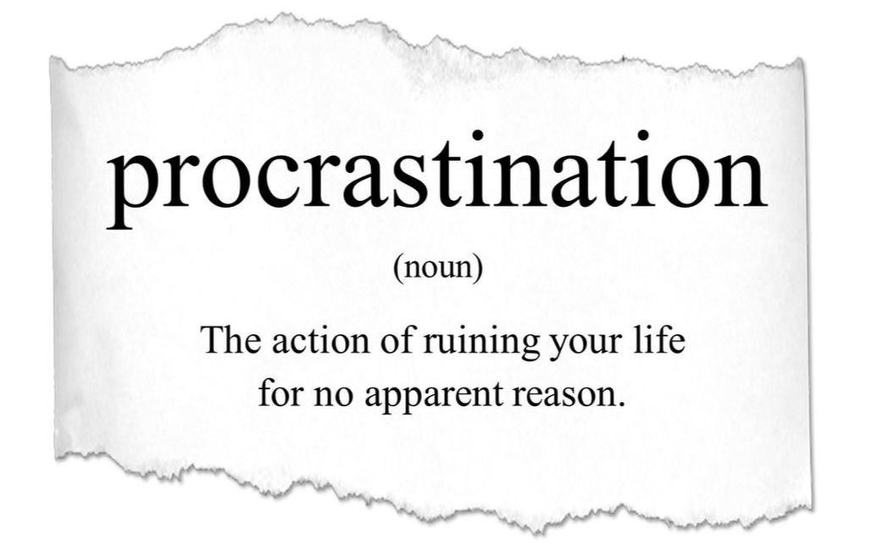
We Must Take Action Now
1.5⁰C warming could trigger feedback loops with the potential to cause runaway warming.(IPCC, 2018)
Risks substantially higher at 2⁰C warming. (IPCC, 2018)
Paris commitments would lead to a 3.2⁰ C rise by 2100. (UNEP, 2019)
The Gap: On current track we will emit enough GHGs by 2030 to make holding warming to 1.5⁰C impossible. (IPCC, 2018)
Must now reduce emissions 2.7%/yr for 2⁰C, 7.6% for 1.5⁰C: would have been 0.7% and 3.3% if started in 2010. (UNEP 2019 Gap Report)
Notes:
July 18, 2019 - Governor Cuomo signed the Climate Leadership and Community Protection Act
Note: Most provisions of CLCPA (other than the community air monitoring requirement) do not become effective unless and until the governor signs S.2385/A.1564, which creates a permanent environmental justice advisory group and an environmental justice interagency coordinating council. If signed, this “EJ” bill takes effect on January 1, 2020.
CLCPA establishes very aggressive, nation-leading GHG reduction goals and sets them in statute for first time in NYS
Strong renewable and clean energy goals and codification of clean energy targets puts NYS on a path to carbon neutrality by mid-century
CLCPA includes strong commitments to disadvantaged communities, environmental justice, and ensuring a just transition to a low-carbon economy
Amends Public Service Law
By June 13, 2021, establish a program requiring load serving entities (LSEs) to effectuate the 70x30 and 100x40 targets
By July, 2024, establish programs to require procurement by LSEs of
9,000 MW of offshore wind by 2030
6,000 MW of solar by 2025
3,000 MW of energy storage by 2030
Ensure achievement of 185 TBtu end-use energy savings by 2025 and at least 20% investment in residential energy efficiency, including multi-family housing, to benefit disadvantaged communities
Specify minimum percentage of energy storage projects deliver clean energy benefits into NYISO zones serving disadvantaged communities and in a manner to reduce peaker use
IOU and NYSERDA report energy savings and clean energy market penetration in LMI and disadvantaged communities

Slide 4
Our Actions Will Yield Many Benefits
Notes:
New York has shown an ability to lead and the law only serves to cement New York’s position as a leader in clean energy, environmental protection, and addressing climate change.
As the 13th largest economy in the world, the work we do together can and will make a difference.
The CLCPA empowers every New Yorker to fight climate change while improving our daily lives through new job opportunities, improved public health, and more resilient communities and infrastructure.
In addition to providing climate leadership, the law includes requirements to protect our communities and ensure that those communities, most notably those that have been historically overburdened and could be in the future as our changing climate takes a stronger hold, benefit from our activities and actions.

Slide 5
Where Are We Now?

Slide 6
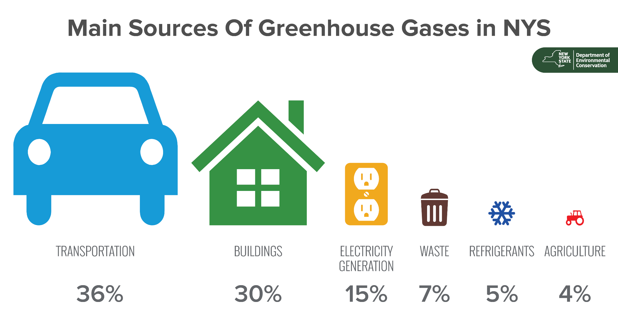
New York State emitted approximately 206 million metric tons of CO₂ equivalent in 2016– about 0.5% of total annual global emissions.
Notes:
Now let’s look more closely at NYS. Although NYS has the lowest per capita GHG emissions in the country, it is still a significant total emitter. Folks tend to think about emissions from power generation, but the transportation sector is the largest source of emissions, both nationally and in NYS, with emissions associated with heating water and space close behind.

Slide 7
New York is Making Progress
Buildings
New Efficiency: New York
Carbon Neutral Buildings Roadmap
Leadership by Example
BuildSmart (EO88)
EO166
Transportation
EVolveNY
Charge Ready NY
Drive Clean Rebate
Municipal Clean Vehicle Rebates
Resilience
Community Risk and Resiliency Act
Resilient New York
Electricity
Regional Greenhouse Gas Initiative
Clean Energy Standard
NY-Sun
Offshore Wind
Energy Storage
Local Governments
Climate Smart Communities
Clean Energy Communities
Short-Lived Climate Pollutants
Methane Reduction Plan
HFC Reduction Strategy
… and more!
Notes:
New York is well positioned to embark on this path.
In the transportation sector, New York stands by our commitment to uphold California’s clean car standards. We are supporting this through programs across agencies that provide rebates and incentives for electric and zero emission vehicles and buses as well as charging stations.
We’ve shown time and again our willingness as state agencies to lead by example. NYPA is working with many of us to reduce the energy consumption of state buildings.
Leadership by example is a core principle of New Efficiency: New York in driving additional energy efficiency beyond our own buildings.
Department of Public Service, Ag and Markets, and DEC are working through the Methane Reduction Plan to address another one of our greenhouse gases.
Department of State, DEC and DHSES are supporting local resilience at a local level through Resilient NY.
And DOT is an important partner in the Climate Smart Communities program
The list goes on.

Slide 8
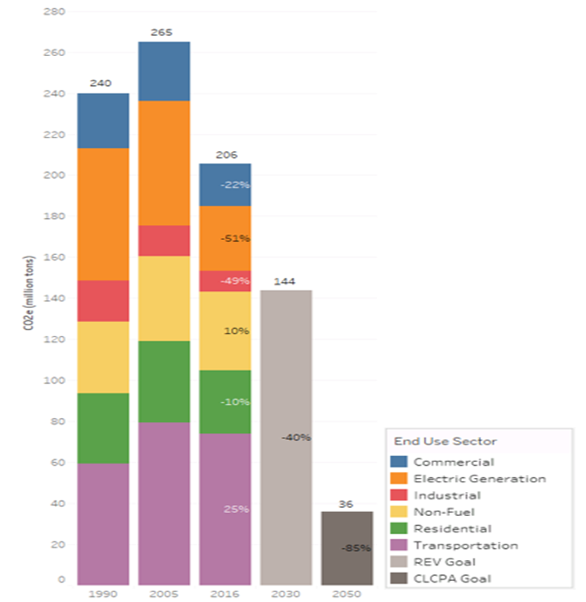
But We Are Going to Have to Do A Lot More…
New York State GHG Emissions by Source Category (MMtCO₂e)
Notes:
While we’ve made good progress, as this bar chart indicates, we are going to have to step up our work to meet our targets and put the state on a path to carbon neutrality.
Achieving a carbon neutral economy means that our economic activities and other practices do not result in a net increase in releasing greenhouse gas emissions into the atmosphere.
The bar chart is based on the state’s most recent greenhouse gas inventory produced by DEC in collaboration with NYSERDA.
It is based on our current inventory methodology. The law requires new methods for calculating New York’s greenhouse gas emissions and will result in some changes to what is being shown. Therefore consider this as illustrative.
The numbers in the 2016 bar compare that sectors emission levels to 1990.
It shows that most of our reductions have come from the electricity sector.
Some further reductions will be achieved through the clean energy and energy efficiency subtargets in the law and increased electrification of buildings and transportation. But we will need to do more and across more than just the electricity sector.
Some sectors will be difficult to decarbonize. Those remaining emissions may need to be captured or sequestered.
We will also need to consider what the transition to a lower carbon economy will mean for upstate industry, affordable housing, land use, and workers and businesses in or supported by traditional energy industries.
This is what the Climate Action Council will help us to determine and where your strategic input will be critical.

Slide 9
Reaching 40% by 2030 and carbon neutrality
Will require
Electrification of cars and heating
Deep penetration of renewables (wind, solar)
Waste diversion (organics and embedded emissions)
Conversion of refrigerants
Deep energy efficiency improvements – in all sectors
↓40%
50
Notes:
We have a lot of work to do to meet even the state’s current interim goal of 40% by 2030, let alone complete carbon neutrality.
In particular, we will need deep market penetration of electric vehicles and use of electricity for space and water heating, i.e., high efficiency heat pumps.
We need to reduce waste in general and especially deposition of organic material in landfills, where it forms methane.
We need to eliminate the use of high-GWP refrigerants, and vastly improve energy efficiency and conservation.

Slide 10
Climate Leadership and Community Protection Act
Puts New York on the path to carbon neutrality with nation’s most aggressive GHG reduction goals: 40x30, 85x50
Codifies clean energy targets:
70% renewable energy by 2030
100% clean electricity by 2040
9,000 MW of offshore wind by 2035
6,000 MW of distributed solar by 2025
3,000 MW of energy storage by 2030
185 Tbtu on-site energy savings by 2025
Commitments to environmental justice and just transition
Notes:
CLCPA establishes very aggressive, nation-leading GHG reduction goals and sets them in statute for first time in NYS
Strong renewable and clean energy goals and codification of clean energy targets puts NYS on a path to carbon neutrality by mid-century
CLCPA includes strong commitments to disadvantaged communities, environmental justice, and ensuring a just transition to a low-carbon economy
Amends Public Service Law
By June 13, 2021, establish a program requiring load serving entities (LSEs) to effectuate the 70x30 and 100x40 targets
By July, 2024, establish programs to require procurement by LSEs of
9,000 MW of offshore wind by 2030
6,000 MW of solar by 2025
3,000 MW of energy storage by 2030
Ensure achievement of 185 TBtu end-use energy savings by 2025 and at least 20% investment in residential energy efficiency, including multi-family housing, to benefit disadvantaged communities
Specify minimum percentage of energy storage projects deliver clean energy benefits into NYISO zones serving disadvantaged communities and in a manner to reduce peaker use
IOU and NYSERDA report energy savings and clean energy market penetration in LMI and disadvantaged communities

Slide 11
Climate Act: Key Deadlines
Statewide GHG Limits 1 year 2021
Social Cost of Carbon 1 year 2021
Annual GHG Report 2 years 2022
Clean Energy Standard Update 2.5 years 2022
Draft Scoping Plan 2 years 2022
Final Scoping Plan 3 years 2023
Statewide GHG Regulations 4 years 2024

Slide 12
Climate Action Council
2 years: Draft scoping plan of recommendations for achieving GHG limits, final in 3 years
Co-chaired by DEC and NYSERDA
Agencies: DOT, DOH, ESD, DAM, HCR, DOL, PSC, NYPA, LIPA, DOS
2 Governor appointments
8 Legislative appointments
Advisory panels:
Transportation
Land use and local government
Housing and energy efficiency
Energy intensive industries
Power generation
Agriculture and Forestry
Notes:
Climate Action Council has two years to develop a draft plan of recommendations for achieving the required GHG reductions (Jan. 2022), which must be finalized a year following (Jan. 2023)
CAC chaired by DEC commissioner and NYSERDA president and includes heads of 10 other agencies
Governor Cuomo will appoint two non-agency members, and Legislative leadership will appoint 8 members
CLCPA requires the CAC to appoint advisory panels to develop recommendations for strategies to reduce emissions in these areas

Slide 13
Working Groups
Just Transition WG
13-17 Members: NYSERDA & DOL (co-chairs), HCR, PSC, developers, energy intensive industry
Purpose: Recommendations to CAC on clean energy transition impacts and opportunities
Climate Justice WG
Members: DEC (chair), NYSERDA, DOL, DOH, 3 NYC EJ, 3 Rural EJ, 3 Upstate Urban
Purpose: Develop criteria for and list of disadvantaged communities; report on barriers and opportunities for clean energy
Notes:
JUST TRANSITION
At least five members from energy-intensive and trade exposed industries
Advise Council on opportunities for workforce development for clean energy economy
Identify energy-intensive industries and related trades
Identify EGU sites that may be closed and can be reused
Advise on potential competitiveness impacts and emission leakage
Conduct study on jobs to address climate and workforce disruption
Climate Justice WG
Members: DEC (chair), NYSERDA, DOL, DOH, 3 NYC EJ, 3 Rural EJ, 3 Upstate Urban
Purpose: Develop criteria for and list of disadvantaged communities; report on barriers and opportunities for clean energy

Slide 14
Climate Action Council
Co-chairs:
DEC commissioner
NYSERDA president
+
10 agency heads,
10 appointees
Secretary to the Climate Action Council
Transportation Advisory Panel
Co-chairs: DEC, DOT
Power Generation Advisory Panel
Co-chairs:
DPS, DEC
Just Transition Working Group
Co-chairs:
DOL commissioner NYSERDA president
+
HCR commissioner,
DPS chair,
9-13 appointees
Climate Justice Working Group
Chair: DEC
NYSERDA, DOH, DOL
At least 9 EJ community representatives
Energy Efficiency & Housing Advisory Panel
Co-chairs: NYSERDA, HCR
Energy-intensive Trade-exposed Industries Advisory Panel
Co-chairs: DPS, ESD
Executive Steering Committee
Co-chairs:
DEC, NYSERDA
+
10 agency head designees
Legal Counsel Team
Co-chairs: DEC, NYSERDA
Agriculture & Forests Advisory Panel
Co-chairs: DAM, DEC
Land Use & Local Government Advisory Panel
Co-chairs: NYSERDA, DOS
Just Transition Working Group Staff
Co-chairs:
DOL, NYSERDA
Staff Steering Committee
Co-chairs:
DEC, NYSERDA
Council Agency Staff
Scoping Plan Team
Staff of Energy Coordinating Working Group
Community Air Monitoring Work Group
DAR
GHG Inventory Work Group
Co-chairs:
DEC, NYSERDA
Communications and Outreach Work Group
Co-chairs:
DEC, NYSERDA
Electricity Work Group
DPS, DEC
NYSERDA, plus others
Buildings Work Group
NYSERDA, HCR
DEC, DASNY, plus others
Local Government Work Group
NYSERDA, DOS
DEC, DOT, ESD, HCR, plus others
Waste Management Work Group
DMM, DAR, OCC
Barriers Report Work Group
Chair: DEC
NYPA, NYSERDA
Social Cost of Carbon Work Group
Chair: DEC
NYSERDA, DPS
Transportation Work Group
DOT, DEC, NYSERDA, DOS DED, NYPA, plus others
Industry Work Group
DPS, ESD
DEC, NYSERDA, DOL, NYPA, plus others
Natural and Working Lands Work Group
DAM, DEC, plus others
GHG Regulations Work Group
DAR, OCC, OGC
Appointed
Agency Staff
DEC Staff

Slide 15
Developing the Scoping Plan
Scoping plan to outline recommendations to achieve the emission targets, including zero emission economy
To include the following:
Measures to aid in just transition of workforce
Mechanisms to limit emission leakage
Measures to achieve healthy forests
Quantification of costs and benefits
Process
Consult with Climate Justice WG and EJ Advisory Group
Hold 6 public comment hearings on the draft plan
Update every five years

Slide 16
Implementing the Scoping Plan – DEC
By end of 2023, DEC to promulgate regulations:
ensure compliance with 2030 and 2050 emission targets
cover all sectors but livestock
reflect findings of scoping plan,
maximize net benefits, reduce leakage and benefit disadvantaged communities.
At least two public hearings and extensive stakeholder consultation

Slide 17
Implementing the Scoping Plan – All Agencies
All agencies shall
implement strategies to reduce their emissions;
consider whether permit, licenses and other actions are inconsistent with achieving emission targets and, if so, identify alternatives or mitigation;
promulgate regulations that contribute to meeting the emission targets.
Actions should benefit, not burden, disadvantaged communities

Slide 18
Benefiting Disadvantaged Communities
Benefits of RE/EE programs to accrue to disadvantaged communities (35/40%)
Council to prioritize disadvantaged communities
Identify measures to reduce emissions of co-pollutants
Consult with Climate Justice Working Group and EJ Advisory Group
DEC rulemakings to implement the Council recommendations
Ensure no increase in co-pollutant emissions or disproportionate burden on disadvantaged communities
Prioritize measures to reduce emissions in disadvantaged communities
DEC to implement community air monitoring
In coordination with CJWG, DEC shall establish pilot by October 2022 to conduct community air monitoring in at least 4 disadvantaged communities.
By June 2024, DEC shall prepare a strategy to reduce emissions in disadvantaged communities with a disproportionate pollution burden

Slide 19
Community Risk & Resiliency Act Amendments
“§17-a. The department of environmental conservation shall take actions to promote adaptation and resilience, including:
actions to help state agencies and other entities assess the reasonably foreseeable risks of climate change on any proposed projects, taking into account issues such as: sea level rise, tropical and extra-tropical cyclones, storm surges, flooding, wind, changes in average and peak temperatures, changes in average and peak precipitation, public health impacts, and impacts on species and other natural resources.
identifying the most significant climate-related risks, taking into account the probability of occurrence, the magnitude of the potential harm, and the uncertainty of the risk.
measures that could mitigate significant climate-related risks, as well as a cost-benefit analysis and implementation of such measures.”
Notes:
CLCPA amends CRRA to add two new sections: 17-a and 17-b
Some aspects of language unclear, but intent appears to be to require consideration of all climate-change effects during DEC’s project review of all UPA permits, and for DEC to recommend cost-benefit analyses and risk-mitigation measures.
UPA permit programs now covered include the following (underlining indicates newly covered):
Protection of Waters (Title Five of Article Fifteen)
Water Supply and Water Transport (Title Fifteen of Article Fifteen)
Wild, Scenic and Recreational Rivers System (Title Twenty-Seven of Article Fifteen), except for that part of Article Twenty-Four administered by the Adirondack Park Agency
Certifications Under Section 401 of the Federal Water Pollution Control Act
State Pollutant Discharge Elimination System (Title Eight of Article Seventeen)
Realty Subdivisions: Sewerage Service (Title Fifteen of Article Seventeen)
Air Pollution Control (Article Nineteen)
Liquefied Natural and Petroleum Gas (Title Seventeen of Article Twenty-Three)
Mined Land Reclamation (Title Twenty-Seven of Article Twenty-Three);
Freshwater Wetlands (Article Twenty-Four), except for that part of Article Twenty-Four administered by the Adirondack Park Agency
Tidal Wetlands (Article Twenty-Five)
Collection, Treatment and Disposal of Refuse and Other Solid Waste (Article Twenty-Seven)
Coastal Erosion Hazard Areas (Article Thirty-Four)
The original CRRA provision to include oil and gas well permits, which are not covered by UPA, remains unchanged.
The amendment to CRRA expands the list of climate hazards that must be considered in these programs from “sea level rise, and/or storm surges and/or flooding” by requiring consideration of “future physical climate risk” in §17-b and describing “risks of climate change” to include a range of climate hazards in §17-a.
Importantly, §17-b authorizes DEC to require mitigation of significant climate risks to any natural resource, public infrastructure or services, disadvantaged communities, or private property not owned by the applicant. This provision may represent an expansion or clarification of DEC authority, particularly in programs for which the underlying authorizing statutes have not previously been interpreted as providing such authority.

Slide 20
Community Risk & Resiliency Act Amendments
Major Projects:
Water Supply and Water Transport (Title Fifteen of Article Fifteen)
Wild, Scenic and Recreational Rivers System (Title Twenty-Seven of Article Fifteen)
Certifications Under Section 401 of the Federal Water Pollution Control Act
State Pollutant Discharge Elimination System (Title Eight of Article Seventeen)
Realty Subdivisions: Sewerage Service (Title Fifteen of Article Seventeen)
Air Pollution Control (Article Nineteen)
Liquefied Natural and Petroleum Gas (Title Seventeen of Article Twenty-Three)
Mined Land Reclamation (Title Twenty-Seven of Article Twenty-Three);
Freshwater Wetlands (Article Twenty-Four)
Tidal Wetlands (Article Twenty-Five)
Collection, Treatment and Disposal of Refuse and Other Solid Waste (Article Twenty-Seven)
Coastal Erosion Hazard Areas (Article Thirty-Four)
§ 17-b:
All climate hazards
DEC authorized to require mitigation of significant climate risks to any natural resource, public infrastructure or services, disadvantaged communities, or private property not owned by the applicant.
Notes:
CLCPA amends CRRA to add two new sections: 17-a and 17-b
Some aspects of language unclear, but intent appears to be to require consideration of all climate-change effects during DEC’s project review of all UPA permits, and for DEC to recommend cost-benefit analyses and risk-mitigation measures.
UPA permit programs now covered include the following (underlining indicates newly covered):
Protection of Waters (Title Five of Article Fifteen)
Water Supply and Water Transport (Title Fifteen of Article Fifteen)
Wild, Scenic and Recreational Rivers System (Title Twenty-Seven of Article Fifteen), except for that part of Article Twenty-Four administered by the Adirondack Park Agency
Certifications Under Section 401 of the Federal Water Pollution Control Act
State Pollutant Discharge Elimination System (Title Eight of Article Seventeen)
Realty Subdivisions: Sewerage Service (Title Fifteen of Article Seventeen)
Air Pollution Control (Article Nineteen)
Liquefied Natural and Petroleum Gas (Title Seventeen of Article Twenty-Three)
Mined Land Reclamation (Title Twenty-Seven of Article Twenty-Three);
Freshwater Wetlands (Article Twenty-Four), except for that part of Article Twenty-Four administered by the Adirondack Park Agency
Tidal Wetlands (Article Twenty-Five)
Collection, Treatment and Disposal of Refuse and Other Solid Waste (Article Twenty-Seven)
Coastal Erosion Hazard Areas (Article Thirty-Four)
The original CRRA provision to include oil and gas well permits, which are not covered by UPA, remains unchanged.
The amendment to CRRA expands the list of climate hazards that must be considered in these programs from “sea level rise, and/or storm surges and/or flooding” by requiring consideration of “future physical climate risk” in §17-b and describing “risks of climate change” to include a range of climate hazards in §17-a.
Importantly, §17-b authorizes DEC to require mitigation of significant climate risks to any natural resource, public infrastructure or services, disadvantaged communities, or private property not owned by the applicant. This provision may represent an expansion or clarification of DEC authority, particularly in programs for which the underlying authorizing statutes have not previously been interpreted as providing such authority.

Slide 21
Implementing CRRA Amendments
Each DEC permit program, supported by OCC, DEP and OGC, will develop guidance
Identify climate/weather hazards relevant to each permit/project type
Determine necessary regulatory and permitting amendments
Identify information and decision-support tool needs
Put amendments and tools in place
For SEQRA too

Slide 22
State of the State
Climate Initiatives

Slide 23
1. Combatting Climate Change
Part 1 $3-Billion Restore Mother Nature Bond Act
Part 2 Green Economy
Part 3 Renewable Energy
Part 4 Waste Reduction
Notes:
“1. Combatting Climate Change” comprises 4 parts; additional proposals of interest in 3. Rebuilding a New N.Y. and 4. Opportunity Agenda

Slide 24
Part 1. $3-Billion Restore Mother Nature Bond Act
Protect high-traffic public lands
Fight flooding and support sustained resilience on Great Lakes
Restore critical habitats and reduce flood risk
Notes:
REDI project implementation
Focus on restoration of significant habitats and flood reduction through
reconnecting waterways
right-sizing dams and culverts
Wetland and floodplain restoration
Shellfish restocking
Open space preservation
Forest conservation
Tree replanting
Reducing ag and stormwater runoff contamination
Upgrade flood control infrastructure
Protect critical facilities
Community relocation
Expansion of renewable energy

Slide 25
Part 2. Combat Climate Change & Grow NY’s Green Economy: A Win-Win
Electric vehicle industry expansion
Green economy tax credits
Building retrofits
Offshore wind industry hub
Notes:
Convene a Blue Ribbon Task Force to Grow the EV Sector
Electrify Upstate Transit Systems
Build a Robust Network of EV Chargers Throughout New York: The Department of Public Service (DPS) will propose a “make-ready” initiative directing utilities to build the grid infrastructure needed to enable the installation of chargers.
Invest $100 million in Green Bank Financing to attract EV-Sector manufacturers and other related businesses
Green Economy Tax Credit for green job wages and capital investments
Retrofit Homes and Businesses to Lower Carbon Emissions: NYSERDA will launch a $30 million Empire Building Retrofit Challenge to demonstrate solutions for high-profile commercial and multi-family buildings across the State.

Slide 26
Part 3. Expand Renewable Energy Power to Meet Zero-Carbon Emissions by 2040
Increase renewable capacity
Prepare the grid for new renewable generation
Community assistance
Notes:
Increase Solar, Onshore Wind and Storage Capacity by More Than 1,000 Megawatts: NYSERDA will make competitive awards to 21 large-scale solar, wind, and energy storage projects across upstate New York,
The State will put together a plan for authorizing and building new transmission capacity to bring clean and renewable power from to areas that need additional electricity capacity, prioritizing using existing rights of way. The plan will include upgrading the grid with smart, new technology that increases the capacity and effectiveness of the system, such as battery storage technology.
Steps to assist with just transition

Slide 27
Part 4. Reduce Waste in Our Communities
Styrofoam ban
Mattress and carpet recycling
Glass reuse expansion

Slide 28
3. Rebuilding a New NY
MTA capital investment
Statewide infrastructure investment
Upstate airport development & revitalization
High speed rail
Notes:
Invest in the MTA’s Capital Plan to Provide More Reliable and Accessible Public Transportation Downstate
Develop an Innovative Strategy to Build High Speed Rail in New York

Slide 29
4. Opportunity Agenda
Supporting New York workers
E-bike, e-scooter legislation
Bringing New Yorkers out of poverty
Affordable housing investments
Workforce development
Future of work centers
Apprenticeship expansion
Training for the green economy
Comprehensive education & training center

Slide 30
Contact Information
Office of Climate Change
NYS Department of Environmental Conservation
625 Broadway
Albany NY 12233-1030
518-402-8448
climatechange@dec.ny.gov

