Slide 1
Lessons Learned and Case Study
Brownfield Cleanup Program
Michele Wittman
Hazard Evaluations Inc.

Slide 2
BCP Pre-Application Meeting
First Meet and Greet
Opportunity to Ask Questions
Ability of Site to be Accepted BCP
Cleanup Criteria and Development Plans
Remediation Options
Allows Client to Understand BCP Requirements and Timing

Slide 3
BCP Application Deficiencies
Correct Name of Applicant – Match exactly to NYS Dept. of State
Proof of access if Requestor is not owner – remember Sale Contract is not enough
Previous Owner and Occupants
Develop a chain of ownership – dating to at least when contamination was released
Develop a chain of occupants and operators – include name and contact, if known

Slide 4
BCP Application Deficiencies
Contact Lists
Include all Contacts – City of Buffalo Planning Board Chairman
Adjoining Properties – to include residents and occupants, not just owners of property
Figures
Include County Tax Map – EC GIS map may not be adequate
Env. History – include figure that shows concentrations that exceed planned cleanup criteria

Slide 5
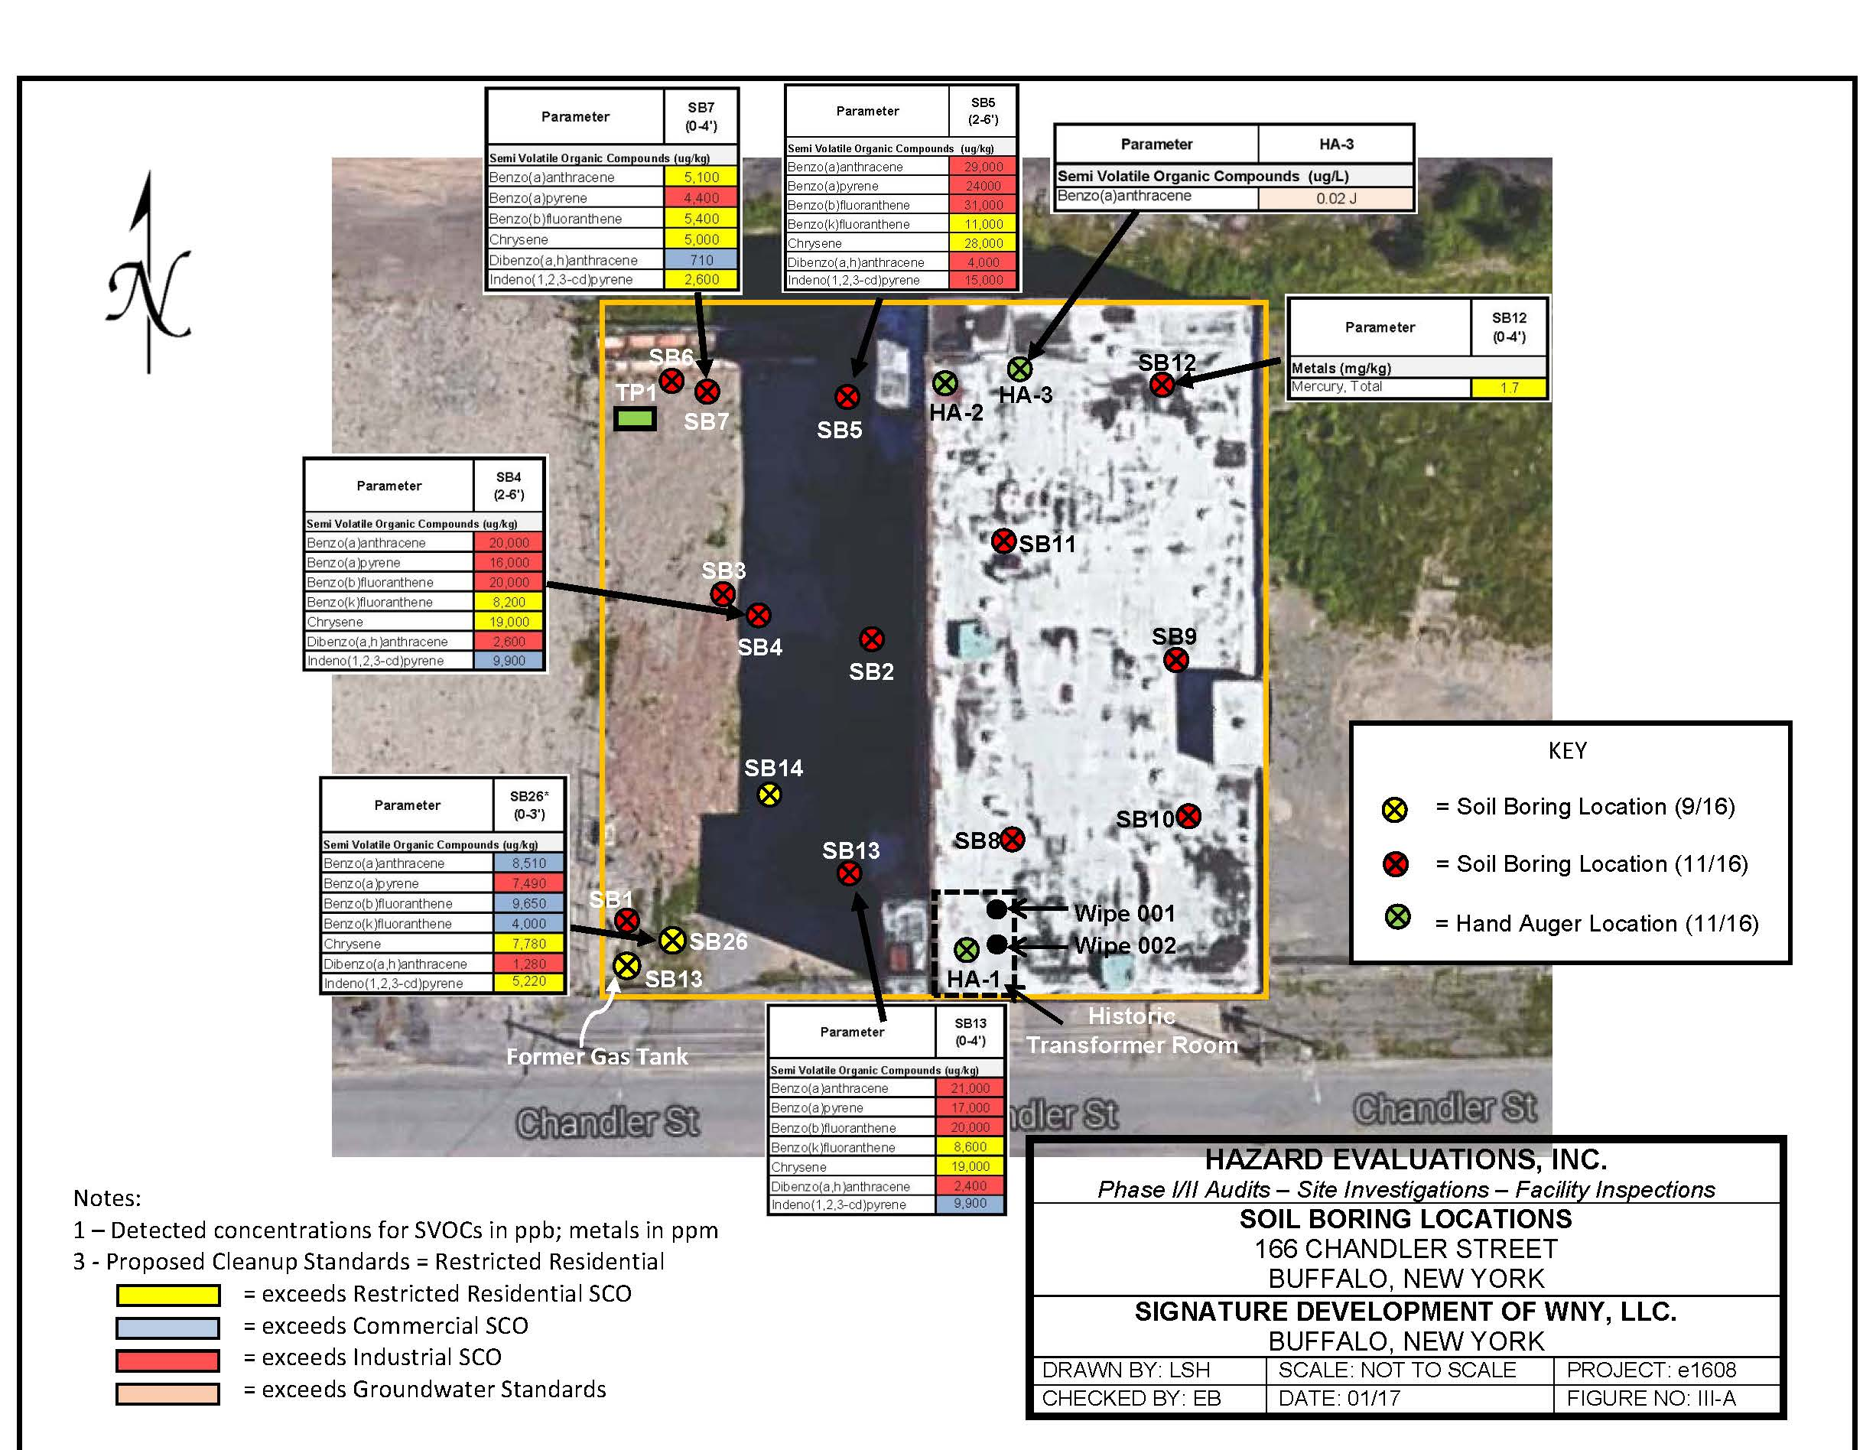

Slide 6
Case Study – 2017 Project, Buffalo, NY
Client wanted Certificate of Completion by December 2017
Application Submitted November 15, 2016
Letter of Incompleteness on December 1, 2016
Final Application Resubmittal and Letter of Completion in January 2017
Acceptance Letter received March 3, 2017
Final BCP Agreement Issued April 24, 2017

Slide 7
Case Study – 2017 Project, Buffalo, NY
Work Plans for RI and IRM submitted with Application; Work Plan approval end of April 2017.
IRM included removal of soil from courtyard and parking lot areas –remaining portions of property covered by building
IRM anticipated to be final remedy

Slide 8
Case Study – 2017 Project, Buffalo, NY
Early May 2017
Asbestos Identified throughout entire building and courtyard deemed ACM Containing – all work ceased.
Client still wanted COC by Dec. 2017
ACM work required removal of top 2-inches of soil due to evidence of ACM.
Soil Piles had roofing shingles mixed in
Soil also had PCBs over 50 ppm.

Slide 9
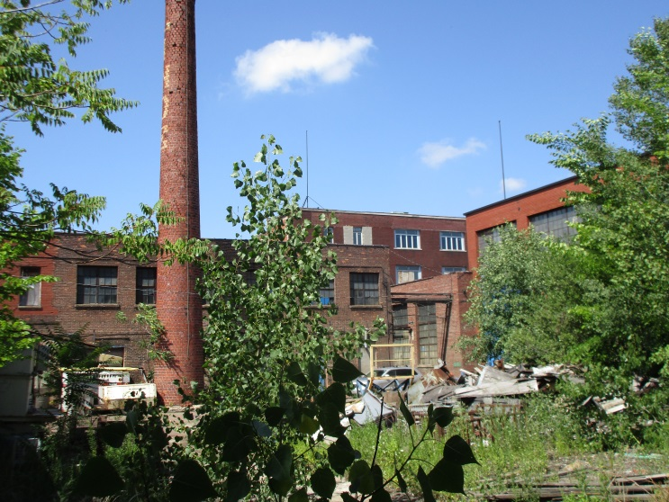
Case Study – 2017 Project, Buffalo, NY

Slide 10
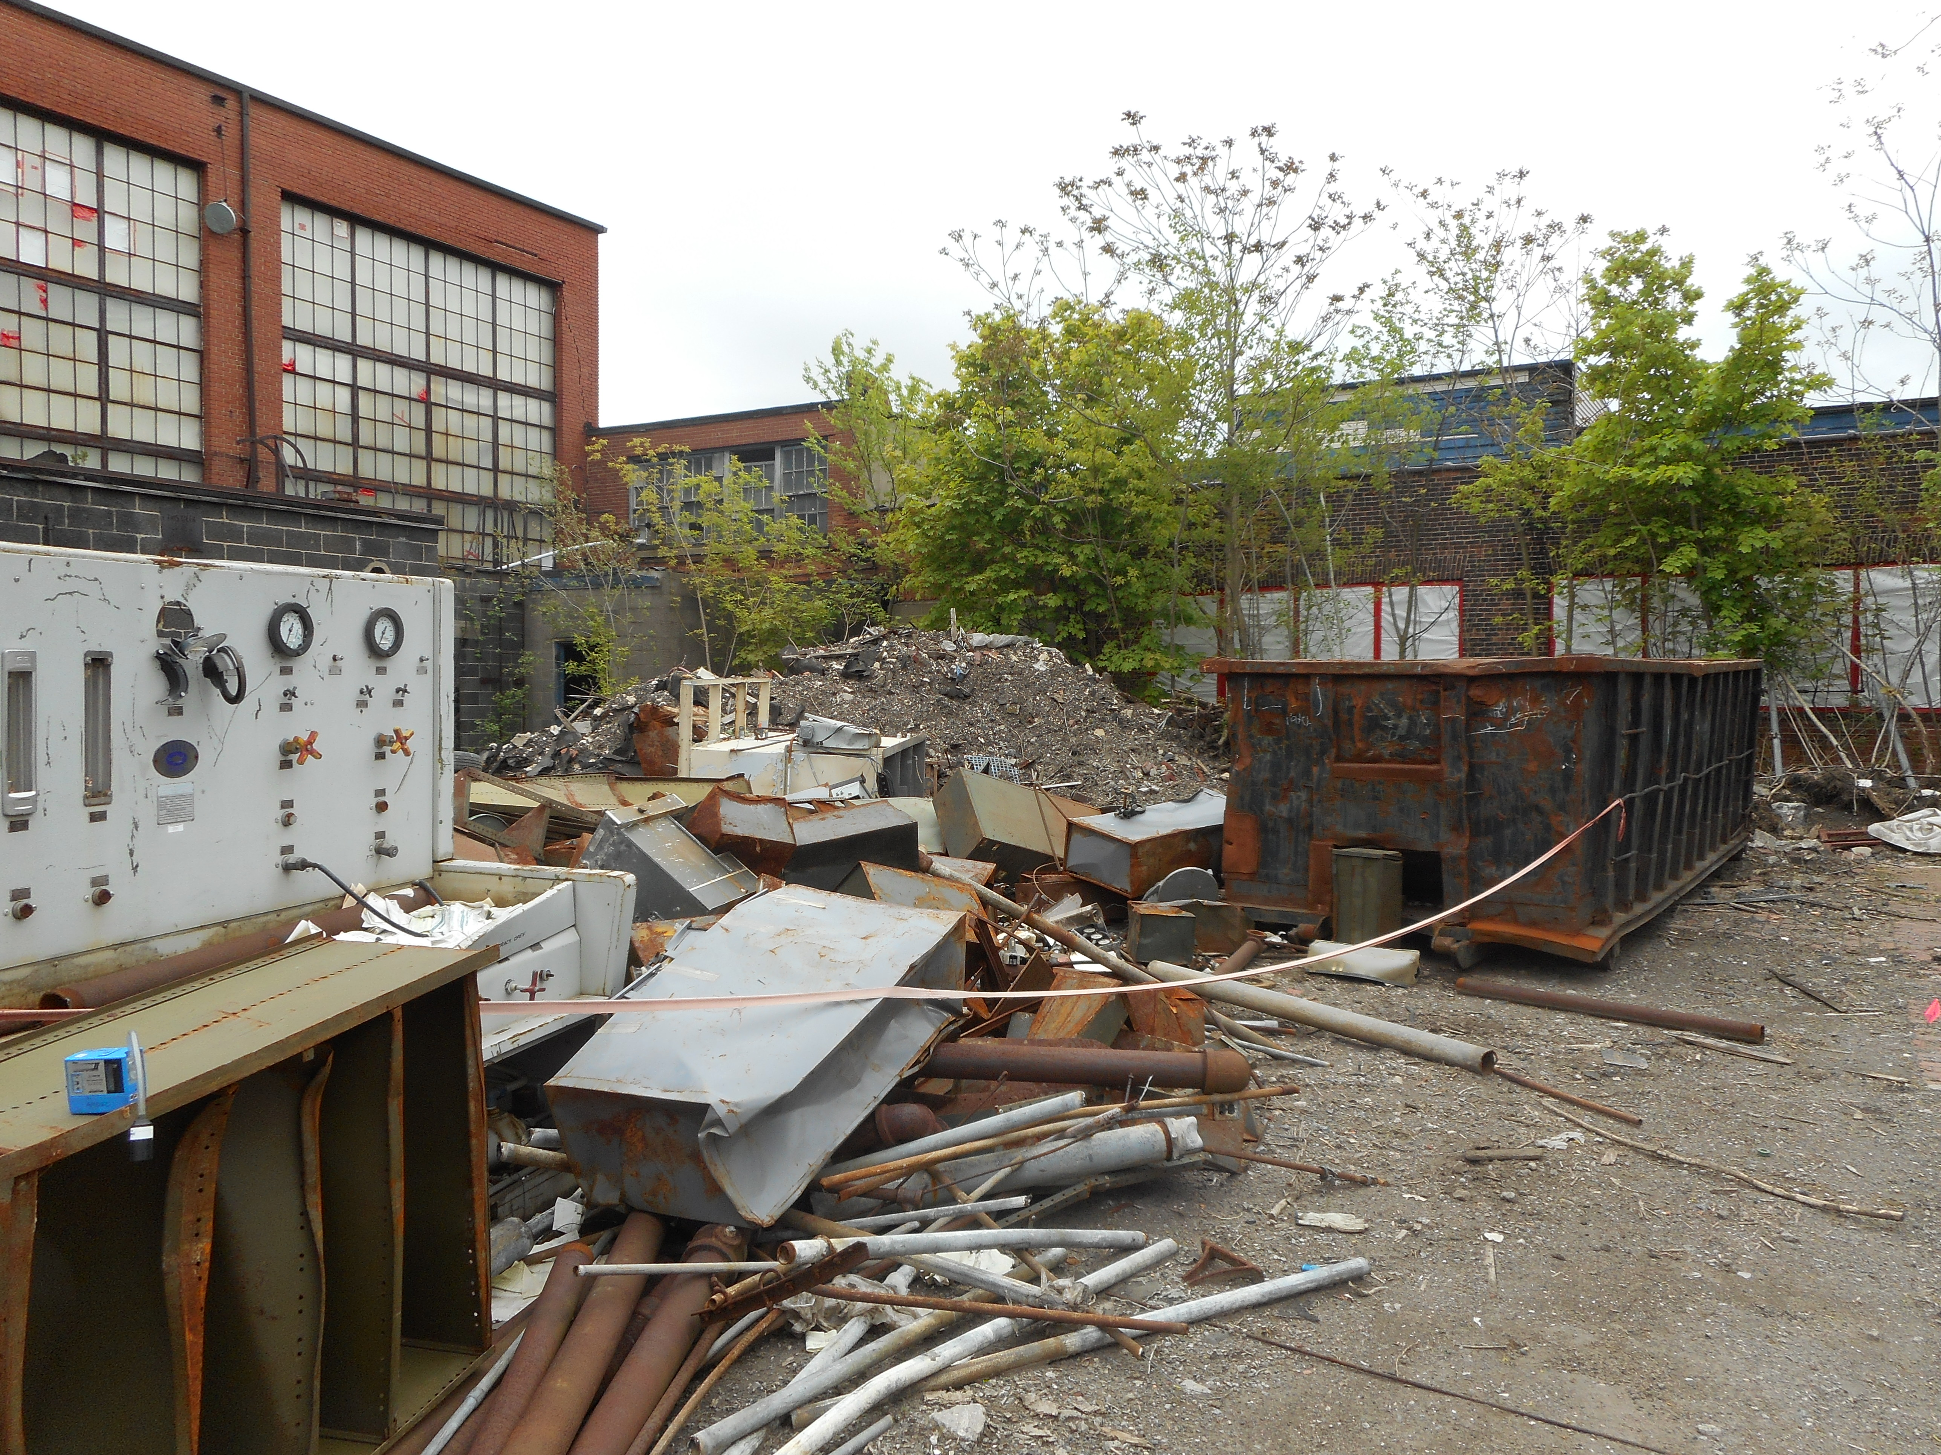
Case Study – 2017 Project, Buffalo, NY

Slide 11
Case Study – 2017 Project, Buffalo, NY
Worked with ACM Contractor for Soil Removal
ACM and PCB soil removed July 2017
Courtyard Control not until August 2017
Remove PCB soil over 50+ ppm
Remove concrete footers and foundations
Remove UST, drainage structures, and impacted fill
Chimney Stabilization and Restoration Issues
Confirmatory sample results confirmed no testing results above Restricted Residential numbers – End of October 2017

Slide 12
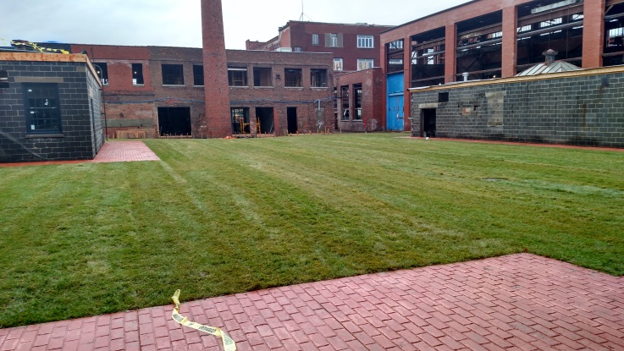
Case Study – 2017 Project, Buffalo, NY
Courtyard – December 2017

Slide 13
Case Study – 2017 Project, Buffalo, NY
Parking Lot – July 2017

Slide 14
Case Study – 2017 Project, Buffalo, NY
Parking Lot area
Plan was simple - excavate to 3 to 4 feet
Identified hazardous levels of Lead – May 2017
Submittal of additional Work Plan for delineation of Lead
Submittal of Work Plan for Lead Stabilization
Work completed in September 2017
Excavation and confirmatory sample results confirmed no testing results above Restricted Residential numbers – End of September 2017

Slide 15
Case Study – 2017 Project, Buffalo, NY
Parking Lot – December 5, 2017

Slide 16
Case Study – 2017 Project, Buffalo, NY
Interior Investigation required to be done
Due to ACM issues, No access to inside the building until July 2017
Found areas of impact – Removed as discovered
PCBs on Concrete – resulting removal of areas of the concrete floor
Final interior removal in October 2017

Slide 17
Case Study – 2017 Project, Buffalo, NY
Last sample collected October 20, 2017
Draft RI/IRM/AAR report issued October 24, 2017
Final Engineering Report Issued December 14, 2017
No Further Action Remedy was accepted and Decision Document Issued December 20, 2017
Site Management Plan accepted December 20, 2017
Certificate of Completion received December 27, 2017

Slide 18
Case Study – 2017 Project, Buffalo, NY
Success at Site due to:
IRM was the final remedy and no further action needed.
Coordination of work with NYSDEC – Worked with us every step of the way and kept us aware of impending deadlines
Motivated Client – Would not postpone COC
Cooperation with owner, contractors, and NYSDEC

