Slide 1
EHS Facility Best Practices
Colin Casey
Vice President
Great Lakes Environmental &
Safety Consultants, Inc.
January 24th, 2018

Slide 2
For over 24 years…
We deliver comprehensive, custom-tailored environmental health &safety solutions
SAFETY SERVICES
Safety Program/Procedure Development
Industrial Hygiene (Noise/Air Monitoring)
Facility/Site Safety Audits
Accident Investigation
Safety Training
OSHA Support

Slide 3
For over 24 years…
We deliver comprehensive, custom-tailored environmental health &safety solutions
ENVIRONMENTAL SERVICES
Air / Water / Soil Sampling
Radiological Contamination
Hazardous Waste Management
Petroleum/Chemical Bulk Storage
Air Emissions Compliance
DEC/EPA Support

Slide 4
OUR CLIENTS INCLUDE
NIAGARA FRONTIER
TRANSPORTATION AUTHORITY
BUFFALO SEWER
AUTHORITY
GENERAL CONTRACTORS & BUILDING TRADES
HEAVY HIGHWAY
CONTRACTORS
30+ WNY
MANUFACURERS
MUNICIPALITIES &
EDUCATIONAL INSTITUTIONS

Slide 5
EHS Facility Best Practices
General Industry Silica Compliance
Process Safety Management (1910.119)
Water Withdrawal Permits
Tier II / TRI Reporting
Chemical / Petroleum Bulk Storage
Stormwater Compliance
Hazardous Waste Management

Slide 6
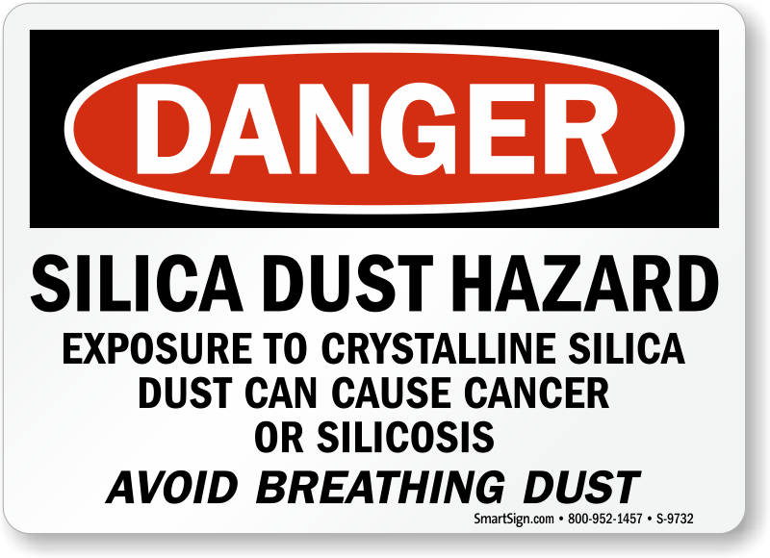
Respirable Crystalline Silica (1910.1053)

Slide 7
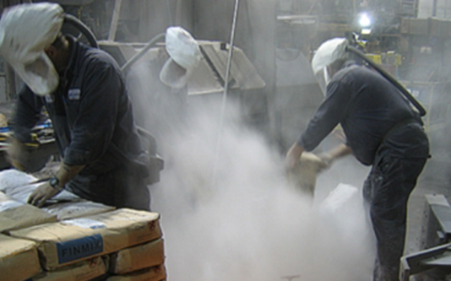
Respirable Crystalline Silica (1910.1053)
Who may be exposed?
Ready Mix Concrete
Abrasive blasting of concrete
Grinding of silica-containing products
What has changed?
PEL of 50 μg/m3 over an 8-hr TWA
(one fifth of old standard)
Written silica exposure control plan
Respiratory protection / medical surveillance
Competent person & required training

Slide 8
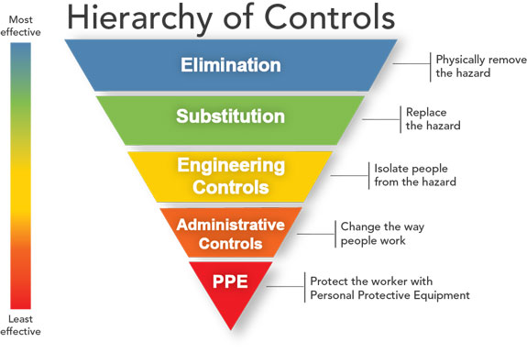
Respirable Crystalline Silica (1910.1053)

