Slide 1
Company Overview & Background

Slide 2
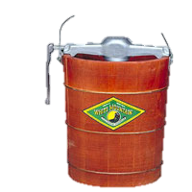
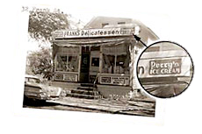
Our History of Growth and Investment
H. Morton Perry buys the Akron Milk route for $1,000
Begin selling round pints using the Perry’s logo
Entry into Partner Branded Distribution (Nestle)
$8.7MM capital investments
1st International sales
Move to current facility, Tripling Capacity
Expand production to include Silos, Amerio, M-8
4th generation takes over day-to-day operations
1918
1950
1982
1987
1997
2000
2011
1932
1971
1984
1993
2001
2014
Intro tamper membrane on round ½’s (Tetra-Hoyer)
Diversify growth portfolio
Begin manufacture for the Grocery channel
QCDSM business systems introduced
Purchase Property for expansion
(One Ice Cream Plaza)
Begin manufacture Columbo Frozen Yogurt
Begin selling Ice Cream to the Akron School District
Advance Sustainable Practices
Notes:
Show all at once

Slide 3
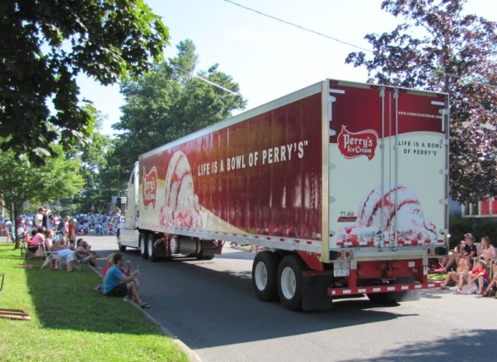
Our Heritage Guides the Way
In business since 1918;
4th generation family owned & operated
#1 Ice Cream brand in Upstate New York
Team-based culture: 25+ Active Safety & business teams
350+ team members w/average seniority of 10.4 years
Notes:
Marsha

Slide 4
Perry’s Ice Cream
Perry’s is headquartered 25 miles East of Buffalo, in Akron, NY
13+ million gallons produced annually
Operate a frozen Direct Store Delivery system in NY, Western PA & Ohio
Akron, NY
Rochester
Buffalo
Syracuse
Albany

Slide 5
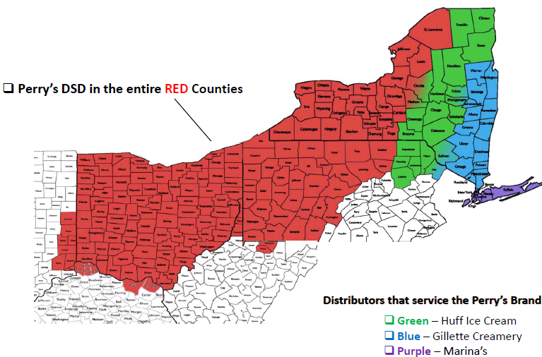
Perry’s Distribution/ Service Area 2017

Slide 6
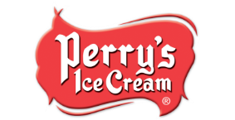
Upstate B/R/S Family Size Category, All Products
$62M Category, -1.9% Growth, 52 Wks. PE 12/2/17
Brand | $ Share
Perry’s | 32.5
Private Label | 24.8
Turkey Hill | 11.8
Friendly’s | 11.7
Breyers | 8.9
Edy’s | 6.1
All Others | 4.2
Source: AC Nielsen, Buffalo/Rochester/Syracuse, Grocery, FDM

Slide 7
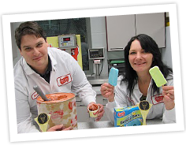
Our Capabilities – Products
Ice Cream 10 -18% butterfat
Premium/Super Premium/Value
Churned/Light (<10% Fat)
Low Fat Ice Cream(<50% of Full Fat)
No Sugar Added
All Natural
Lactose Free
Sherbet/Sorbet/Gelato
Frozen Yogurt (also Greek) with active cultures
Notes:
What type of sqrounds can we run?

Slide 8
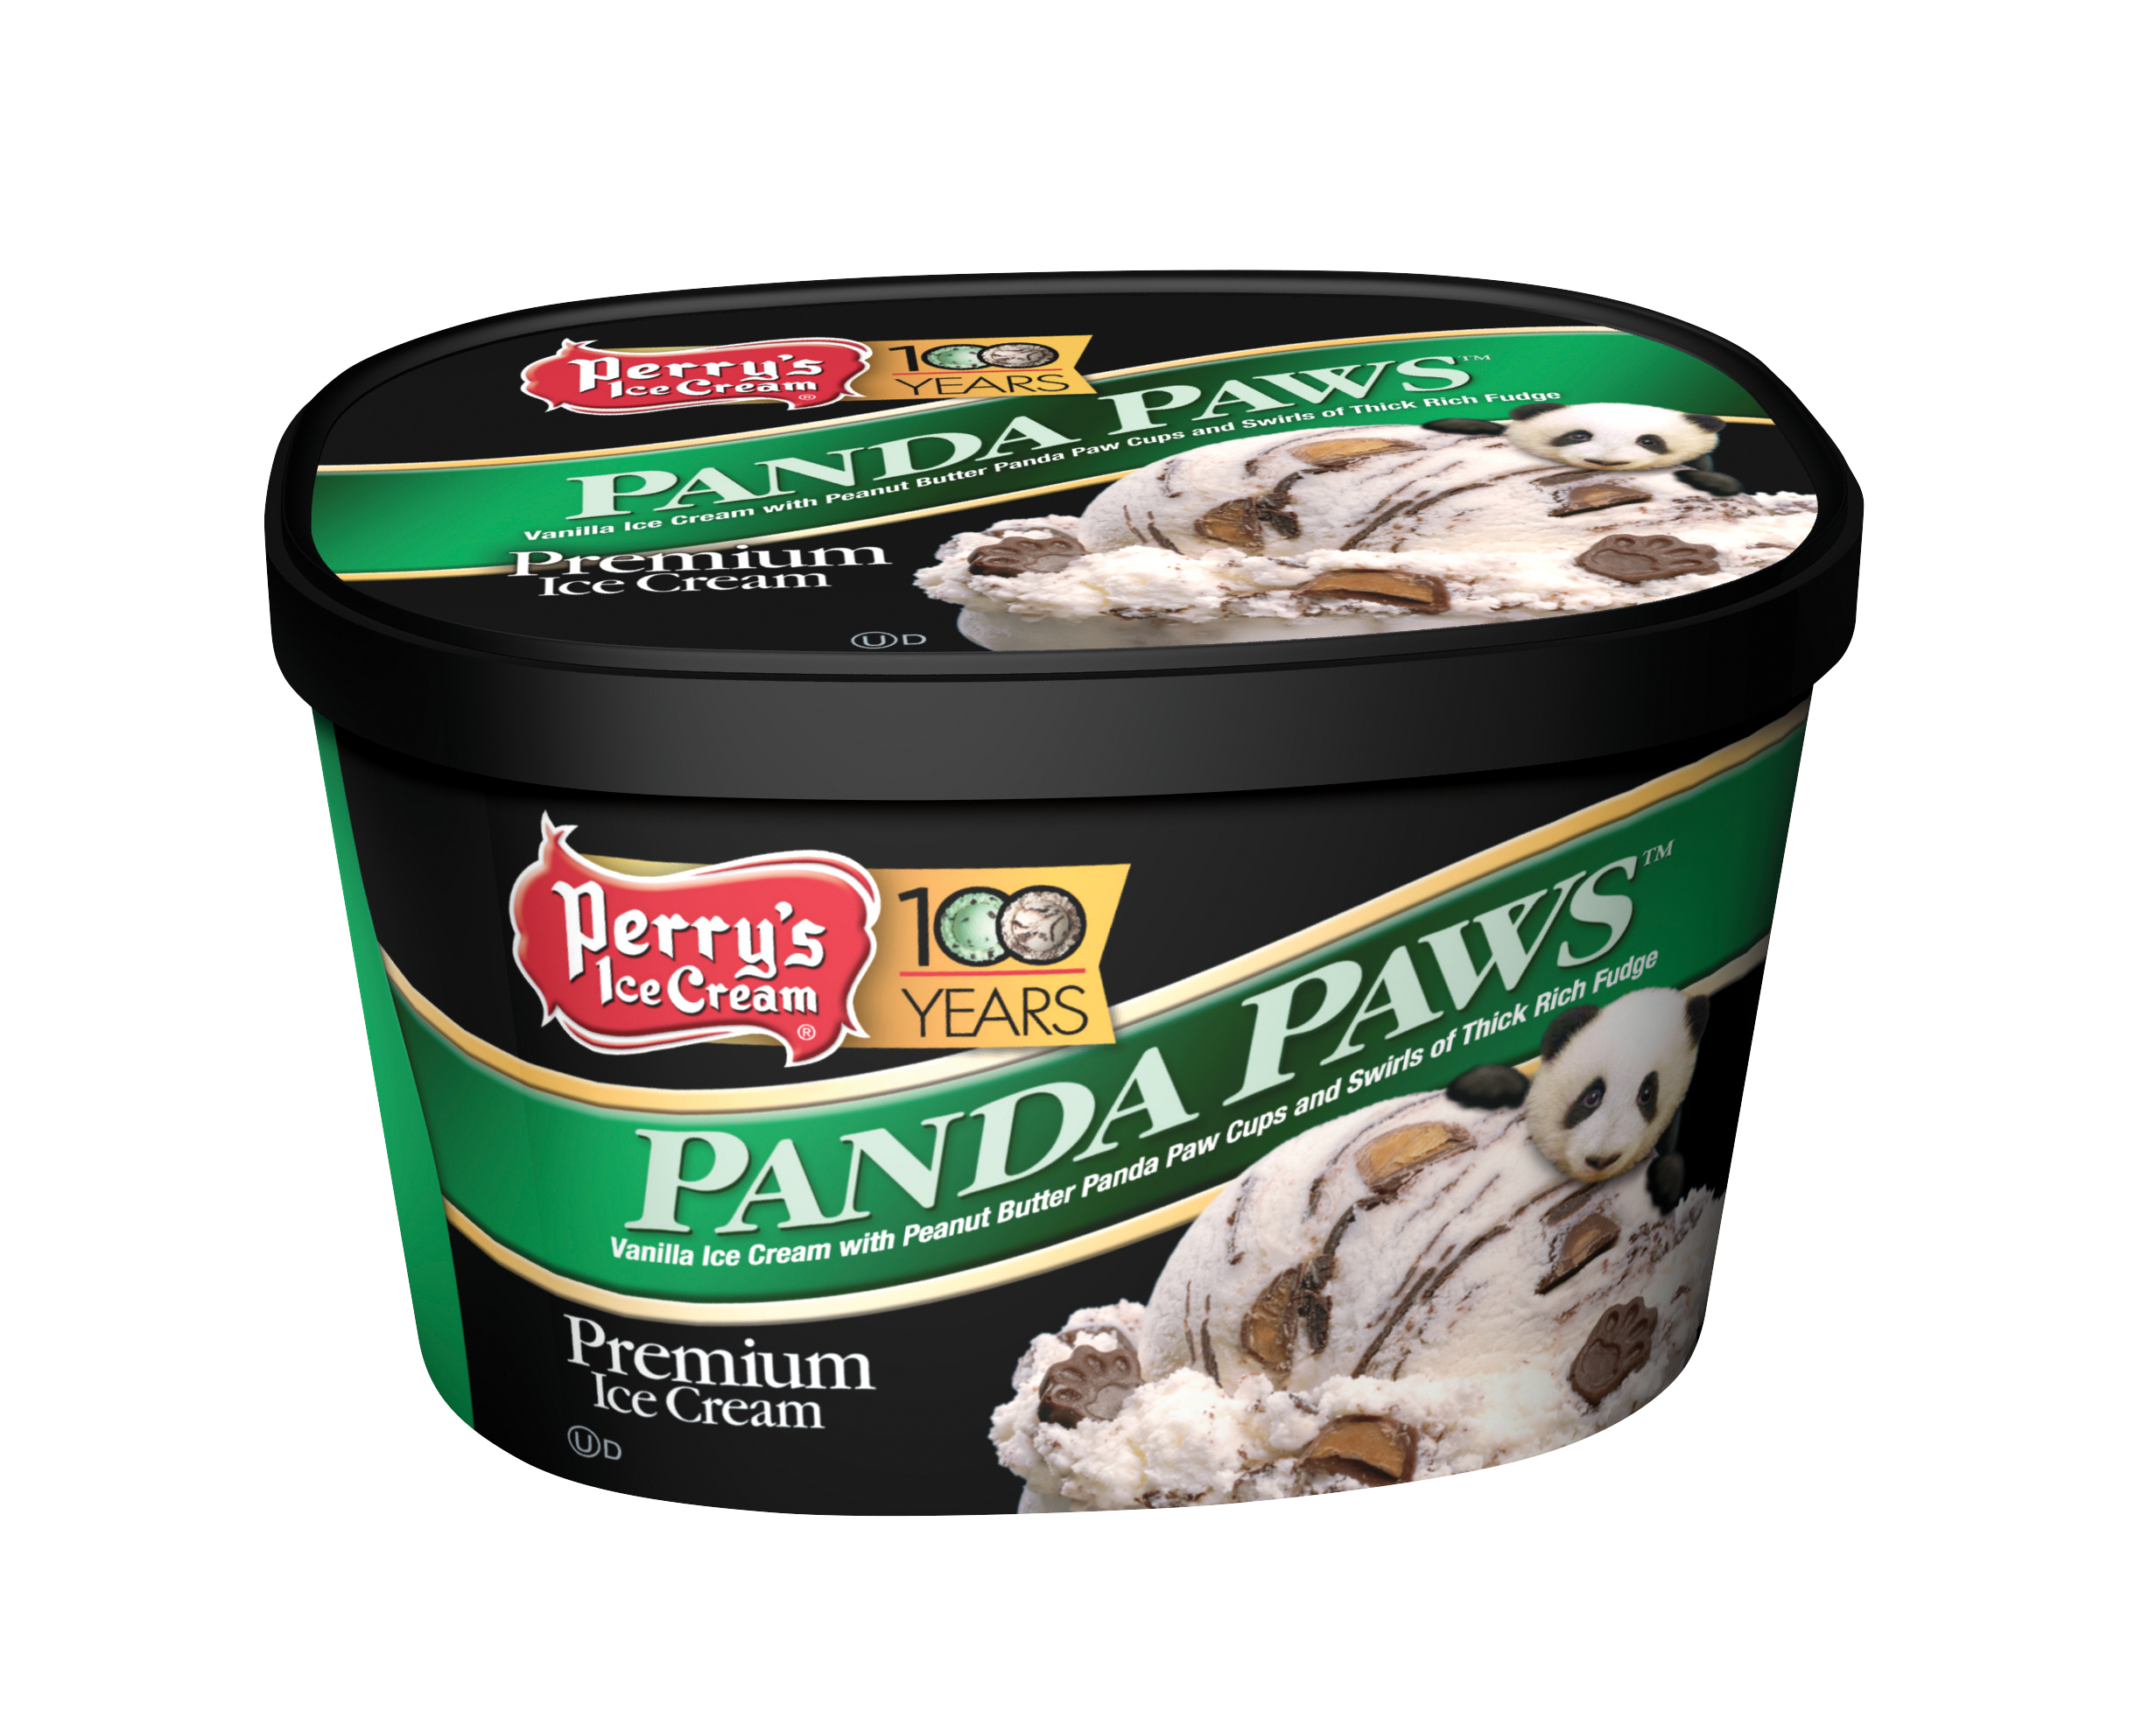
Our Capabilities – Packaging Sizes
48 oz. Sqrounds
Round half gallons & quarts
Bulk tubs, various sizes
Pints
Rectangle Ice Cream sandwiches
Stick items – various forms and sizes (3 oz and less)
Notes:
What type of sqrounds can we run?

Slide 9
Personal Background
5 years US Navy- Auxiliary Systems Technician FFG-7 Class Ships
31+ years career at Perry’s Ice Cream
22 years as the Maintenance Engineering Manager
Ammonia Task Force Chairman
Local RETA Chapter- Secretary, First VP and recently elected President
Certified Industrial Refrigeration Operator
NYS Hazardous Material Technician

Slide 10
Associations

Slide 11
Facility
120,000 square foot production facility
Waste water pretreatment plant
Truck maintenance facility
40,000 square foot warehouse
Two stage, 1,900 ton ammonia refrigeration system, charged with approximately 53,000 lbs.

Slide 12
Maintenance Engineering
16 Union Maintenance Technicians cover the Plant 24hr/7 days
Three Automation Engineers
Maintenance Supervisor
Maintenance Planner/Scheduler
PSM/RMP Coordinator
Maintenance Support- Parts Clerk, General Labor & Housekeeping

Slide 13
Regulatory Programs EPA & NYS DEC
Risk Management Plan- Ammonia System
Chemical Bulk Storage Plan
SARA Title III Chemical Reporting
SPDES Permit- Non-Contact Cooling Water
Storm water
Water With drawl Permit/Plan

Slide 14
OSHA Programs
Process Safety Management- Ammonia System
Confined Space
Respirator Program
Emergency Action & Fire Protection Plan
Powered Industrial Vehicles
Fall Protection
Electrical Safety
Blood Borne Pathogens

Slide 15
Questions?

