Slide 1
Long-term Measurement of Ultrafine Particles in the Urban and Rural Environment
Dirk Felton, P.E. Research Scientist III
Seminar: AWMA Niagara Frontier Section
January 25, 2017
Division of Air Resources
Bureau of Air Quality Surveillance

Slide 2
What are Ultrafine Particles?
Solid or liquid droplets in a specific size range
Primary
Natural Sources: sea spray, volcanos, wildfires
Anthropogenic Sources:
Outdoor: combustion emissions Indoor: manufactured products including printer toner, carbon nanotubes and medical and skin care products
Secondary
Nucleation and Gas to Particle reactions
Notes:
Nucleation – Particles form because environmental conditions favor particles over gasses
Combustion emissions - emitted gasses cool leading to particle formation
Gas to Particle reactions Sulfate and photochemistry (SOA)

Slide 3
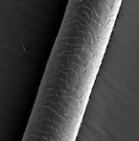
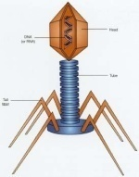
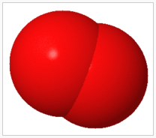
Red Blood cell
DNA
Oxygen
Hair
Bacteria
Virus
1
Meter
1 Million
Microns
100
Nanometer
0.1
Microns
10
Nanometer
0.01
Microns
1
Nanometer
0.001
Microns
0.1
Nanometer
0.0001
Microns
10,000
Microns
1,000
Microns
100
Microns
10
Microns
1
Microns
100,000
Microns
Rain Drops
Mist/Fog
Tobacco Smoke
Visible Particles
Invisible Particles Scatter Light
Ultrafine particles
Molecules
UFP Size:
How small are we talking about?
A Micron is a Million^{th} of a Meter
A Nanometer is a Billion^{th} of a Meter
Wavelength of Visible Light: 390 – 700 nm
Notes:
Each black line as you move to the right divides the size by 10
UFP are defined by size – 1-100 nm 2 orders of magnitude
Particles in a size that can stay suspended cover about 6 orders of magnitude
UFP size range is roughly between the wavelength of light and the size of molecules
Oxygen molecule 0.5 nanometers

Slide 4
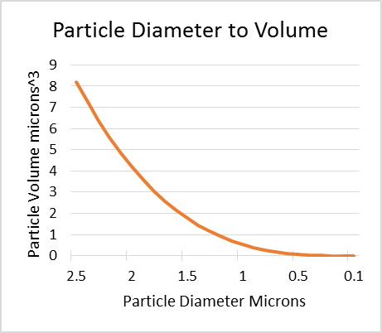
Red Blood cell
DNA
Oxygen
Hair
Bacteria
Virus
1
Meter
1 Million
Microns
100
Nanometer
0.1
Microns
10
Nanometer
0.01
Microns
1
Nanometer
0.001
Microns
0.1
Nanometer
0.0001
Microns
10,000
Microns
1,000
Microns
100
Microns
10
Microns
1
Microns
100,000
Microns
Particles measured by
Weight in a volume of air (µg/m³)
Particles measured by Number in a volume of air (#/cm³)
A 100 nm particle has 0.0064% of the volume of a PM-2.5 particle
Notes:
Particles larger than 100 nm are large enough to have enough mass to be measured by determining the weight of particles collected on a filter.
We can’t weigh ultrafine particles because of geometry
PM-2.5 particles have a volume of about 8 cubic microns –
100 nm particles have a volume nearly indistinguishable from zero
Volume = 4/3 Pi R^3

Slide 5
Red Blood cell
DNA
Oxygen
Hair
Bacteria
Virus
1
Meter
1 Million
Microns
100
Nanometer
0.1
Microns
10
Nanometer
0.01
Microns
1
Nanometer
0.001
Microns
0.1
Nanometer
0.0001
Microns
10,000
Microns
1,000
Microns
100
Microns
10
Microns
1
Microns
100,000
Microns
45 Years:
Evolution of PM NAAQS
1971 – Total suspended particles
1987 – PM10 daily 150, Annual 50 μg/m³
1997 – PM2.5 daily standard 65 μg/m³
2006 – PM2.5 daily standard 35 μg/m³
2012 – PM2.5 annual standard lowered from 15 to 12 μg/m³
20?? – PM NAAQS (currently under review)
Total Suspended Particulates
PM10
Ultrafine particles
PM2.5
Ambient Ultrafine Particles are not regulated in the US
Notes:
What about regulation?
45 years of ambient air quality standards and monitoring methods have been based on particle mass
NAAQS are Based on impacts to health and include 4 criteria: Indicator, Avg Time, Level, Form
To regulate UFP, the indicator and monitoring methods will have to change
In the EU, UFP emissions standards are being developed.

Slide 6
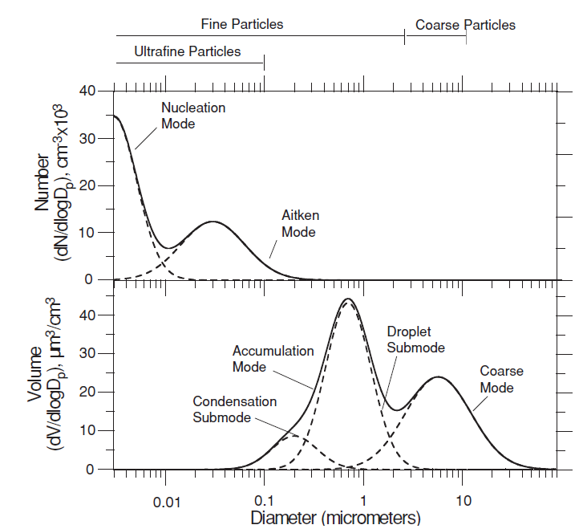
Size Distribution of Ambient Particles
Nucleation:
secs-minutes
Aitken:
hours-days
Accumulation:
days-weeks
Coarse:
hours-days
Notes:
Particles in the environment are typically found in one of these size categories - occur as a result of a formation process or because they are a size that is relatively stable
Formation (short lived): Nucleation and Coarse mode
Stable: Aitken and accumulation mode
Nucleation – evaporation, diffusion
Aitken – diffusion, coagulation
Accumulation – in between diffusion and gravitational settling (long range transport)
Coarse – deposition settling

Slide 7
What Processes are Involved?
Increase UFP (Due to primary combustion emissions)
Direct emission of carbon or metallic particles
Emitted Gases convert to Particles
Nucleation and Condensation
Decrease UFP (creates gradient away from source)
Volatilization, Diffusion, Dispersion
Coagulation and Condensation
These processes are effected by environmental conditions: (temp, sunlight, humidity, wind speed)
Notes:
Gas to Particle reaction includes photochemistry
The processes that decrease UFP occur more slowly when it is cold and less humid
Condensation can move particles into the UFP range or more likely out of the UFP range

Slide 8
Health Implications
UFP can easily be inhaled and pass into the lungs
The small size of UFP allows for interstitial passage from nasal and lung tissue into the bloodstream where normal particle removal processes are ineffective
Biological responses from oxidative stress such as inflammation and increased blood pressure are evident even when the particles are low in toxicity and are strongest with smaller particles¹
Composition of UFP including presence of transition metals may increase toxicity² Biological responses may be due to particle size, number, composition, surface area or charge
¹Pieters, Environmental Health Perspectives, March 2015.
²Romieu, European Respiratory Journal, January 2008.
Notes:
We do know that there are biological responses to UFP.
Uncertainty over what causes biological response, size and number, composition, charge, surface area

Slide 9
Review for 2012 PM NAAQS
The 2009 Integrated Science Assessment (ISA) found that the linkage between UFP and cardiovascular and respiratory short-term health effects was Suggestive not Causal
CONSISTENCY of the observed association
STRENGTH of the observed association
SPECIFICITY of the observed association
TEMPORALITY of the observed association
GRADIENT clear exposure-response relationship
PLAUSIBILITY credible association
EXPERIMENTAL results that support the relationship
COHERENCE evidence from various fields
Notes:
The EPA requires some level of certainty before they set a NAAQS for a pollutant
These Factors describe the relationship between the pollutant and the health effect
The EPA began a review of the PM NAAQS in 2015 and should complete the process in 2018.

Slide 10
NYSDEC Ambient UFP Monitoring
Urban Neighborhood: Queens College
Seasonality, diurnal pattern, urban background
Rural: Pinnacle State Park Steuben County
Seasonality, long range transport (Whiteface?)
Near Road: Buffalo on I-90 Between Exit 51 and 52
Rochester on I-490 at Exit 20
Queens on LIE 495 at Exit 23 (Summer 2017)
Mobile source impact, diurnal pattern, seasonality
Peace Bridge Special Study: (concluded Sept, 2015)
Busti Avenue close to PB Plaza
PS 198 Neighborhood background (Summer)
Notes:
Where do we Monitor UFP?
Whiteface started in June

Slide 11
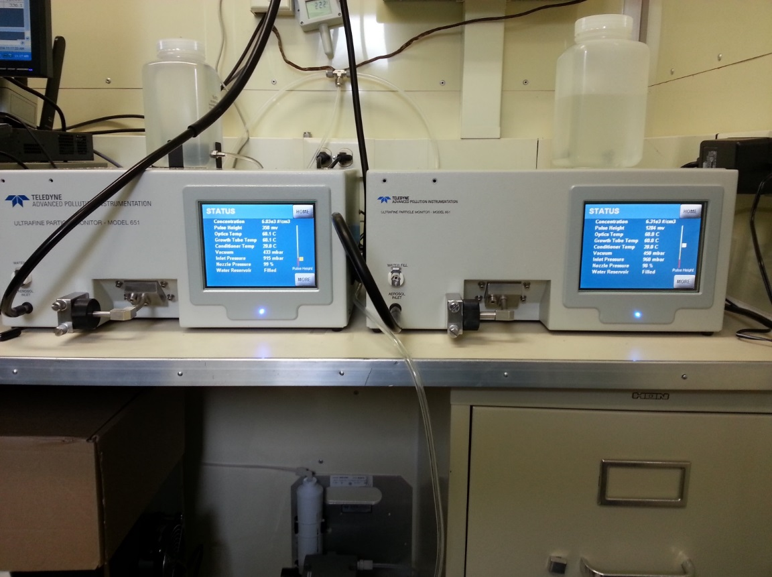
Instrumentation: Ultrafine Particle Number
API Model 651 TSI Model 3783
Water CPC
Lower size cut 7nm
(0.007 microns)
1 Micron Cyclone Inlet
2nd Unit was on Loan from the Manufacturer
First instrument designed for continuous ambient air quality monitoring
Data units are # of particles/cm³ (minute or hour)
Notes:
First released in 2011
Went through revisions – updated version was released in 2013
Before this instrument was developed researchers didn’t collect long-term datasets

Slide 12
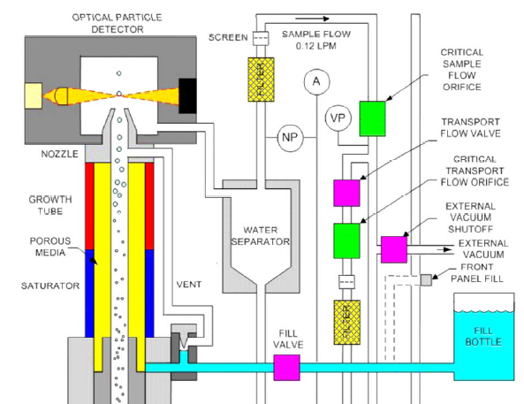
Condensation Particle Counter
CPC
Notes:
UFP enter from the bottom and grow in size due to condensation
UFP are much smaller than the wavelength of light so condensation is used to grow the particles into a larger size so they can be counted by pulsing a laser

Slide 13
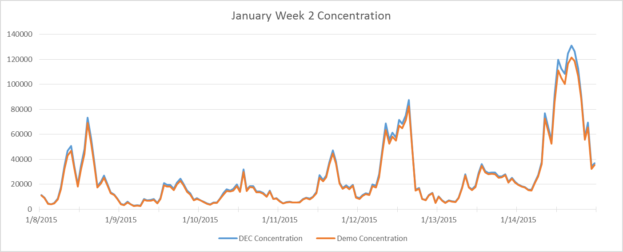
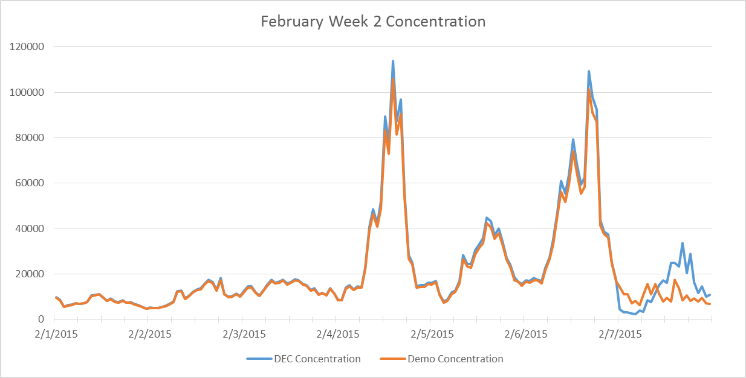
UFP Data: Precision
The two instruments demonstrate excellent precision
At very high particle concentrations one instrument is slightly higher
One of the inlets appears to have frozen for a day in February

Slide 14
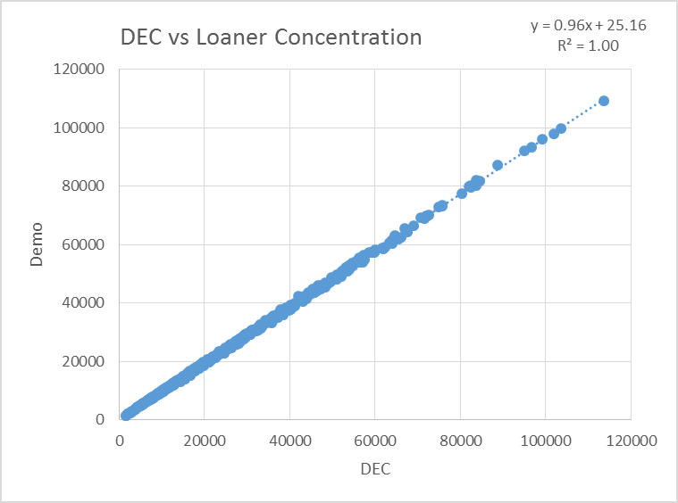
UFP Data: Precision 1-Hr Averages
The precision of the UFP instrument is better than any of our gas analyzers
We are confident in our ability to measure UFP accurately

Slide 15
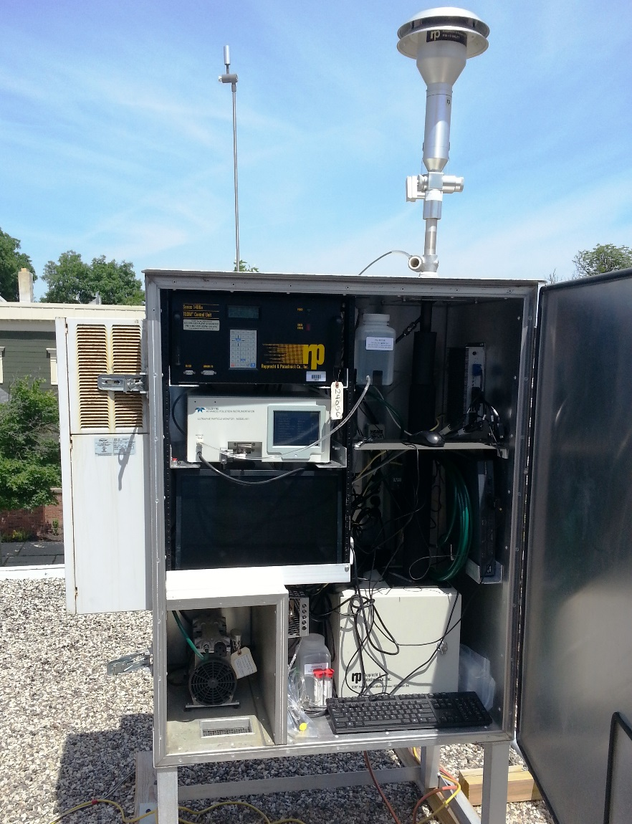
UFP Instrument Siting
UFP Monitors require shelters with full HVAC (20-25 Deg C)
UFP Cyclone Inlet
The UFP instruments are installed with the same inlet configuration at each site
Notes:
The water CPC is robust and can be operated in remote field locations where an environmental shelter is available.

Slide 16
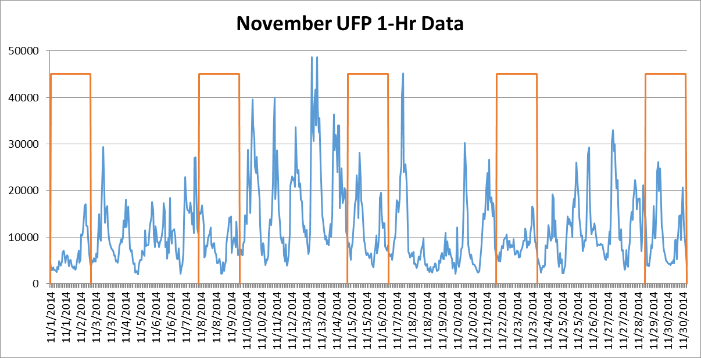
UFP Data: 1-Hr Averages (particles/cm³)
At this urban location emissions are consistent: UFP are typically higher on the weekdays and data show a strong daily pattern
(weekends in orange)
Notes:
Month of Peace Bridge Data –
The UFP varies every day – low at night, high during the day but peaks vary
Sources are consistent day to day
The concentration of UFP at this location varies mostly due to environmental conditions
Consistent with a pollutant that has a high source oriented component than transport component

Slide 17
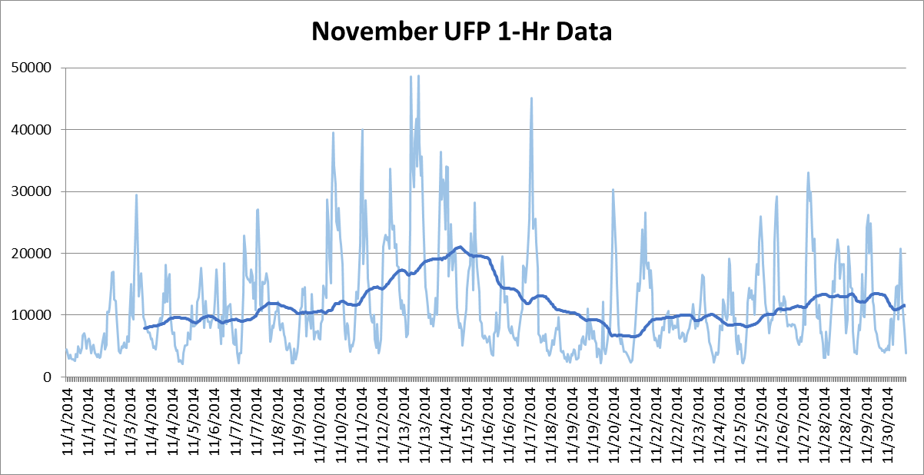
UFP Data: 1-Hr Averages
If you smooth the data you can see an underlying multi-day pattern due to meteorology (WD, WS, Temp, RH)
Notes:
The data show evidence of daily sources combined with multiday patterns
During the Fall and Spring we often have multi day inversions that can lead to build up of locally generated pollutants
Weather can decrease UFP rain and high winds
increase UFP – cold, low humidity and low wind speeds

Slide 18
How does UFP Respond to Environmental Changes?
Notes:
We are confident that we can measure UFP
How can we characterize the impact the environment has on UFP?

Slide 19
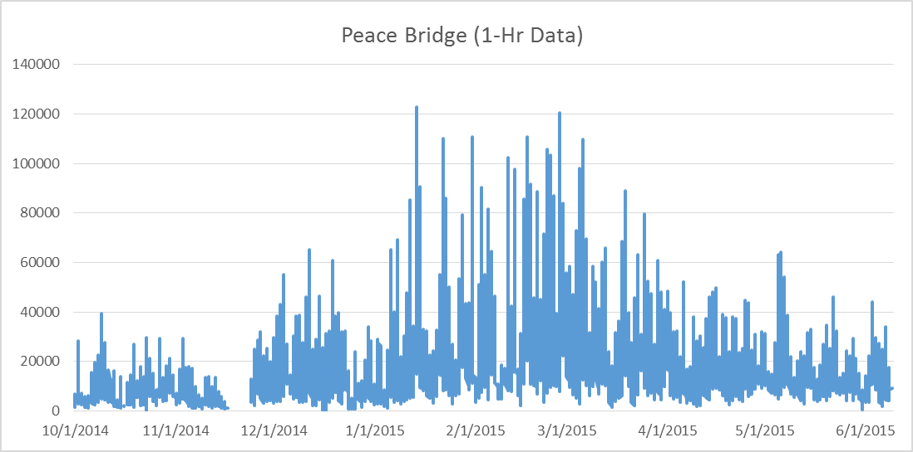
Peace Bridge UFP: Seasonal Time Series
Data are presented with Winter in the Center of the plot
UFP is more stable in cold temps
< Evaporation
< Humidity
< Particle Growth
also Low B Layer
Sources are similar year round but UFP is twice as high in the winter
Notes:
The time of year at least here in Buffalo can cause a 2 to 3 fold increase in UFP
The published studies of UFP don’t show this and I realized that the early research on UFP was all done in Los Angeles

Slide 20
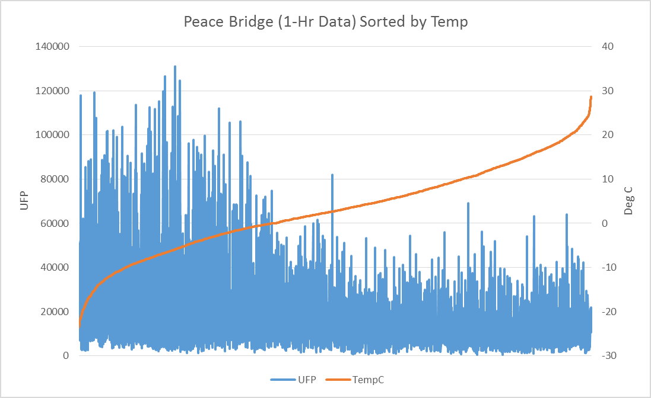
Peace Bridge UFP: Sorted by Temp (Deg C)
At colder temps, the UFP range is higher but the low values are similar year round
Local mobile source emissions are consistent year-round

Slide 21
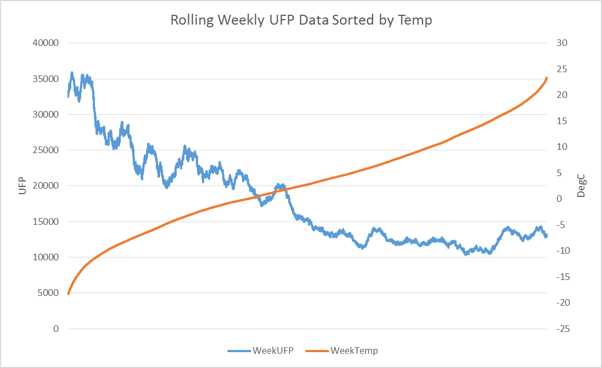
Rolling Weekly Ave. UFP and Temp (Deg C)
At colder temps, the average UFP is 2 to 3 times higher than the average during hot weather

Slide 22
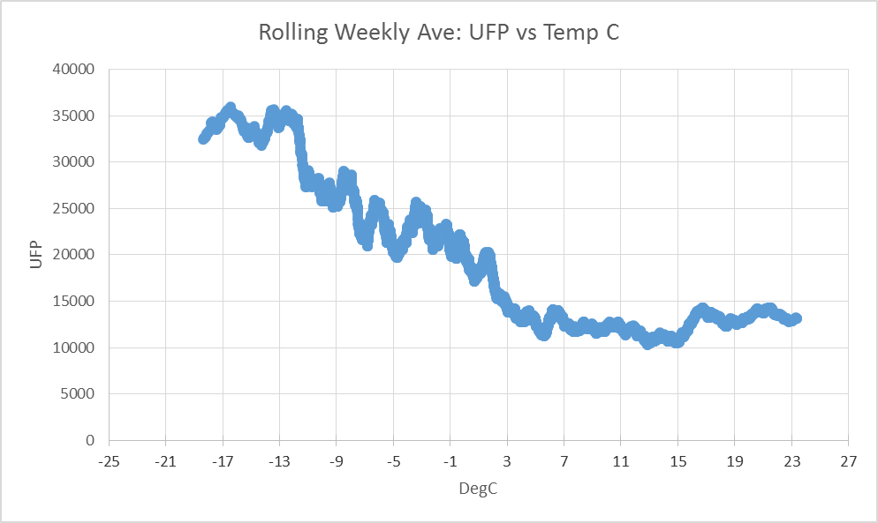
Rolling Weekly Ave. UFP vs Temp (Deg C)
XY Plot
(UFP vs Temp ºC) shows the relationship between UFP and temp at this location

Slide 23
How does the Temperature Dependence of UFP in Buffalo Compare to other Locations?

Slide 24
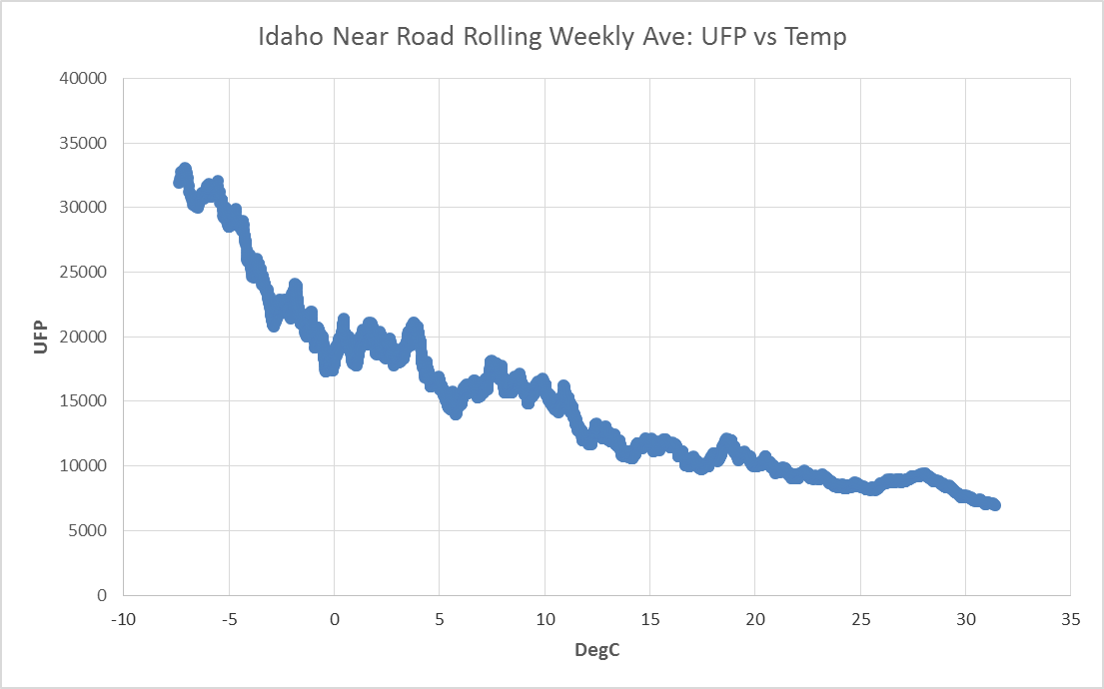
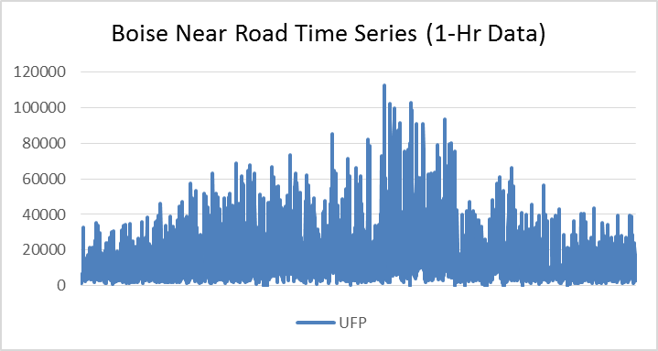
Rolling Weekly Ave. UFP vs Temp (Deg C)
Boise, Idaho
Near Road 2012 Data Winter in Center of time series plot
Boise Near Road AADT: 103,000
Notes:
Boise, Idaho the dependence and the actual concentrations are very similar to Buffalo
Boise was one of the first cities to have a near road monitor

Slide 25
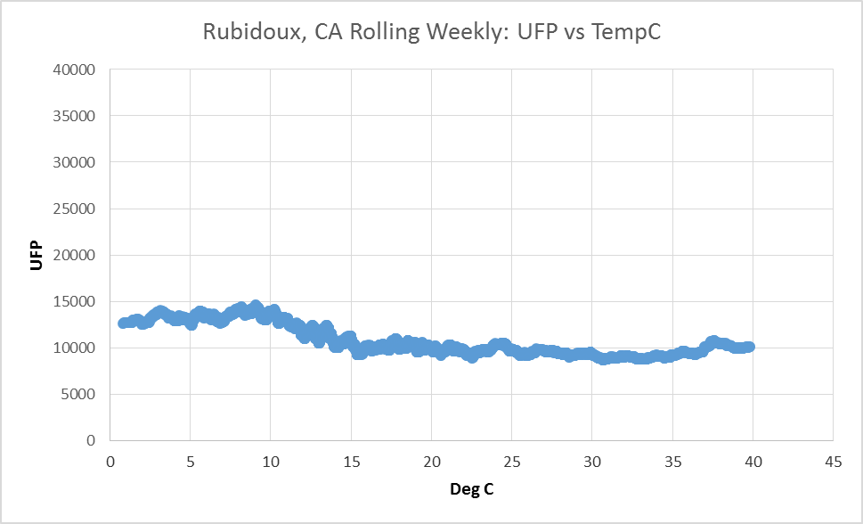
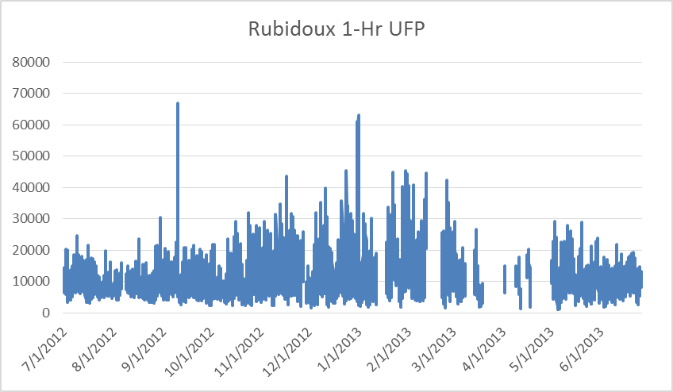
Rolling Weekly Ave. UFP vs Temp (Deg C)
Rubidoux, CA
2012/13 Data
Winter in Center of time series plot
UFP increases by about 28% during cooler periods
But the concentrations are lower overall
Notes:
Central Valley east of Los Angeles

Slide 26
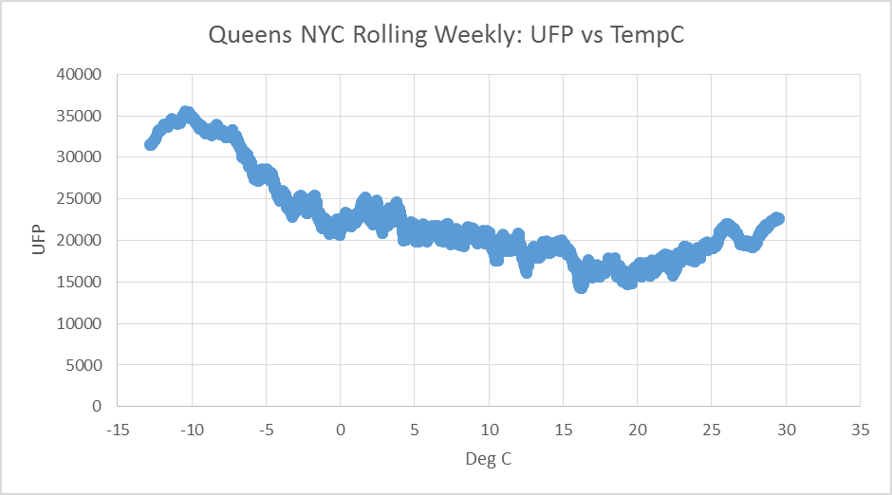
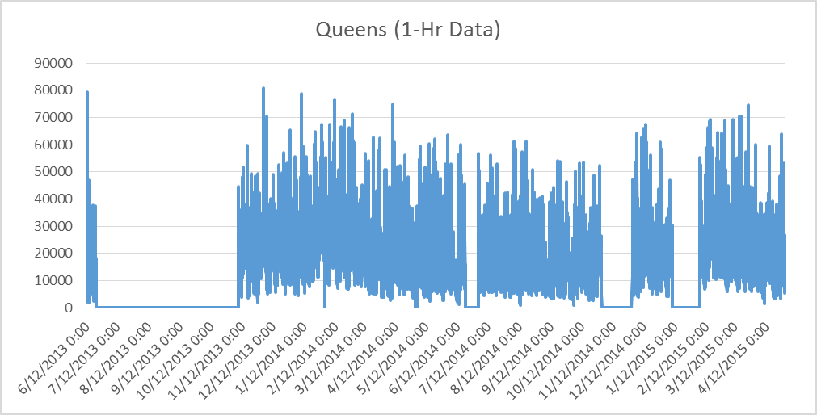
Rolling Weekly Ave. UFP vs Temp (Deg C)
Queens, NYC
2013 - 2015 Data Winter in Center of time series plot
UFP is higher at low temperatures
but UFP also increases at higher temps
Baseline is elevated in NYC
Notes:
Here we see that there is a another phenomenon going on that increases UFP as temperatures increase

Slide 27
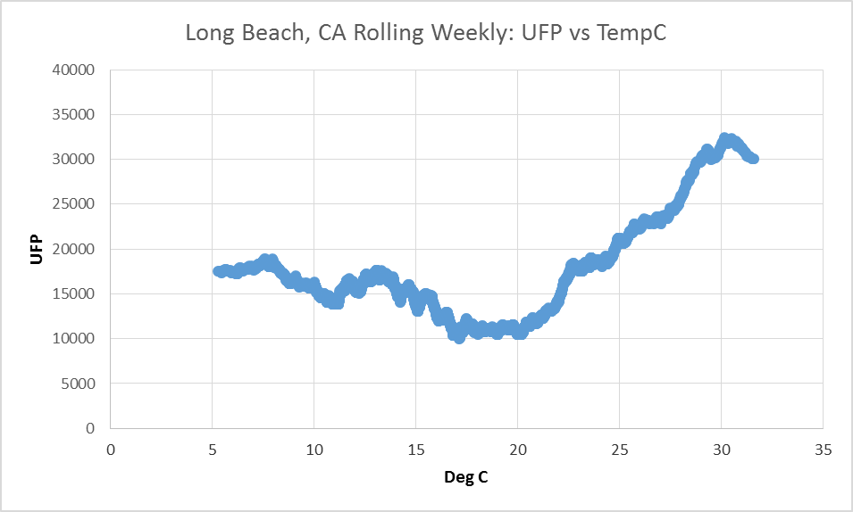
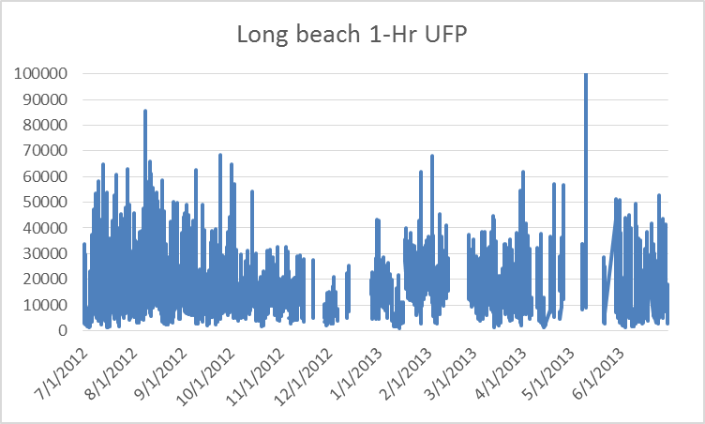
Rolling Weekly Ave. UFP vs Temp (Deg C)
Long Beach, CA
2012/13 Data
Winter in Center of time series plot
UFP increases by 20% - 40% at low temps
UFP is increased by a factor of 3 at high temps
Notes:
Long Beach is the 2nd busiest Port in the country and has a tremendous amount of truck traffic to move all that cargo

Slide 28
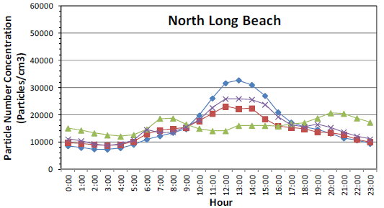
Seasonal Diurnal UFP: Long Beach, CA
MATES IV Study
Summer afternoon Peak is evidence of Local Secondary UFP production
Elevated UFP in the Summer occurs in the afternoon, not at commuting times
Local SOA > Local Primary Production → high VOC
Notes:
Multiple Air Toxics Exposure Study
South Coast Air Basin

Slide 29
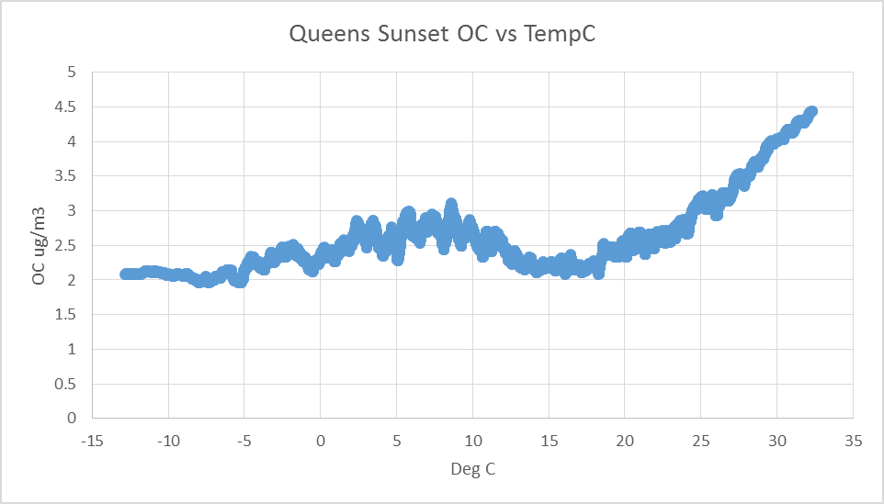
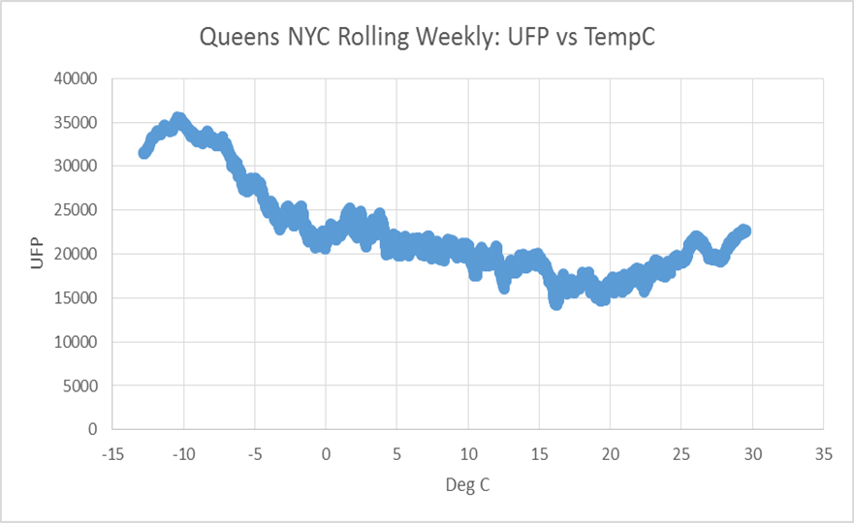
Secondary UFP Production: Queens
Sunset 1-Hr OC PM data are elevated as temps increase above 20-25º C
Elevated OC PM_{2.5} matches temp range when UFP increases
Notes:
We don’t have information on UFP species but we do have PM-2.5 species data.

Slide 30
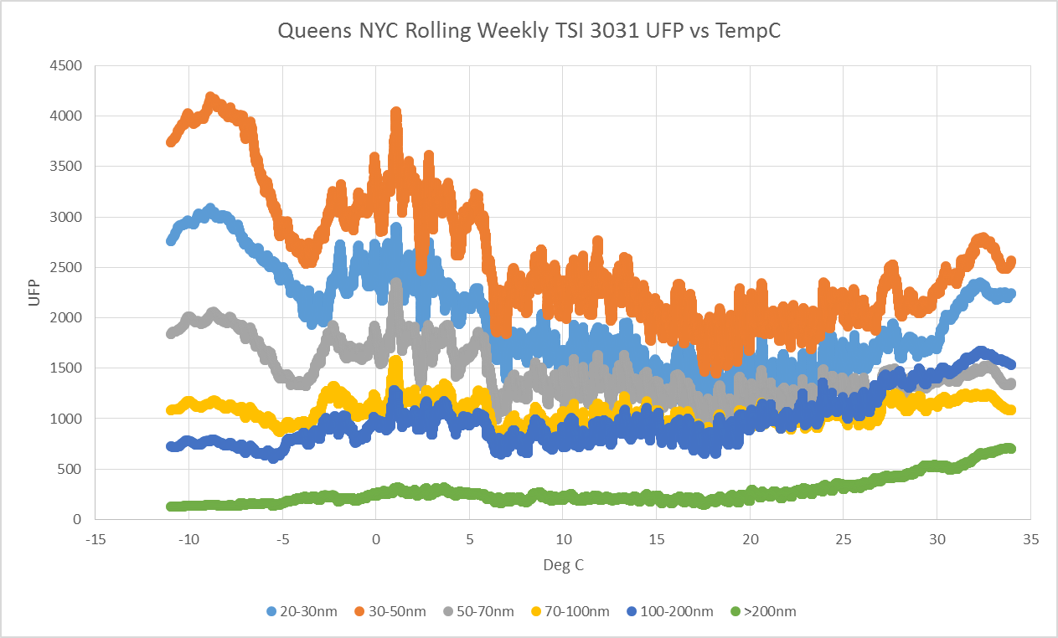
What size fractions increase at what temp?
This plot shows the UFP size fractions sorted by temp
Smaller incr more when it is colder than warmer
Larger incr more when it is warmer
Combined data 2009 – 2010 and 2013 - 2014
TSI 3031 Particle Detection Limit: 20 nm
Notes:
TSI 3031 separates UFP into 6 size categories by charging the particles and by using a Differential Mobility Analyzer to determine the number of particles in each size category.
This data is limited to particles larger than 20nm

Slide 31
UFP and Environmental Conditions
Cold: UFP are elevated when temperatures are cold because the removal processes (evaporation and agglomeration) are reduced
Hot: UFP can be elevated when temperatures are hot because production processes are increased but:
Requires precursors (pollutants) and sunlight
Must overcome increased removal processes
Moderate: UFP typically are lowest when temperatures are (15º ± 3º C)
Good for human exposure?

Slide 32
Urban, Rural and Near-road UFP Data in New York State

Slide 33
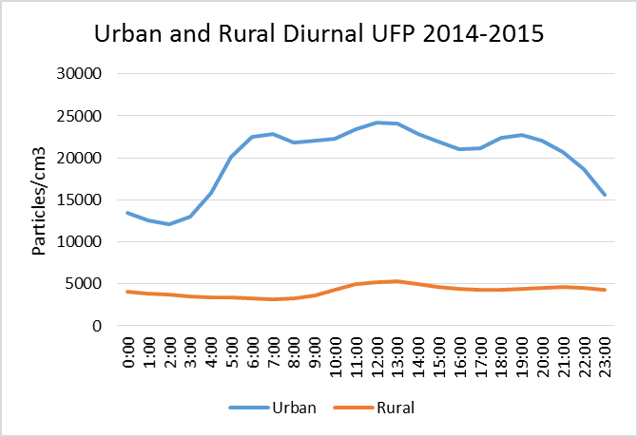
Urban UFP Data: Queens, NYC
Average UFP is 20,000/cm³ (5 times the rural site)
Primary UFP increases during morning and evening commuting hours
The mid-day peak indicates a photochemical process – likely Secondary Organics
Urban UFP only approached rural levels after a 4 day Nor’easter in October 2015
Notes:
Diurnal Plot
Urban site UFP higher than rural site average 99% of the time

Slide 34
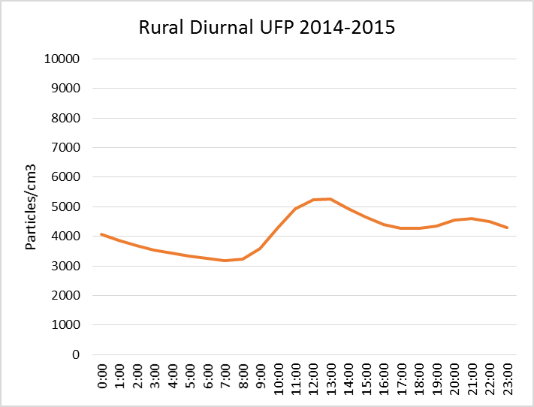
Rural UFP Data: Steuben County
Site is removed from sources
Average UFP is 4,100/cm³ 20% of urban UFP
There is no evidence of a morning rush hour
The Midday peak indicates a photochemical process – likely Secondary Organics
At night UFP briefly increases due to condensation and then decreases due to condensation as particles grow out of the UFP size range
Notes:
At rural sites we can see how UFP behaves when we are away from sources

Slide 35
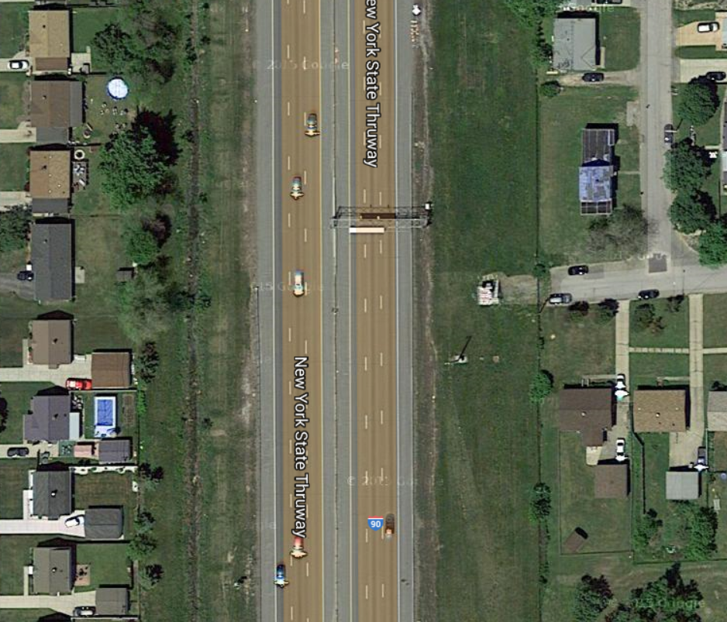
Near Road Site for the Buffalo/Niagara CBSA
New EPA regulations require NY to have
2 monitors in NYC
1 in Buffalo
1 in Rochester
The Buffalo site is 20 m from I-90 between Exit 51 and 52 (Cheektowaga)
AADT is 131,019
EPA recommends monitoring UFP and Black Carbon at these sites
Notes:
EPA is trying to get a better understanding of the near road gradient
Sites are located between 20m and 50m from travel lane
The houses in this picture are about 50-60m from the travel lane

Slide 36
Near Road Air Quality Monitoring
Millions of people in this country live near roadways
New Federal Air Quality Standards for NO₂, CO and PM_{2.5} require Near Road Monitoring in cities (MSAs) with populations over 1 Million
400m
500m from road
300m
200m
100m
Notes:
10 Million people live within 100m of a road with 25,000 AADT
60 Million people live within 500m of a road with 25,000 AADT
This is one of the reasons why it is important to understand the gradients of mobile source pollutants
The further mobile source pollutants travel away from the road, the greater the number of people who are exposed

Slide 37
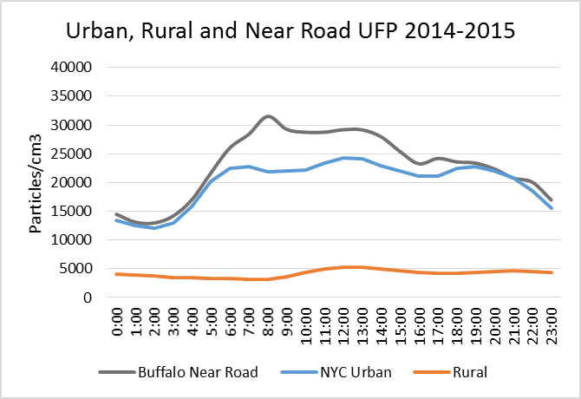
Near Road, Urban and Rural UFP Data
Buffalo Near Road UFP average concentrations are highest during the morning commute and higher than NYC urban average
UFP concentration is a better indicator of proximity to a source than it is to the size of the source
Notes:
Near Road data in comparison to urban neighborhood and rural data

Slide 38
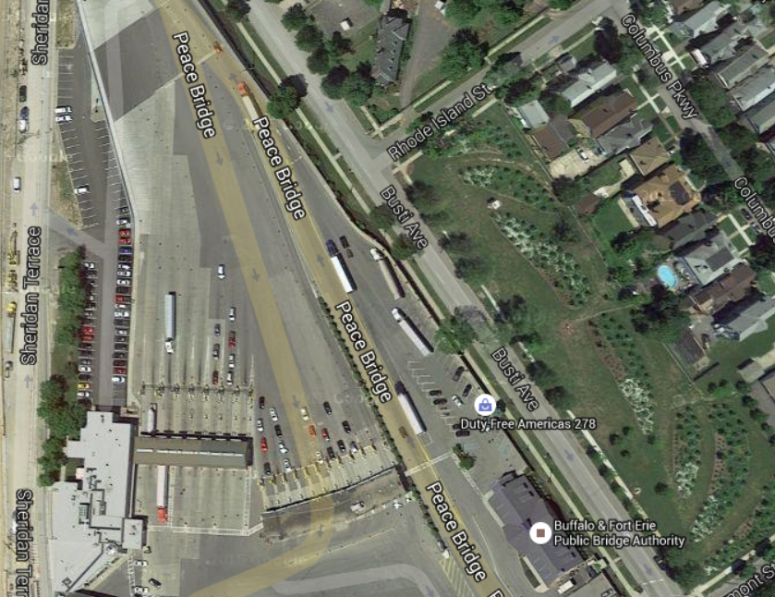
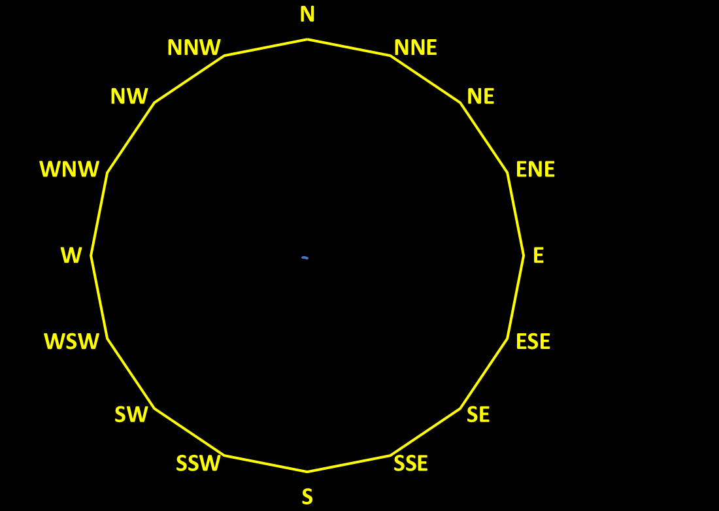
Busti Avenue Downwind, Max Impact Site
Peace Bridge (Mobile Source Study)
The shelter was located about 40 m from the Peace Bridge Plaza and more than 200 m from I-190
Customs Clearance Lanes
Customs Clearance Lanes
We monitored PM_{2.5}, UFP and Air Toxics for 1 year

Slide 39
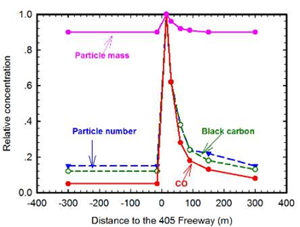
UFP and Theoretical Distance to Mobile Sources
Wind Direction
UFP is often used as an indicator (tracer) of mobile source emissions because it has a very steep gradient downwind from roads
UFP returns to background within a few hundred meters of edge of road
Zhu et al., JAMA 2002, Atm. Env., 2002
Karner, Environmental Science & Tech, 2010
Notes:
Early research - Los Angeles – Ground Zero for vehicle emissions research
The gradient is steep because the smallest particles generated by mobile source emissions are short-lived
The steepest part of the decay of UFP occurs between 20 and 60 m from the edge of the road

Slide 40
UFP and Actual Distance to Mobile Sources
Wind Direction
Buffalo Near-road site is 20 m from I-90
Peace Bridge site is 40 m from the customs clearance lanes
Zhu et al., JAMA 2002, Atm. Env., 2002
Karner, Environmental Science & Tech, 2010
Notes:
Early research - Los Angeles – Ground Zero for vehicle emissions research
The gradient is steep because the smallest particles generated by mobile source emissions are short-lived
The steepest part of the decay of UFP occurs between 20 and 60 m from the edge of the road

Slide 41
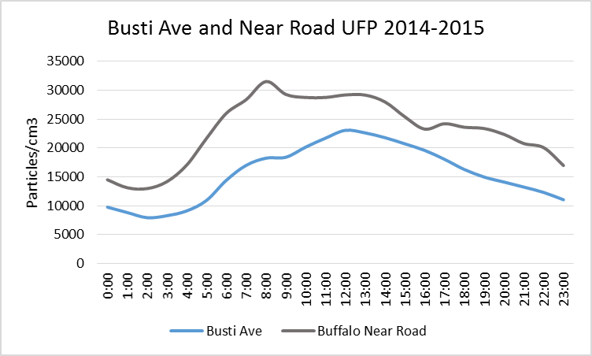
Peace Bridge UFP Data
The Near-road UFP are higher than the Peace Bridge max impact site
The Near road site is closer to the roadway and the AADT is higher than the traffic on the Peace Bridge and I-190
The shape of the peak is important. The Busti Ave peak is later – bridge delays and traffic increase through midday
Notes:
The near road site is 20 m from highway traffic
Busti Ave is 40 m from bridge traffic
The comparison between the two sites supports the strong gradient of UFP away from the roadway

Slide 42
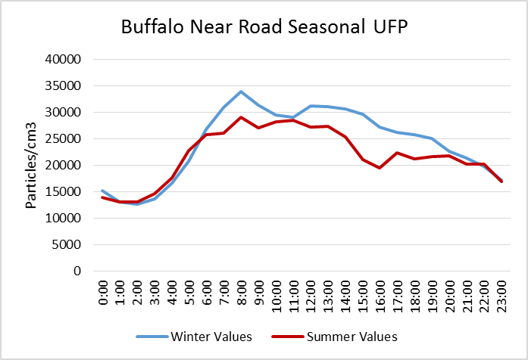
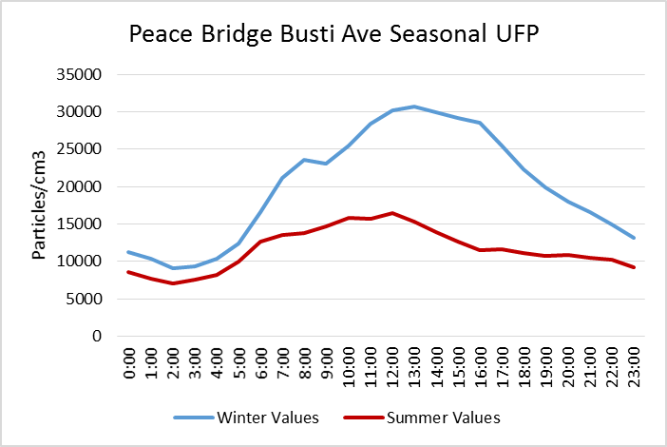
Seasonal UFP: Summer vs Winter
At the near road site 20m from the road the summer and winter UFP are similar
At the Busti Ave site 40m from the Peace Bridge the summer UFP are ½ of the winter
Notes:
20m vs 40m - Seasonal comparisons also support the strong gradient of UFP
1. The decay of UFP is not as evident in the winter
2. There is no decay within 20 m. – turbulent area
This may have an implication for exposure?

Slide 43
Can we Identify Sources of UFP with Ambient Data?

Slide 44
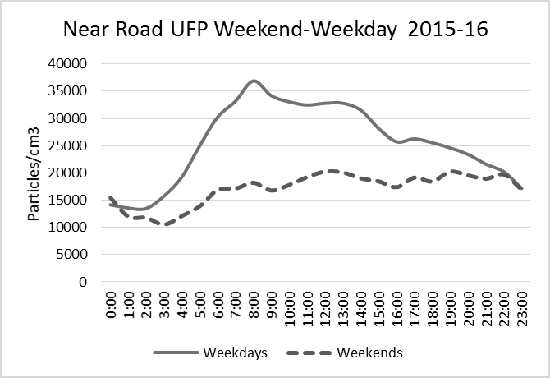
Buffalo Near Road UFP Data
Buffalo Near Road UFP Weekday-Weekend comparison show that motor vehicles are responsible for more than 50% of the UFP at this location
Notes:
The easiest analysis is weekday vs weekend

Slide 45
Peace Bridge UFP and Auto Traffic
At the Peace Bridge, auto traffic correlates with UFP on weekdays but, on weekends, auto traffic increases and UFP decreases
Auto traffic and UFP are not proportional
Notes:
What about cars vs trucks
UFP is higher on weekdays and lower on weekends – opposite of auto traffic

Slide 46
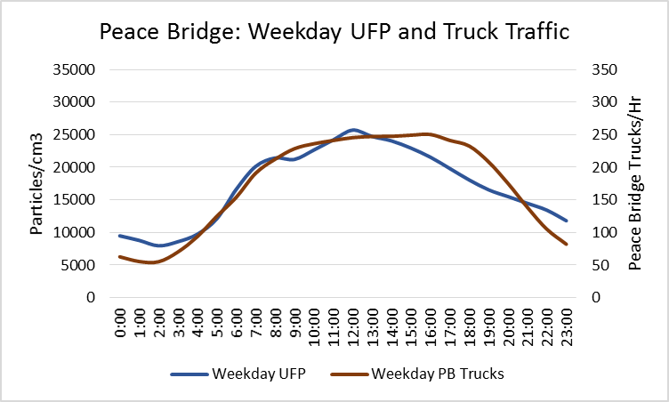
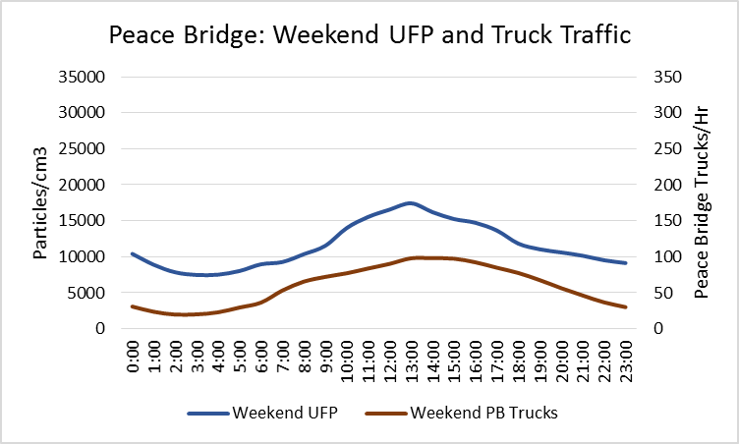
Peace Bridge UFP and Truck Traffic
The pattern of UFP closely matches the hourly average weekday truck traffic on the Peace Bridge
The UFP and Truck traffic are lower on the weekends but the diurnal patterns are very similar
The weekend offset is likely due to other sources of UFP including biomass burning
Notes:
The weekend UFP offset begins late on Friday and winds down late on Sunday

Slide 47
Why Do we Monitor UFP in a Rural Area?

Slide 48
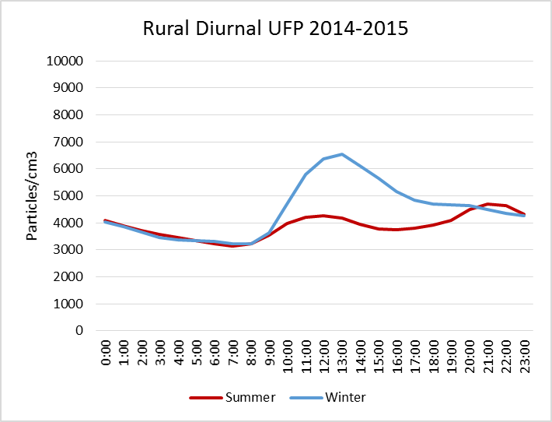
Rural UFP Data: Steuben County
Site is removed from sources so natural processes that increase and decrease UFP can be evaluated
Midday peak is higher in the winter
In the summer, the production of UFP is higher in the evening due to gas to particle reactions and condensation when evaporation is at a minimum
Notes:
At rural sites we can see how UFP behaves when we are away from sources
We saw this diurnal plot before but this time summer and winter are separate
There is a constant tug of war between particle production and particle loss
Condensation evaporation agglomeration condensation

Slide 49
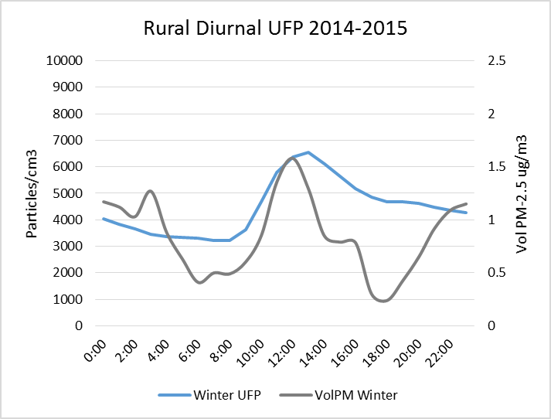
Rural UFP and Volatile PM Mass
The site has a 1405DF TEOM that provides the volatile fraction of PM_{2.5}
The volatile fraction of PM_{2.5} is about 20% of the total at this site in the wintertime
Notes:
UFP are short-lived and sometimes correlate with the volatile fraction of PM-2.5

Slide 50
Rural UFP and Volatile PM Mass
Volatile PM_{2.5} correlates with UFP midday
Since there are no local sources, the increase in PM confirms the presence of new particles
The decrease in volatile PM_{2.5} in the afternoon suggests UFP are evaporating not agglomerating and not growing
Notes:
The decrease in volatile mass after noon suggests that the UFP are evaporating and not agglomerating

Slide 51
Rural UFP and Volatile PM Mass
Volatile PM_{2.5} is anti-correlated with UFP in the evening
As the sun goes down, condensation increases
In the evening, some new particles are formed but particles “grow” out of the UFP range and quickly increase volatile PM_{2.5} mass
Notes:
Once the particles are over 100 nm they are counted as UFP but they become a bigger component of PM-2.5
The increase in volatile mass in the evening suggests that the UFP are agglomerating and not evaporating

Slide 52
Daily Change in UFP in Rural Areas
Increase UFP
Gas to Particle Reaction (new)
Condensation (1nm)
Result: New particles
Decrease UFP
Evaporation (gas)
Agglomeration (mass)
Condensation (100nm)
Result: Gas, larger particles
There is a constant tug of war between particle production and particle loss: temp, sunlight, availability of pollutants
Pollutants can quickly change state between UFP, gas and larger particles
Notes:
Nitric Acid – Sulfate - Organic Aerosols
When I talk about UFP to the public they are usually concerned about the health impact of particle number
What we are learning is that some pollutants can quickly change from small particles to gases and we are all exposed to these pollutants no matter what state they are in.

Slide 53
Findings: Behavior of Ultrafine Particles
UFP decreases within meters of emission source
Near-road - after the turbulent zone
UFP concentrations are sensitive to environmental factors
UFP lowest in moderate temperatures
UFP typically highest in the winter when UFP are more persistent and primary UFP travel further into neighborhoods
UFP can be highest in hot weather when conditions exist for particle production
Notes:
Diffusion

Slide 54
Conclusions
UFP Monitoring technology has greatly improved
Water CPC has enabled this work
Millions of people live near busy roadways and are exposed to elevated levels of UFP
PM NAAQS are currently under review
UFP are included in the Assessment (ISA)
Rural monitoring sites provide evidence of UFP transport, production and loss mechanisms
Urban sites have higher UFP due to the combination of production and primary sources
Near Road sites show steep gradient for UFP

Slide 55
Next Steps: Study to Address Intra-urban UFP
1-Yr study with 3 fixed sites and 4 portable monitors
How does mobile source UFP move from busy roadways through urban areas in a typical community with grid shaped roadways?
Where are the UFP hotspots in an urban area?
What vehicle type is primarily responsible for high UFP in urban areas?
How well does a central fixed monitor represent the UFP in an urban area?

Slide 56
Thank You
Connect with us: Facebook: www.facebook.com/NYSDEC Twitter: twitter.com/NYSDEC Flickr: www.flickr.com/photos/nysdec
Dirk Felton, P.E.
Research Scientist III
625 Broadway
Albany, NY 12233-3256
dirk.felton@dec.ny.gov
518-402-8508

