Slide 1
Method comparison of monitoring COVID-19 virus through wastewater-based epidemiology
By Vicky Huang and Daniel Bedoya

Slide 2
Team
MS
Dr. Ian Bradley
Dr. Yinyin Ye
Emily Segelhurst
UG
Daniel Bedoya
Sydney Gallo
Danya Hanin
Vicky Huang
Joyce Wang

Slide 3
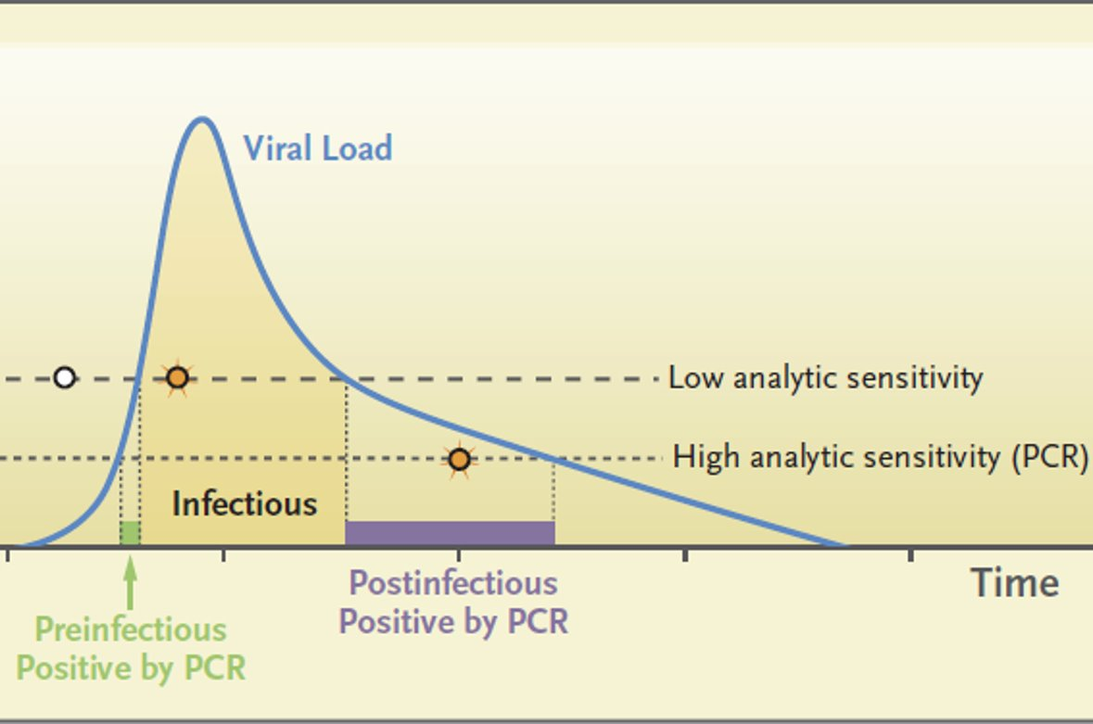
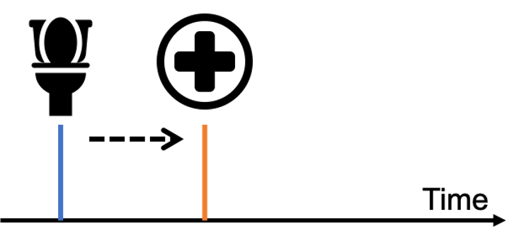
Wastewater Based Epidemiology (WBE)
Early detection & mitigation window
SARS-CoV-2 in feces as soon as...
3 days after infection
5 days before symptoms
7 days before hospitalization
Wastewater-based epidemiology analyzes wastewater to determine the consumption of, or exposure to, chemicals or pathogens in a population.
Notes:
Add information of the

Slide 4
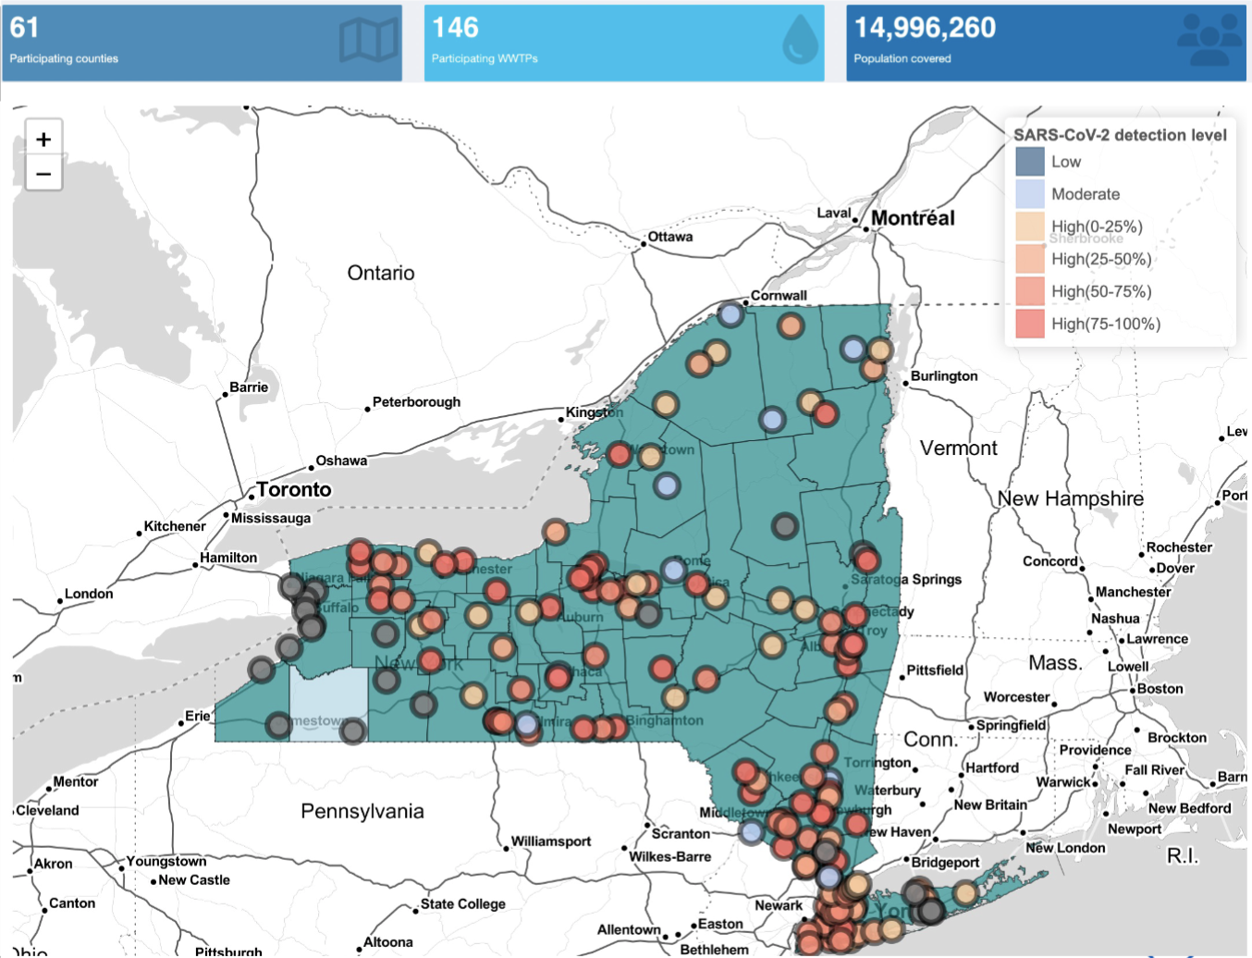
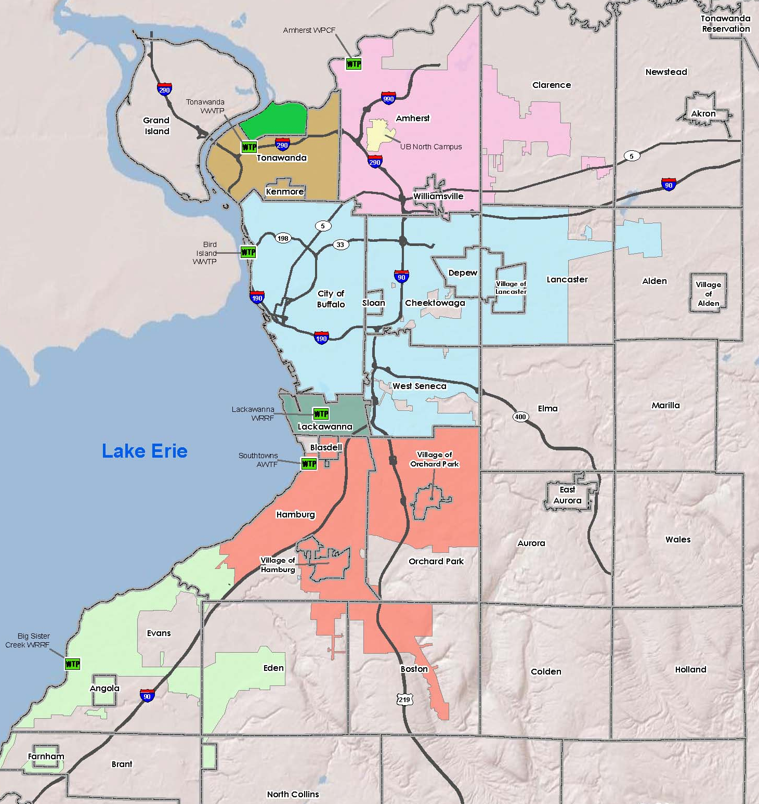
NYSDOH state-wide surveillance network

Slide 5
Western New York Watersheds
Sewershed​ | Permit Flow Rate (MGD)​ | Population​
City of Tonawanda​ | 2.5-5​ | 14,873​
Lackawanna​ | 4.5​ | 17,859​
Southtowns​ | 16​ | 94,616​
Kenmore Tonawanda​ | 25​ | 70,470​
Amherst​ | 48​ | 140,324​
Bird Island​ | 180​ | 437,357​
*MGD: million gallons per day

Slide 6
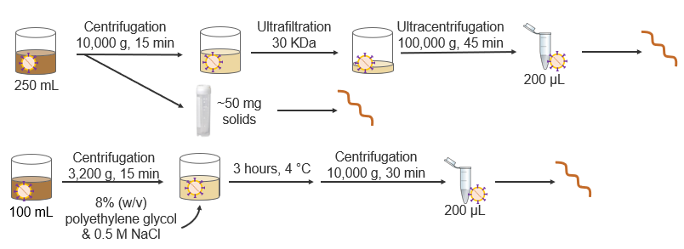
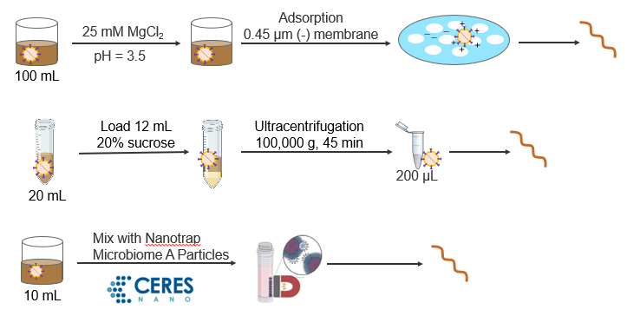
Overview of 6 methods
Tangential-flow ultrafiltration
Solids
Polyethylene glycol (PEG) precipitation
Electronegative membrane filtration
Ultracentrifugation
Nanotrap magnetic beads

Slide 7
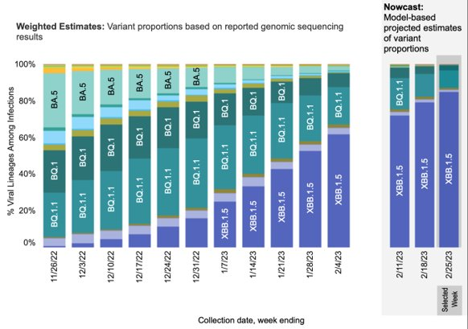
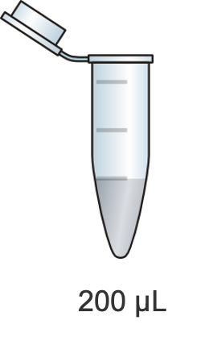
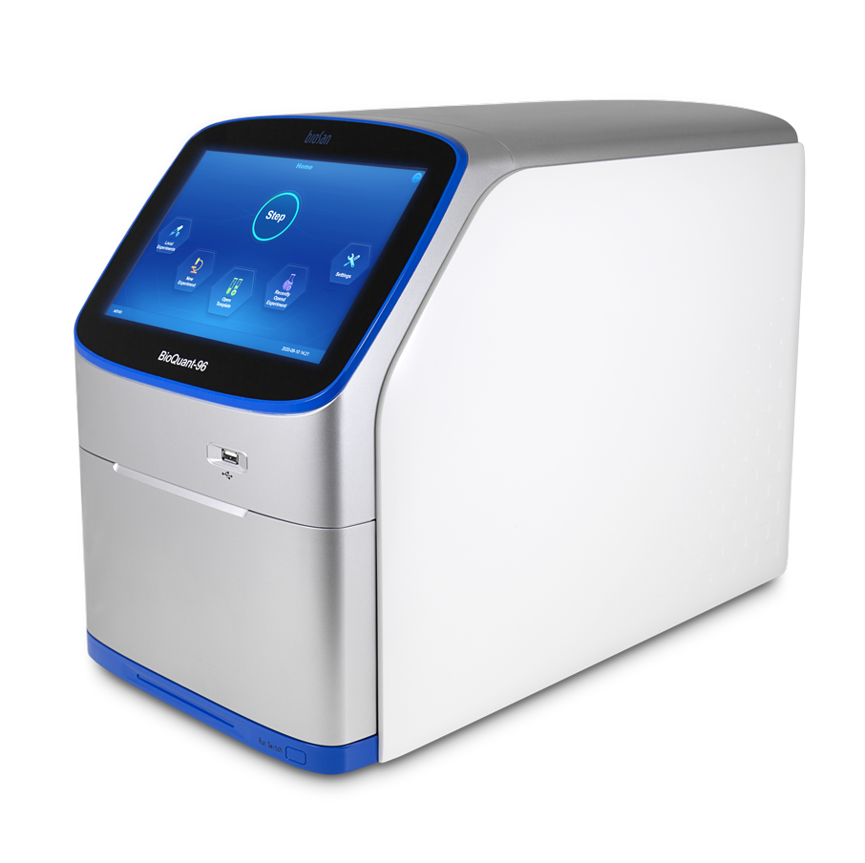
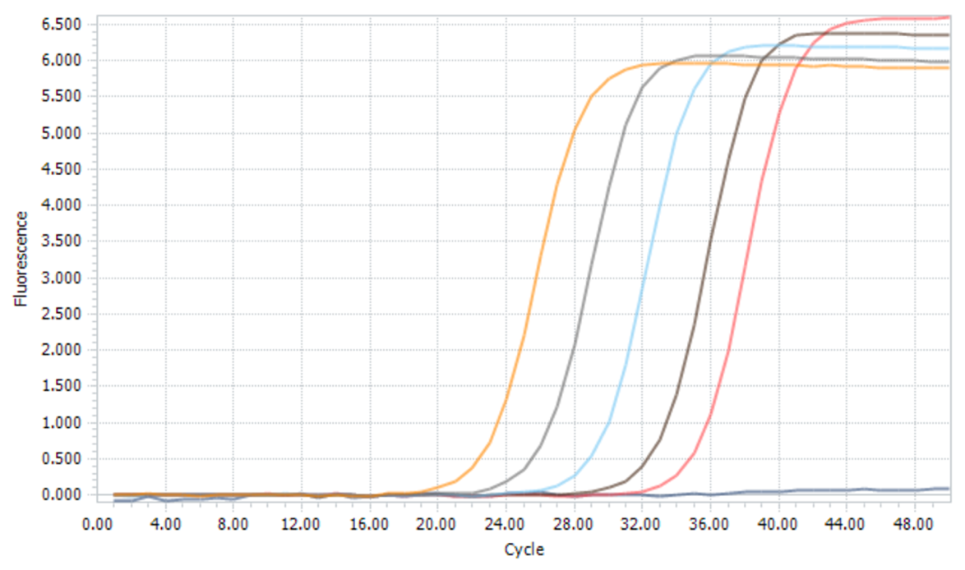
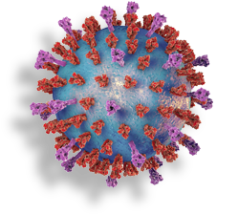
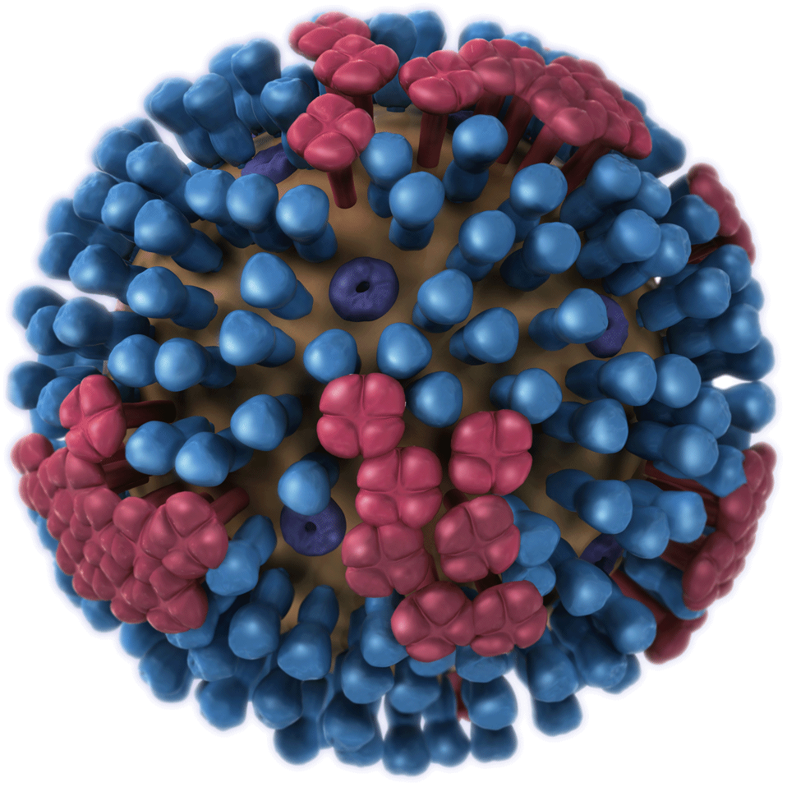
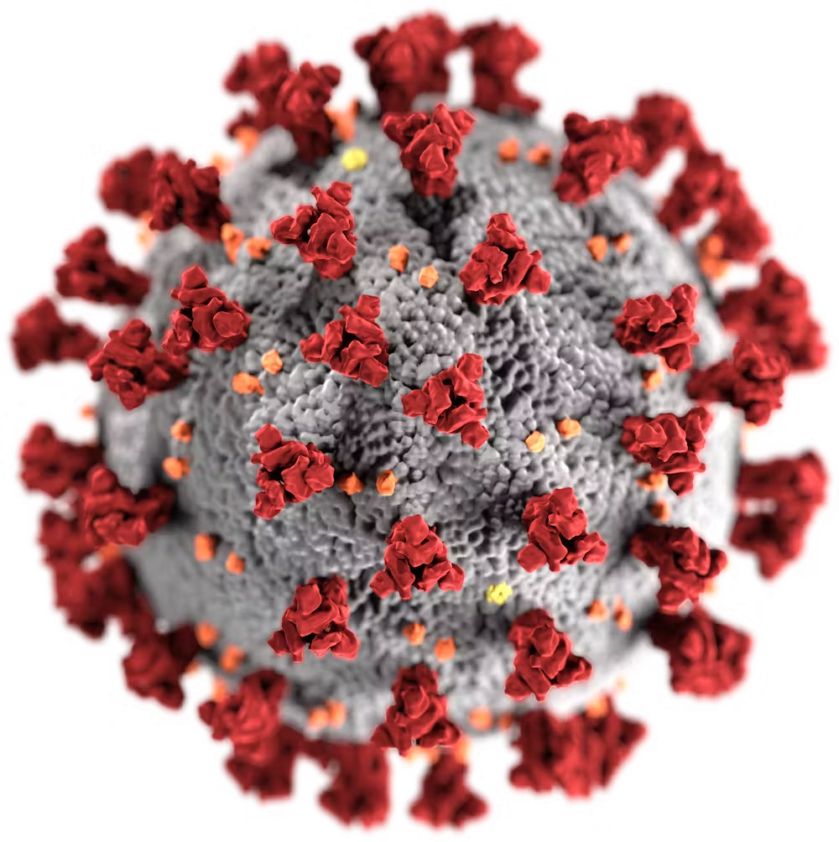
PCR Detection
Genome Sequencing
Amplification
Gene Detection
MATCH:

Slide 8
Challenges of detection
SARS-CoV-2 genes in wastewater are in low concentration
Wastewater contains non-viral substances that may inhibit downstream detection
Wastewater
PCR inhibitors: urea, blood, body fluids, water, soil, etc.
Concentration
Purification
Notes:
Add explanation for PCR inhibitors:
PCR method is prone to inhibiting substances that may present in the samples. Which can affect the sensitivity of detection or even lead to bad result. It’s important to remove the potential inhibitors. Some of the common inhibitors in wastewater are urea, blood, body fluids, water, soil

Slide 9
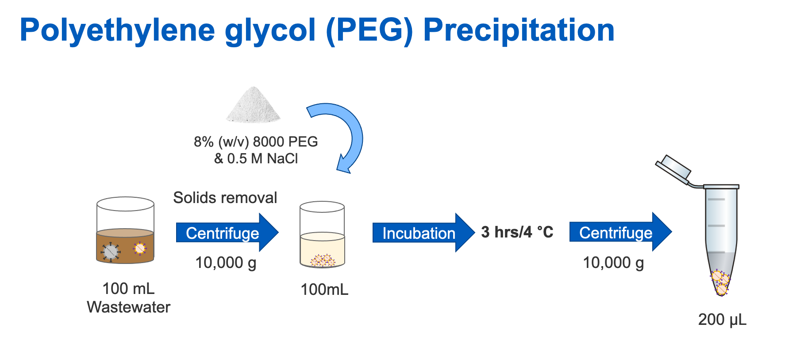

Slide 10
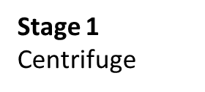
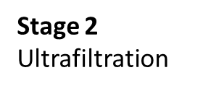
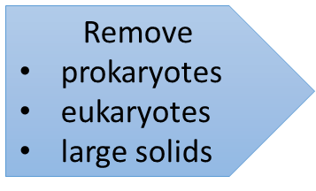
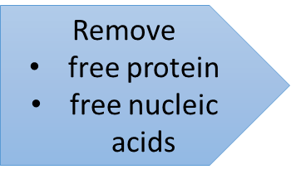
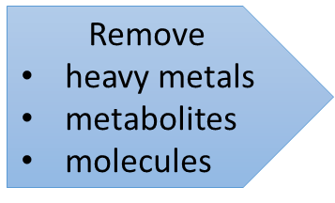
Tangential-flow ultrafiltration (UF)
Stage3
Ultracentrifuge
250 ml
Notes:
*625 times concentrated
Talk about why we are concentrating the ML

Slide 11
Goals
Comparison of virus detection sensitivity
Comparison of costs
Comparison of scalability

Slide 12
Task 1: Assess the PCR inhibition removal from wastewater concentrated by commercial nucleic acid extraction kits
Hypothesis: Commercial extraction kits cannot effectively remove PCR inhibition.
RT-qPCR
Spike in BCoV at 7×10⁸ gene copies
Virus concentration
Nucleic acid extraction
undiluted
1 x
5-fold dilution
5 x
10-fold dilution
10 x
QIAGEN QIAamp
DSP Virus Kit
ZYMO Quick
DNA/RNA Viral Kit
250 mL
Ultrafiltration
PEG
100 mL
6 sewersheds
Notes:
PCR inhibitors are any factor which inhibit the detection in PCR later on in the experiment.
BCoV gene copies detected by RT-qPCR (qPCR stands for quantitative polymerase chain reaction and is a technology used for measuring DNA using PCR.)
Deliverable: compare recovery of BCov genes by different nucleic acid extraction kits and determine the dilution factor that is needed for qPCR analysis

Slide 13
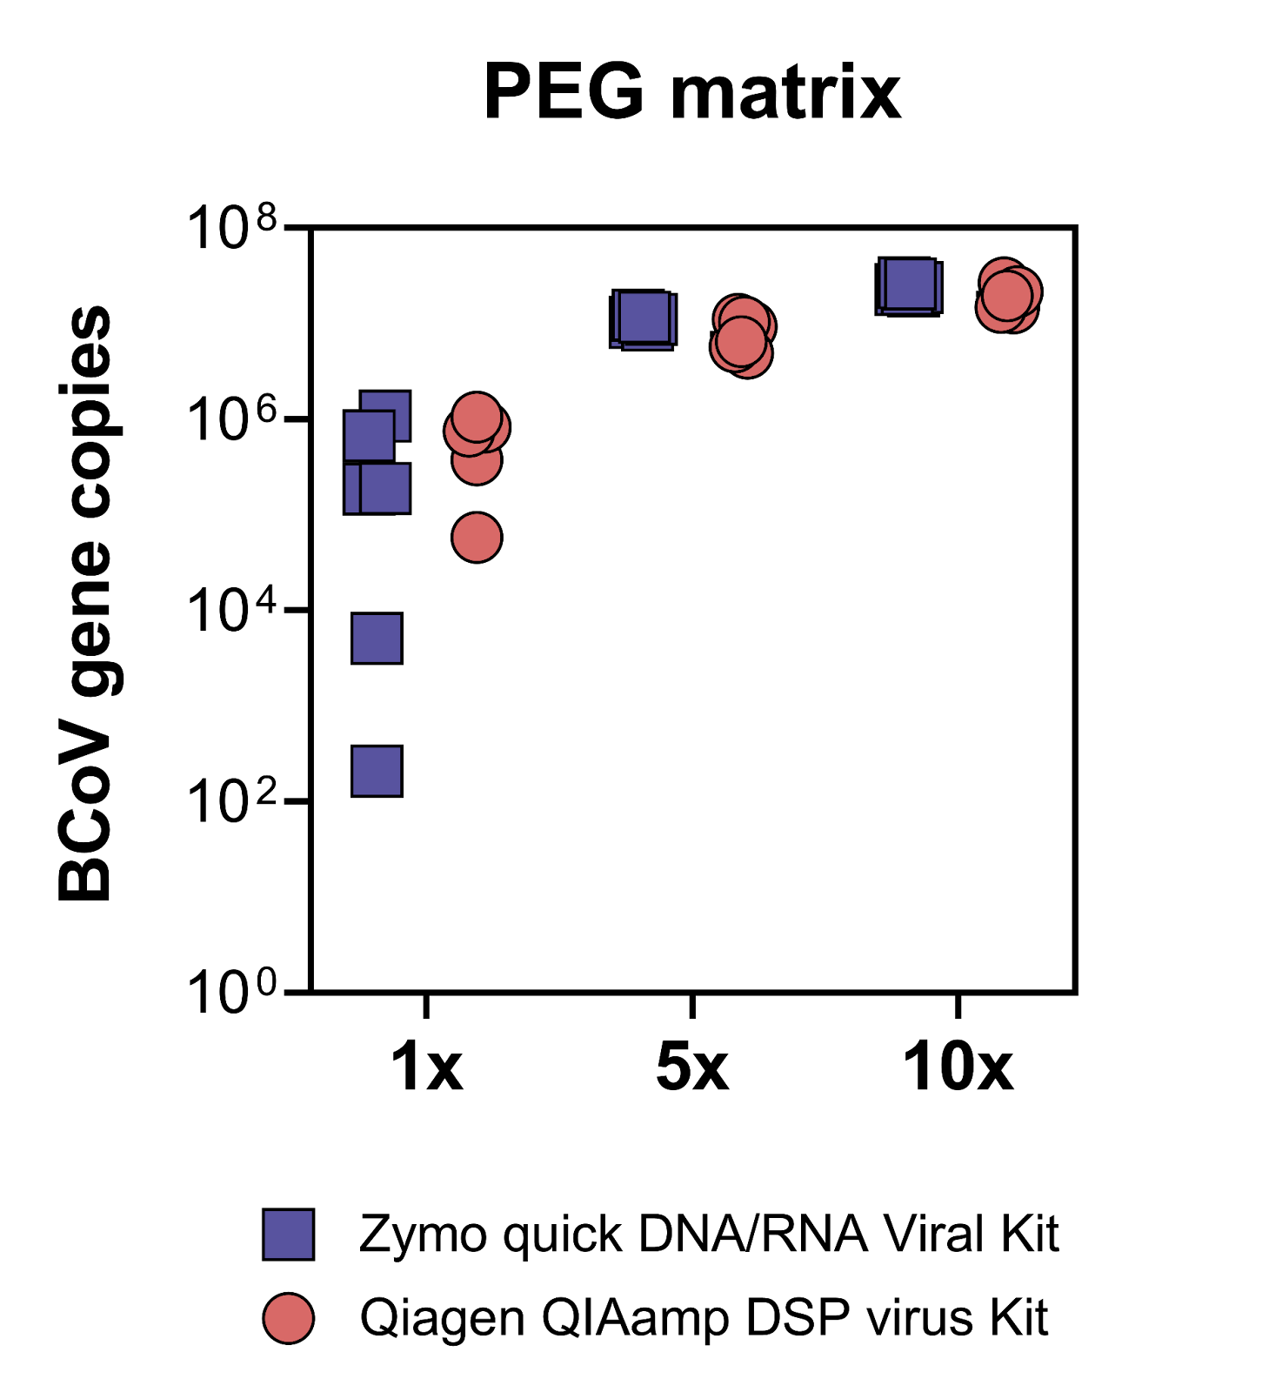
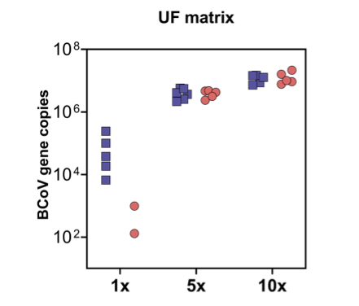
Result: BCoV (gene copies/µL PCR reaction)
1x, 5x and 10 x dilution prior to PCR
Notes:
Interpretations on the result:
10x dilution is selected for task 2 based on the result of task 1. Highest BCoV gene copies shown from both kits for all the methods

Slide 14
Task 2. Compare the extraction efficiencies of exogenous and endogenous viral nucleic acids from wastewater concentrates​
Virus concentration
Nucleic acid extraction
BCoV
4×10⁷ gene copies/mL
QIAGEN QIAamp
DSP virus Kit
ZYMO Quick
DNA/RNA Viral Kit
RT-qPCR
Ultrafiltration
10-fold dilution
BCoV
PMMoV
CrAssphage
SARS-CoV-2
250 mL
3 L
100 mL
Pooled
Bead beating
4000 rpm
1 min
or 5 min
QIAGEN RNeasy
PowerMicrobiome Kit
ZYMO Quick RNA
Bacterial/Fungal Microprep
PEG
500 mL
6 sewersheds
14
Notes:
Goal: To make a decision for kits
Two key points:
Compare exogenous and endogenous viral nucleic acids at the same initial levels; pooling samples
Pool samples are used from combining water samples from 6 sewer sheds because we focus on the efficiency of extraction here, not the recovery of genes from each location

Slide 15
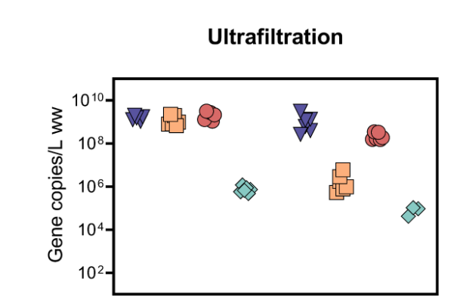
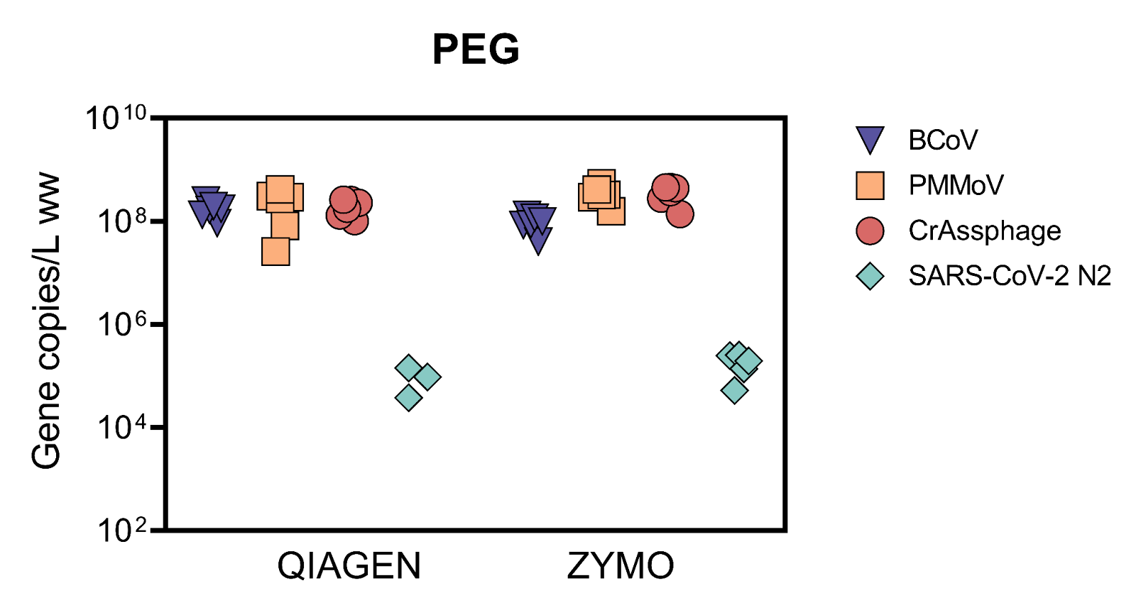
Result: Commercial extraction kits recovered exogeneous and endogenous viral nucleic acids with varying efficiency rates.
​
ZYMO
QIAGEN
Notes:
know the full names of each virus
Ultrafiltration: zymo shows better with higher detection on 3 viruses
PEG: zymo shows slightly better with less sparity

Slide 16
UF Cost analysis and scalability
Recurring Costs
Non-Recurring Costs
Item | Quantity | Unit Price | Total
VWR PIPETTE SERO 50ML PR CS100 | 6 | 0.89 | 5.37
MilliporeSigma™ Sucrose, OmniPur™, Calbiochem™ 8510-500GM(ml) | 30 | 0.07 | 1.96
Sorensen microcentrifuge tubes 2ML PK400 | 6 | 0.06 | 0.36
Sodium Hydroxide (Pellets/Certified ACS), Fisher Chemical™ (g) | 40 | 0.06 | 2.25
Gibco PBS, pH 7.4 (ml) | 1.2 | 0.03 | 0.03
PYREX™ Reusable Glass Serological Pipets, TD, Color-Coded | 1 | 9.66 | 9.66
VWR® Disposable Pasteur Pipets, Flint Glass | 6 | 0.20 | 1.22
VWR universal tips, filtered, sterile, standard, 100-1250 ul | 6 | 0.03 | 0.18
Total Cost Per Run |  | 10.99 | 21.02
Item | Quantity | Unit Price | Total
Vivaflow 50R Hydrostart membrane 30 kDa, VF05H2 | 6 | 216.81 | 1300.86
Sartorius Vivaflow™ Models Accessories: Diafiltration Reservoir | 6 | 187.64 | 1125.84
VWR® Media/Storage Bottles with GL Screw Caps | 2 | 6.74 | 13.49
NaOH waste collection bottle | 1 | 33.12 | 33.12
Polypropylene 250 ml centrifuge bottles | 6 | 11.87 | 71.25
Ultracentrifuge tube | 6 | 4.78 | 28.68
sartorius vuvaflow 50R | 2 | 1500 | 3000
Total Cost |  | 1960.97 | 5573.24
Challenges : manual labor and training; high investment
Reusable period for non-recurring cost: 1year
Total cost: $5594 (maximized 6 samples per run)
Notes:
Recurring total cost for 6 samples is $21; non-recurring cost is $5,500 including …..but sustained for up to an year with proper maintanence
Challenges: manual labor and training for stage in ultrafiltration
Specific 6 samples per run

Slide 17
PEG Cost analysis and scalability
Recurring Costs
Item | Quantity | Unit Price | Total
Polyethylene glycol (PEG) 8000 | 48 g | 0.08 | 3.70
VWR Serological Pipettes | 6 tips | 0.89 | 5.37
Sorenson Microcentrifuge tubes | 7 tubes | 0.03 | 0.23
Gibco Phosphate Buffered Saline (PBS) | 1.2 mL | 0.02 | 0.03
VWR filtered pipette tips | 6 tips | 0.05 | 0.33
Sodium Chloride (NaCl) | 17.4 g | 0.03 | 0.53
 |  | Total Cost per Run: | 10.19
Challenges: time consuming
Advantages: Cheap cost & high potential to scale up
Total cost: $152.75 (maximized 6 samples per run)
Non-Recurring Costs
Item | Quantity | Unit Price | Total
250 ml Polypropylene Centrifuge Bottles | 12 | 11.88 | 142.56
 |  | Total Cost: | 142.56
Notes:
Advantages: much cheaper compared to UF with very low initial cost(no equipment needed); high potential to scale up
Challenge: time consuming-up to 6 hours; but no need to watch in incubator
Total cost around $150

Slide 18
Future work and expected deliverables
Compare to other methods (UG, S, EMF, KF)
Investigate the effects of wastewater analysis workflows on the downstream virus detection
PCR detection
genome sequencing
Notes:
Future work: sequencing for variance and compare to other methods

Slide 19
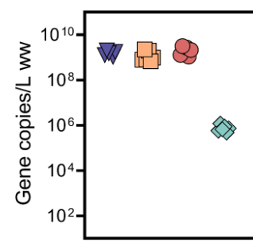
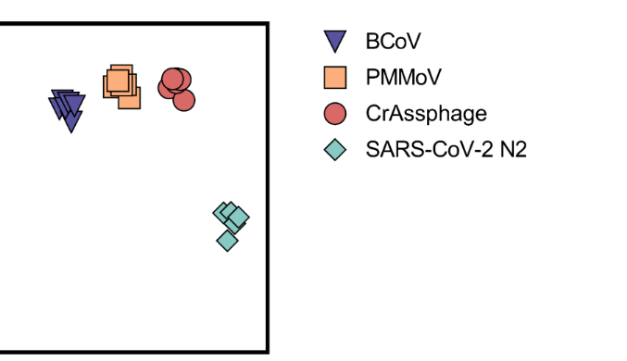
Ultrafiltration had the higher recoveries of viruses from wastewater.
Ultrafiltration
PEG
Do these virus concentration methods work equally well for genome sequencing?
Notes:
UF works better from the data so far, showing more gene copies from the detection; downside back to high cost and labor demand
Next question is along with the future work, do this result work equally well for genome sequencing? Will there be a superior method?

