Slide 1
WASTEWATER-BASED EPIDEMIOLOGY FOR PUBLIC HEALTH SURVEILLANCE
Sydney Gallo

Slide 2












Mahbub
Alam
(PhD)
Chonglin Zhu
(PhD)
Ian Bradley
(Assistant Prof CSEE & RENEW)
Emily Segelhurst
(MS)
Vicky
Huang
(UG)
Daniel
Bedoya
(UG)
Danya
Hanin
(UG)
Joyce
Wang
(UG)
Yinyin Ye (Assistant Prof CSEE)
Sydney
Gallo
(UG)
Joseph Fiegl, P.E., BCEE – Erie County
Gale Burstein, MD, MPH, FAAP,
Erie County Department of Health
UB Wastewater Committee: John Tomaszewski, Ian Bradley, Yinyin Ye, Jean Wactawski-Wende, Tom Russo, Jeff Angiel, Brian Foti, Greg Wilding, Craig Abbey, Brian Haggerty

Slide 3
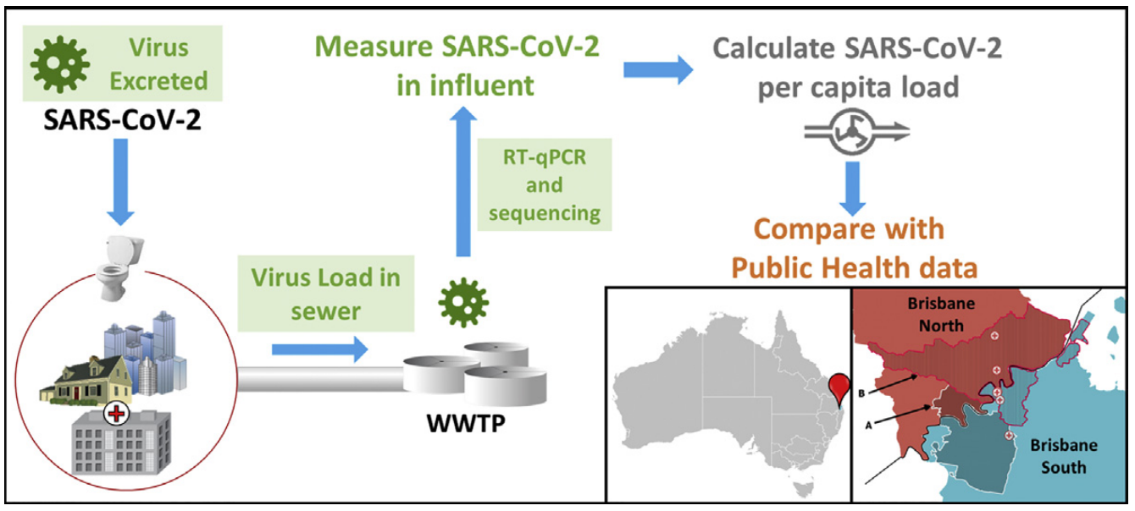
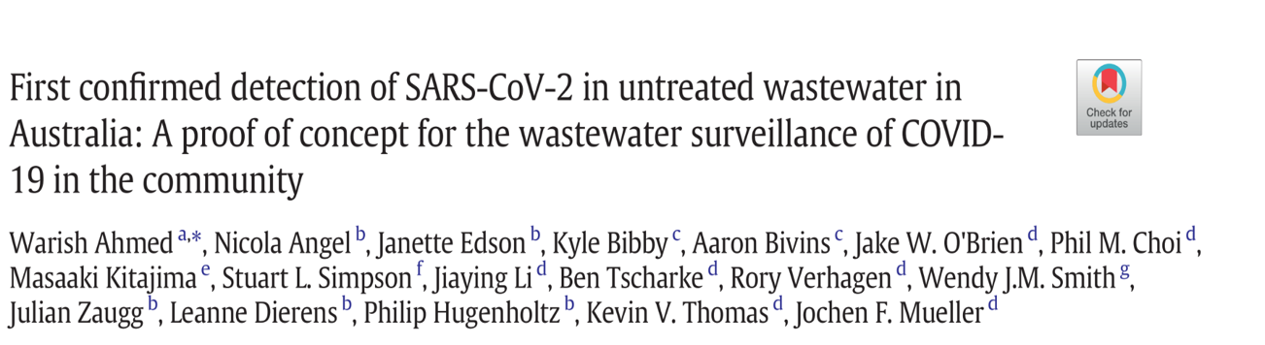
Wastewater Based Epidemiology (WBE)
“Any substance that is excreted by humans and is stable in wastewater can be used to back-calculate the original concentration excreted by the serviced population”

Slide 4
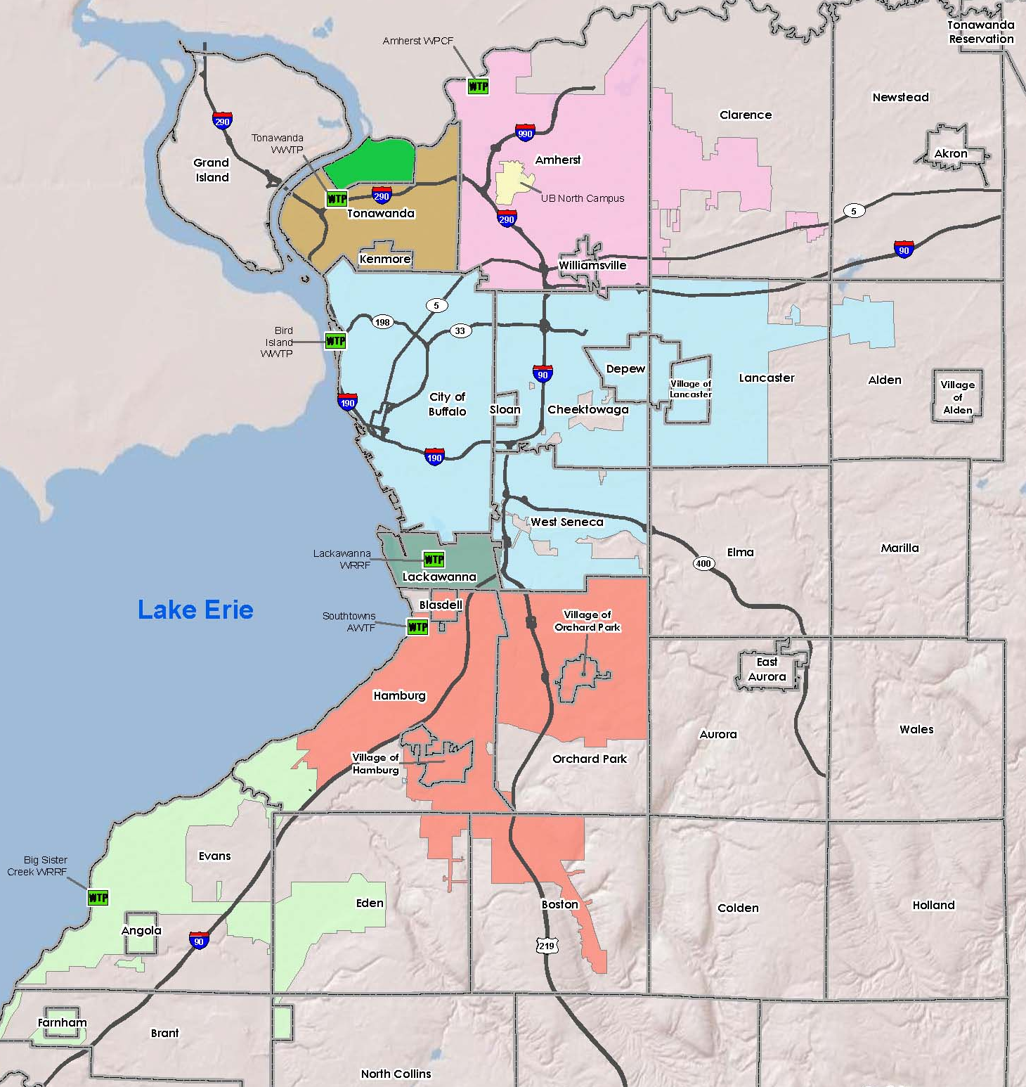
Wastewater Based Epidemiology (WBE)
“Any substance that is excreted by humans and is stable in wastewater can be used to back-calculate the original concentration excreted by the serviced population”
Sewershed | Permit Flow Rate (MGD) | Population
City of Tonawanda | 2.5-5 | 14,873
Kenmore Tonawanda | 25 | 70,470
Amherst | 48 | 140,324
Bird Island | 180 | 437,357
Notes:
Discuss what makes a “composite” sample. Discuss “sewershed” concept (like a watershed).

Slide 5
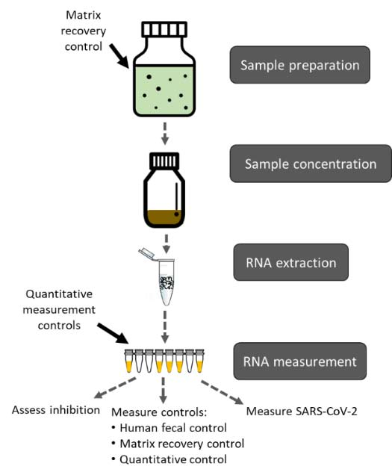
CDC’s NWSS Recommended Methods:
Matrix Recovery control
  BCoV, murine coronavirus, or bovine respiratory syncytial virus
Human Fecal Normalization
  Viruses: Pepper Mild Mottle virus, crAssphage
  Bacteria: Bacteroides HF183, Lachnospiraceae Lachno3
Flow
”One size fits all” approach
Notes:
The idea behind the CDC’s NWSS is that every state would have a WW monitoring program that feeds into a larger national network in order to better track the rest of the pandemic and whatever future issues pop up. And included with this national network is recommended methods. So they recommend a matrix recovery control that is added before processing and measured at the end of quantification in order to calculate how efficient the processing methods are. We use BCoV in our lab, but they are recommend murine coronavirus or bovine respiratory syncytial virus. The next recommended method is normalizing by human fecal concentration, which is important because only about 10% of wastewater is actually human waste and it can be even lower in combined sewers during rainfall events. Our lab uses Pepper mottle virus. And lastly they mention normalizing by flow, but almost as a set aside from these other methods.
(One thing that caught my attention is that this is also quite a bit of work. To run a matrix control and human fecal normalization on top of the Covid-19 quantification adds about 5 hrs of work for each round of samples run. Also, while the materials are fairly easy to purchase now, there were times during the pandemic when we would be waiting at least a month for a specific supply to come in for PCR. And not to mention reruns and hiccups along the way. Our BCoV runs for instance, were not very consistent. It was very tempermental at times and there would be runs where our recovery was obviously much lower than what it should be, causing spikes in our covid data that were nearly impossible. So often times plates would need to be reran or an average of past recoveries had to be used, defeating the purpose of the recovery normalization.)
(But more importantly) for these methods there was no specifications for sewers of different populations, sizes, or types in the methods.

Slide 6
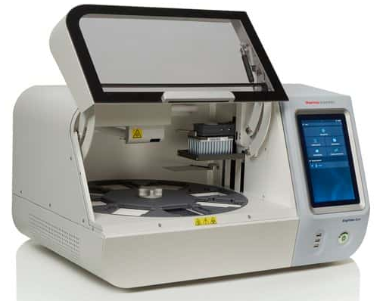
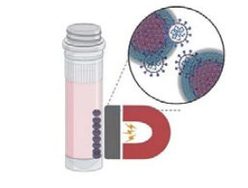


Nanotrap ® Magnetic Bead Extraction
Nanotrap magnetic beads
Mix with Nanotrap Microbiome A Particles
Nucleic acid extraction
10 mL
https://www.ceresnano.com/viruscapture

Slide 7
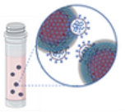
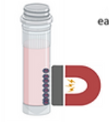
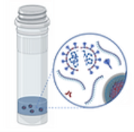
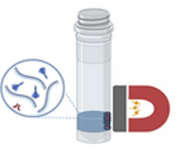
Nanotrap® particles recover SARS-CoV-2 in wastewater.
10 mL raw wastewater
Virus capture
Virus concentration
Virus lysis
Only 10 mL wastewater is needed (~100 mL for UF and MF methods).
The entire process is automated.
12 samples can be processed at the same time.
RNA purification
https://www.ceresnano.com/viruscapture

Slide 8
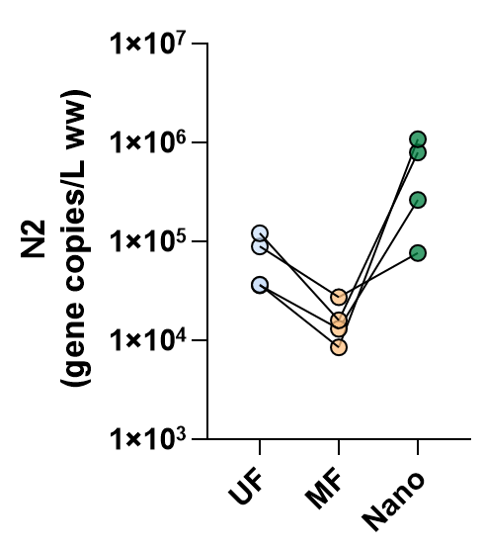
The Nanotrap® particles yielded highest SARS-CoV-2 N gene levels among the three tested methods.
4 Erie County wastewater sample collected on Feb. 3, 2022
CDC recommends to normalize SARS-CoV-2 N gene levels with the gene copies of fecal indicator (e.g., pepper mild mottle virus, PMMoV) in the same sample.
Notes:
4 Erie County wastewater sample collected on Feb. 3, 2022
It is unknown whether the Nanotrap method can capture fecal indicators (e.g., pepper mild mottle virus) for data normalization (CDC recommendation).

Slide 9

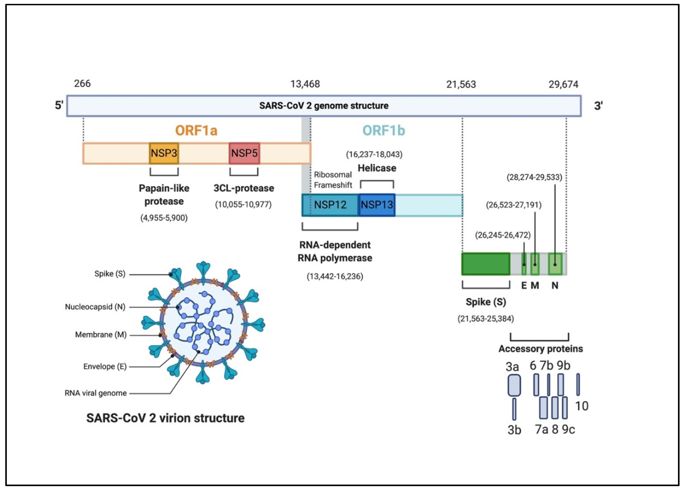
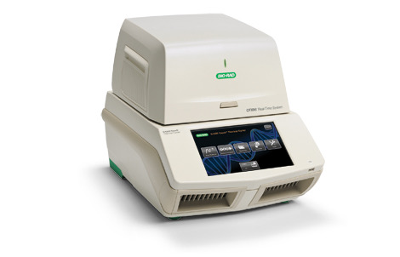
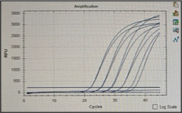
RT-qPCR is done with N gene followed by BCoV (recovery) and PMMoV (fecal strength).
N2
BCoV
PMMoV
Standard curve of SARS-CoV-N gene positive control

Slide 10
Uses for Viral Public Health Surveillance
CDC
Erie County
Chautauqua County

Slide 11
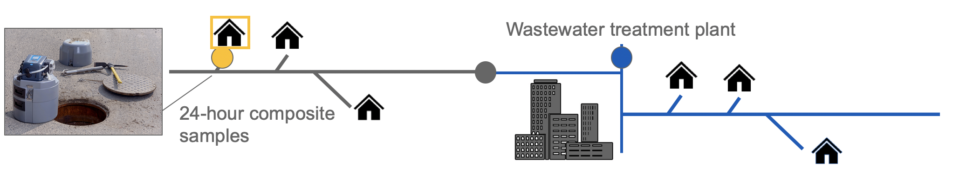
Monitoring genes in wastewater could track disease presence and burden in the community

Slide 12
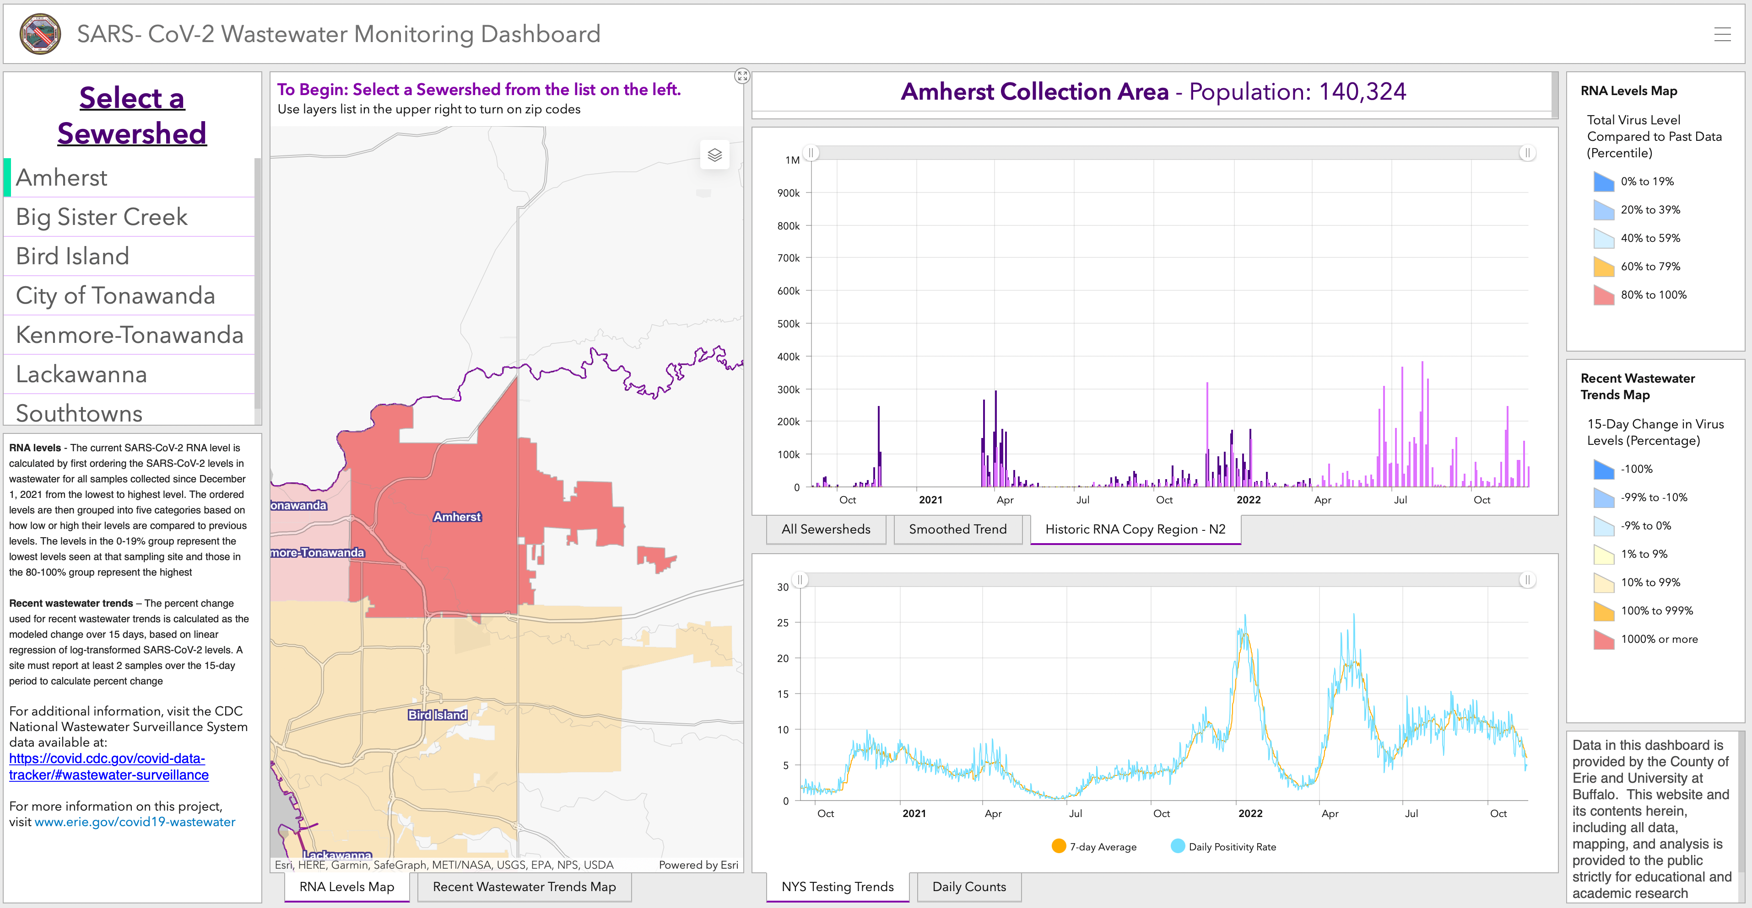
Wastewater data collect over the last two years mirrors each wave of the pandemic
Notes:
So we had all this wastewater data that was providing really good insight into community spread and cases in the area and wanted to get it out so that people could see it. And so did a lot of other labs. Our dashboard is in the upper right and the bottom picture is of the CovidPoops19 dashboard which keeps track of all the covid-19 wastewater dashboards across the world, and you can see there’s quite a lot of us at a variety of scopes from county to dorm level.

Slide 13
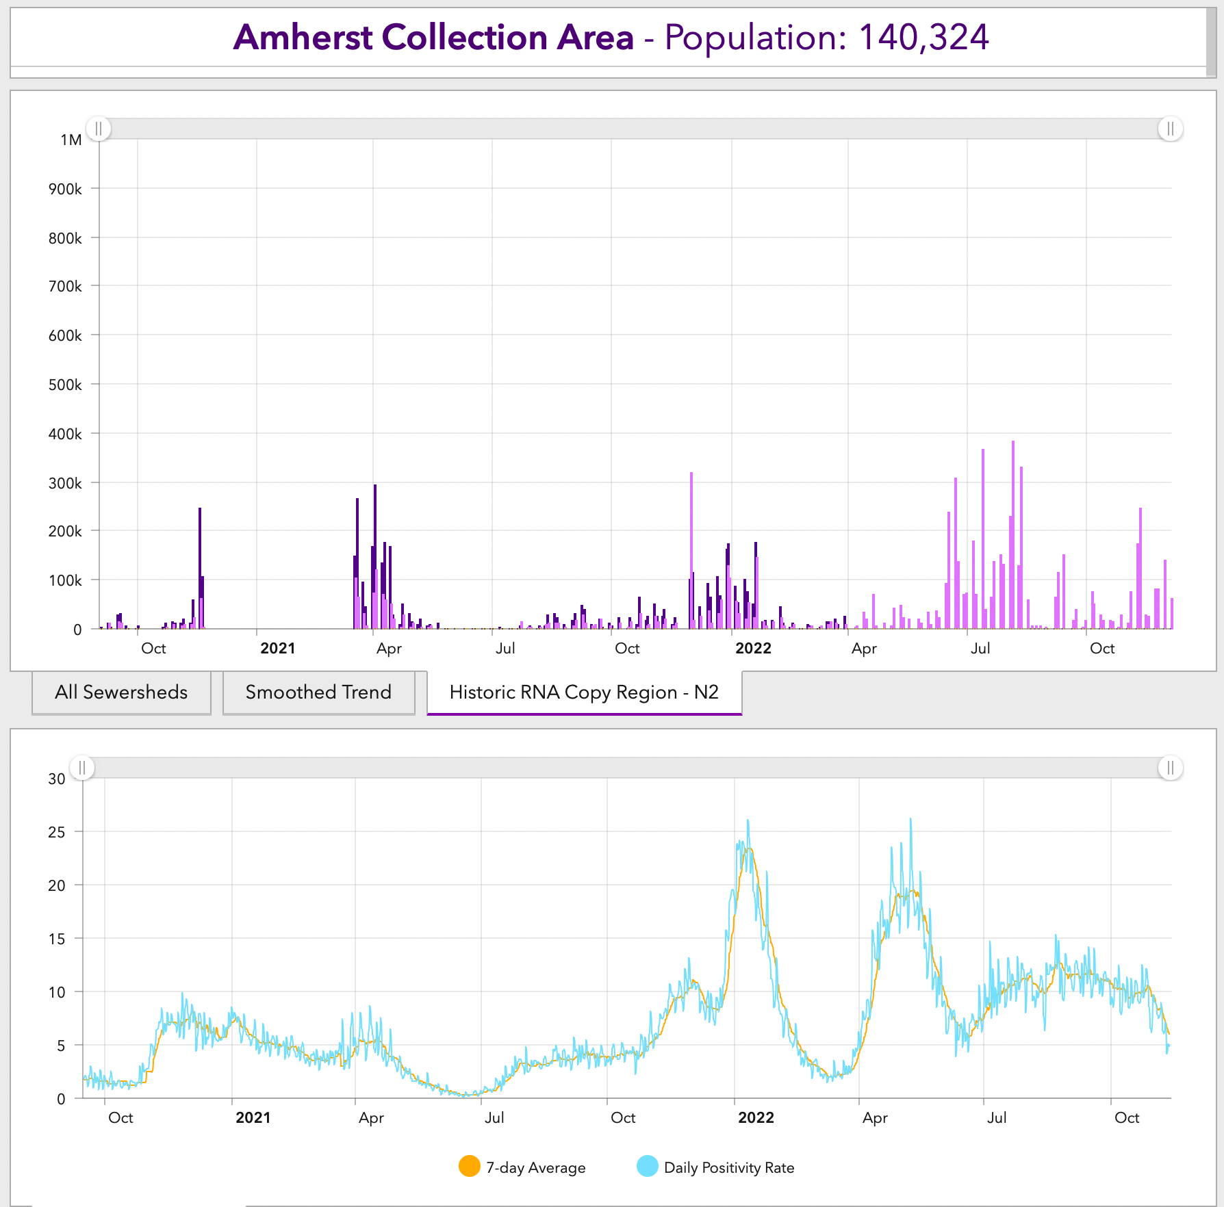
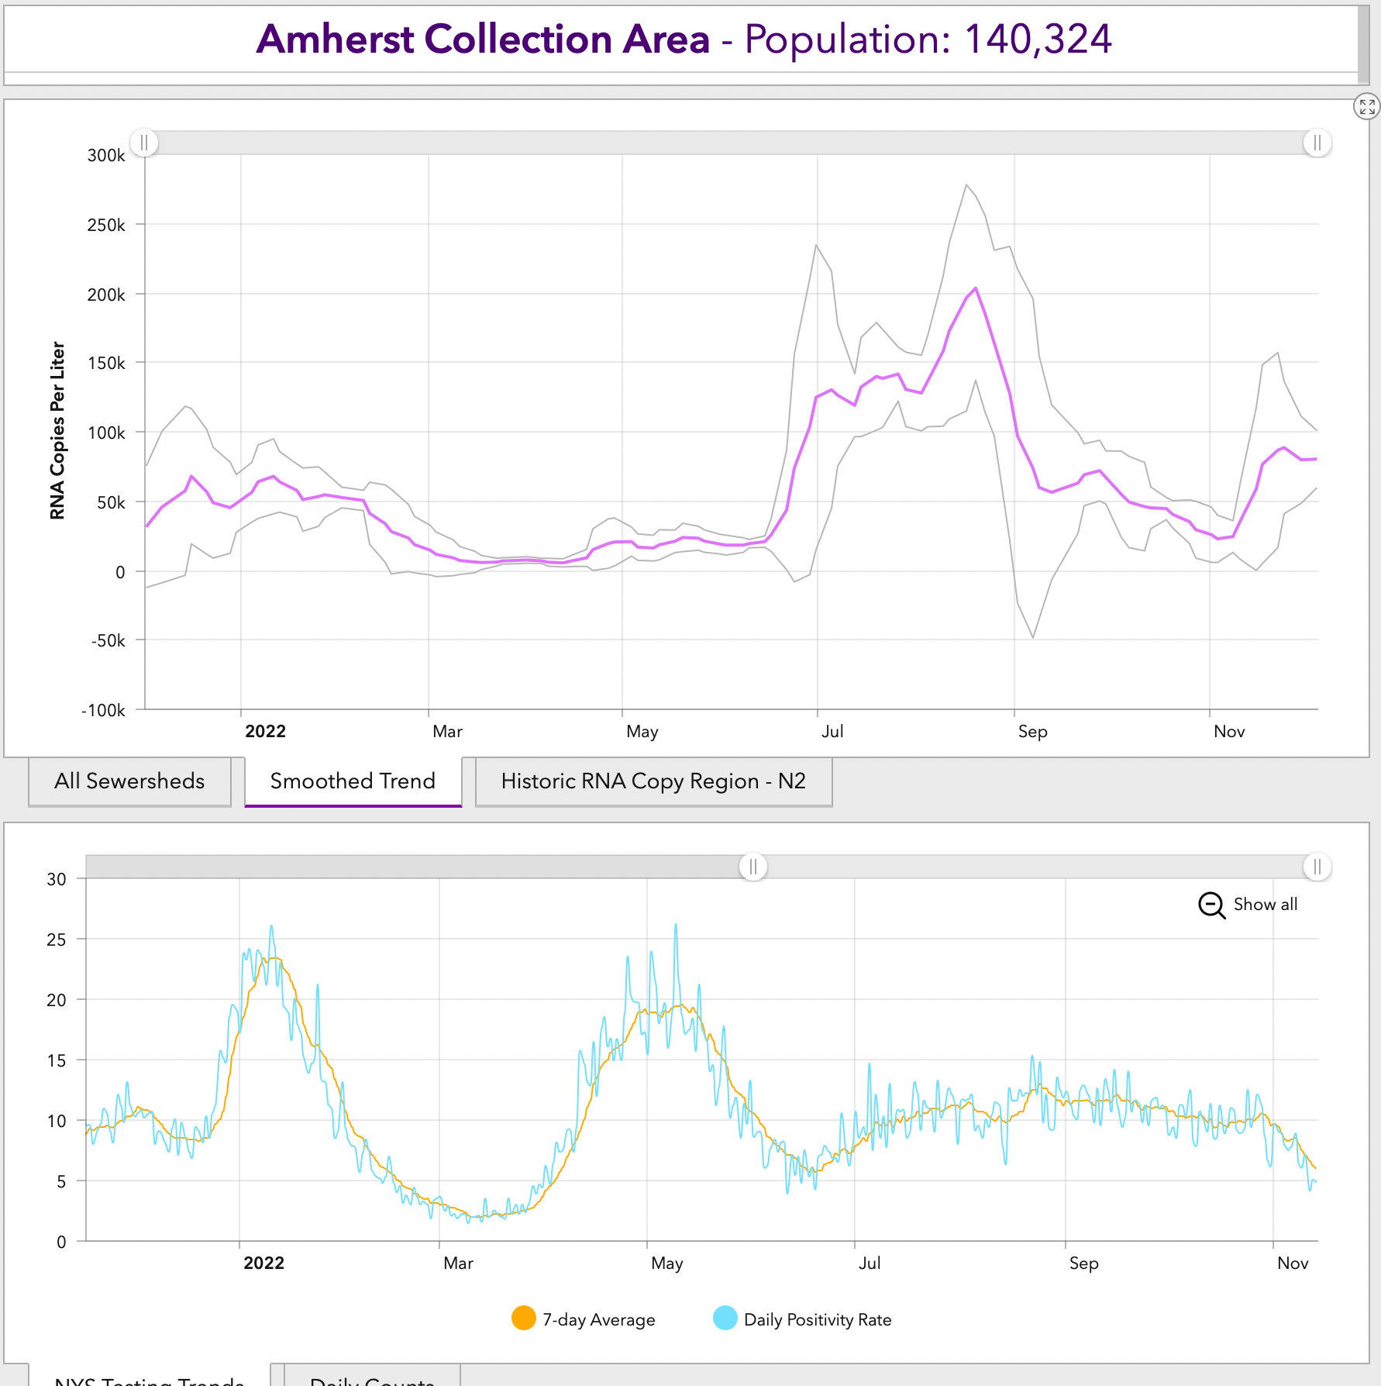
Wastewater data collect over the last two years mirrors each wave of the pandemic
Notes:
So we had all this wastewater data that was providing really good insight into community spread and cases in the area and wanted to get it out so that people could see it. And so did a lot of other labs. Our dashboard is in the upper right and the bottom picture is of the CovidPoops19 dashboard which keeps track of all the covid-19 wastewater dashboards across the world, and you can see there’s quite a lot of us at a variety of scopes from county to dorm level.

Slide 14
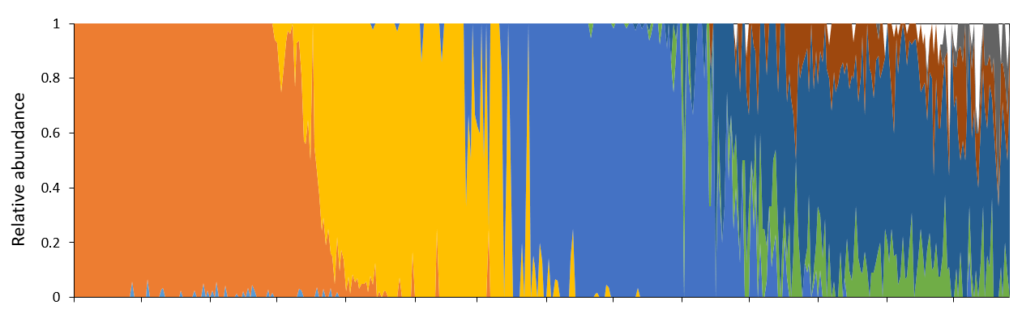
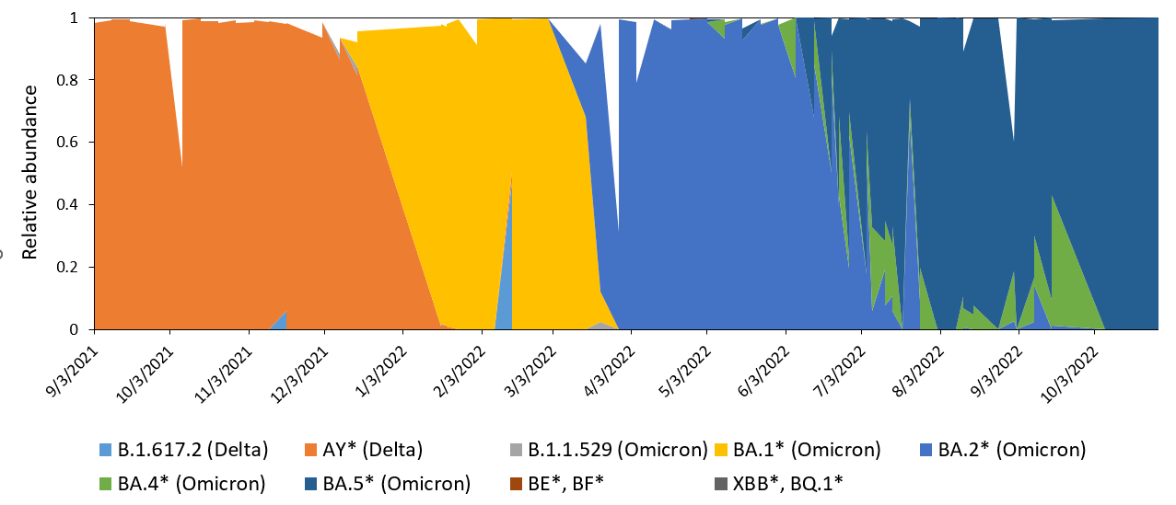
The relative abundances of SARS-CoV-2 variants are comparable between clinical and wastewater data.
Clinical data
Erie County
Wastewater data
Erie County
Notes:
Include new data

Slide 15
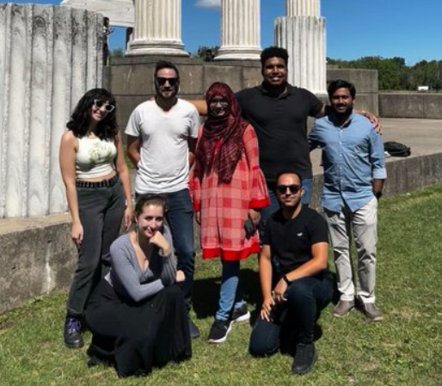




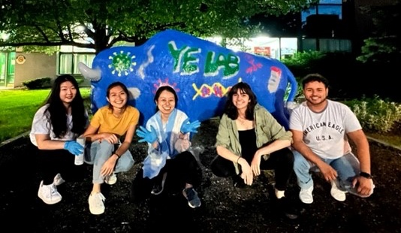

Acknowledgements
UB Genomics and Bioinformatics Core: Jennifer Surtees, Don Yergeau, Jonathan Bard, Natalie Lamb, Alyssa Pohlman, Amanda Boccolucci, Jamaal Emerson, Brandon Marzullo, Norma Nowak
UB Wastewater Committee: John Tomaszewski, Jean Wactawski-Wende, Tom Russo, Jeff Angiel, Brian Foti, Greg Wilding, Craig Abbey, Brian Haggerty
New York State Wastewater Network: Milagros Neyra, Dustin T. Hill, Lydia J. Bennett, Christopher Dunham, Mohammed Alazawi, Brenden Bedard, Mary Collins, Austin Fehrman, Christopher Gobler, Alejandro Godinez, Hyatt Green, Brianna Hanson, Tabassum Insaf, Haley Kappus-Kron, Daniel Lang, Elliot J. Moran, Dana Neigel, Shailla J. Raymond, David A. Larsen
Erie County collaborators: Joseph Fiegl, Gale Burstein

