Slide 1
Lead chemistry in drinking water
Prashant Deherikar
Advisor: Dr. Ning Dai

Slide 2
Introduction
Lead is a neurotoxin, represents a significant public health risks especially to infants, young children and pregnant women
Health concerns:
  Lower IQ
  Shorter attention span, learning and behavioral problems in children
  High blood pressure, kidney and liver damage in adults
Sources of Lead:
  Drinking water pipes: Lead service line, leaded solder, leaded brass, galvanic pipes
  Lead paints
Regulations:
  Lead and copper rule (USEPA 2021): 15 ppb Action level and 10 ppb triggered level
Simoni, EPA ORD, 2020

Slide 3
Strategies for mitigating lead risk
US EPA estimates there are about 6-10 millions Lead service lines across united states
Lead service line replacement is the best way to get rid of lead from drinking water but it’s a costly and slow process
Adjustment of water chemistry
  pH/Alkalinity adjustment
  Disinfectants
  CSMR/Coagulants
Addition of corrosion inhibitors
  Orthophosphate
  Polyphosphate
  Ortho/Poly Blend

Slide 4
Lead Chemistry
Pb²⁺ + CO₃²⁻ ↔ PbCO₃
2Pb²⁺ + CO₃²⁻ + 2OH⁻↔ Pb₂(CO₃)(OH)₂
Pb²⁺ + H₂O ↔ PbO + 2H⁺
5Pb²⁺ + 3PO₄³⁻ + Cl⁻ ↔ Pb₅(PO₄)₃Cl
Dissolved Pb = Pb²⁺ + PbCO₃ + Pb₂(CO₃)(OH)₂ + Pb₅(PO₄)₃Cl +….
Total lead = Dissolved Pb + Particulate Pb
Table 10.1, Pg 370, Brezonik:An Introduction to the Chemistry of Natural and Engineered Aqautic
Oxidation: Pb ↔ Pb²⁺ + 2e⁻
Pb ↔ Pb⁴⁺ + 4e⁻
Reduction: OCl⁻ + H⁺ + 2e⁻ ↔ Cl⁻ + OH⁻
2OCl⁻ + 2H⁺ + 4e⁻ ↔ 2Cl⁻ + 2OH⁻
O₂ + 4H⁺ + 4e⁻ ↔ 2H₂O
Corrosion products forms passivating scale over time
Simoni, EPA ORD, 2020

Slide 5
Types | Lead Oxidation State | Name | Formula | Log Kso
Oxides | Pb(IV) | Plattnerite | PbO₂ | ---
 | Pb(II) | Litharge | PbO | ---
Carbonates | Pb(II) | Cerussite | PbCO₃ | -13.13
 | Pb(II) | Hydrocerussite | Pb(CO₃)₂(OH)₂ | -45.3
Phosphate | Pb(II) | Hydroxypyromorphite | Pb₅(PO₄)₃OH | -62.79

Slide 6
Strategies to mitigate lead risk by adjusting water chemistry : pH
High pH favors the formation of low solubility scale Hydrocerussite, lowering lead levels
However, it is affected by temperature and iron
Providence, RI change in pH from 10.3-9.7, caused dissolution of lead bearing iron rust layer and increased lead and iron concentration
Simoni, EPA ORD, 2020 and Sheldon et al., 2014

Slide 7
Strategies to mitigate lead risk by adjusting water chemistry : Disinfectant
Free chlorine provides high ORP environment, favors formation of low solubility PbO2
Utilities strive to comply with multiple regulation: chlorine forms Disinfection Byproducts so switch to monochloramine is considered
Washington DC’s water crisis: caused by switch from chlorine to chloramine
J. Barry maynard, 2008 and Edwards et al., 2004

Slide 8
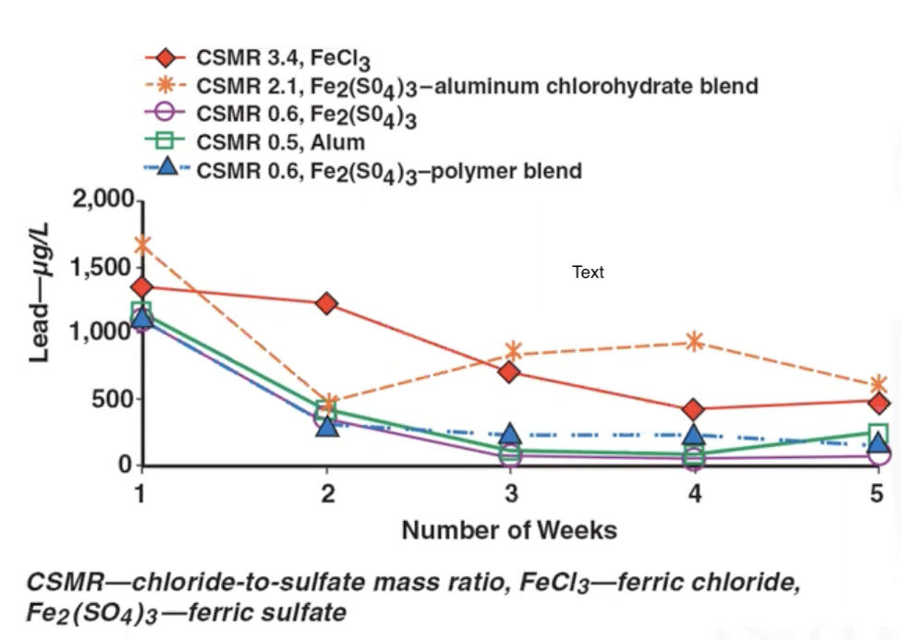
Strategies to mitigate lead risk by adjusting water chemistry : CSMR
Chloride-to-sulfate mass ratio : [Cl⁻]/SO₄²⁻]
CSMR > 0.6 leads to a serious concerns for increased lead concentration
Flint water crisis: CSMR was one of the important factor
Nguyen et al., 2012 and Kelsey et al., 2017

Slide 9
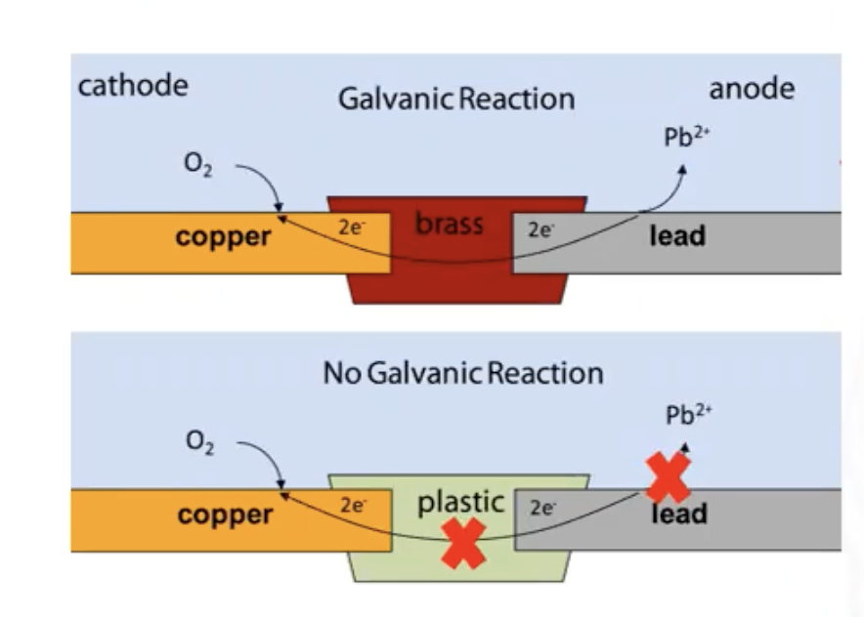
Strategies to mitigate lead risk by adjusting water chemistry : Plumbing Material
Partial replacement of lead can form galvanic connection
In Lead and copper connection lead is corroded preferentially, increasing lead levels
Anode is where oxidation occurs
Cathode is where reduction occurs

Slide 10
Strategies to mitigate lead risk by adjusting water chemistry :Corrosion inhibitors
Corrosion Inhibitors are added to form very low soluble scales and control lead levels
Common Corrosion Inhibitors used are:
  Orthophosphate
  Polyphosphate
  Zinc-Orthophosphate
  Sodium Silicate
Orthophosphate is the most commonly studied and gives the lowest lead levels
However, considering the complexities of lead chemistry, its performance varies from system to system

Slide 11
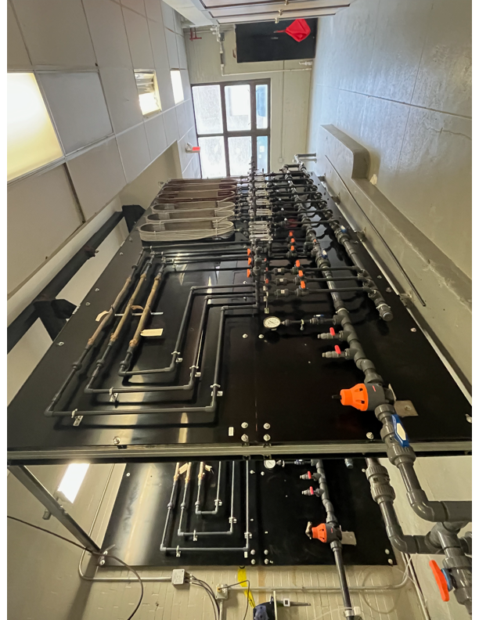
Pipe loop study
Buffalo water authorities and UB conducting study on effectiveness of corrosion inhibitors
Pipe loop study close to home drinking water system
Goals:
  Effectiveness of Phosphate based corrosion Inhibitors
  Different dosage and type
Pipe loop @ Colonel ward, Buffalo

Slide 12
References:
Lead Corrosion Control Chemistry, Simoni Triantafyllidou, EPA ORD-Region Small Drinking Water Systems Meeting 10/14/2020.
Sheldon Masters, Marc Edwards.; Increased Lead in Water Associated wit Iron Corrosion, Environmental Engineering Science, December 2014.
J. barry Maynard, Overview of Lead Scale Formation and Solubility, 2008.
Marc Edwards, Abhijit Dudi.; Role of chlorine and chloramine in corrosion of lead-bearing plumbing materials, American Water Works Associations, October 2004.
Kelsey J. Pieper, Min Tang, and Marc A. Edwards, Flint Water Crisis Caused By Interrupted Corrosion Control: Investigating “Ground Zero” Home, Environmental Science & Technology, February 2017.
Caroline K. Nguyen, Kendall R. Stone, Marc Edwards.; Chloride-to-sulfate mass ratio: Practical studies in galvanic
corrosion of lead solder , American Water Works Associations, January 2011.

