Slide 1
Julie M. Barrett O’Neill, Region 9 DEC
March 2023 AWMA

Slide 2
Start Out with a Little Inspiration
https://www.youtube.com/watch?v=bCS_7gnV6ns

Slide 3
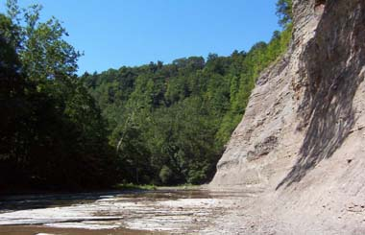
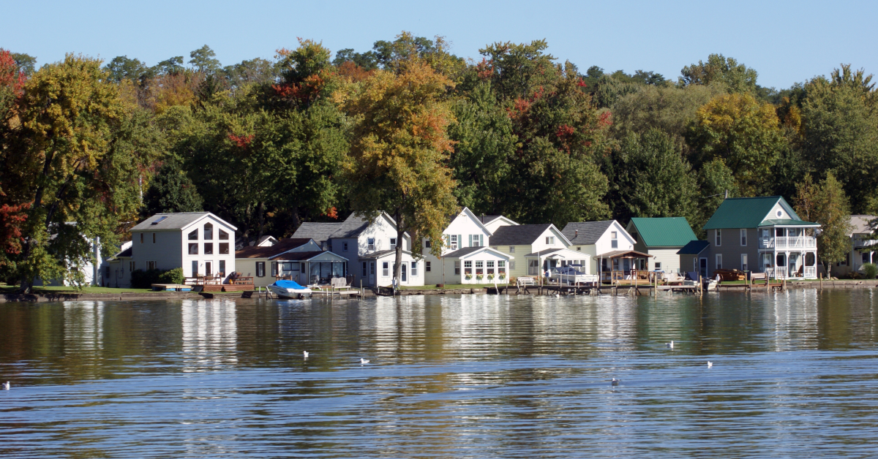
Not to forget

Slide 4
Quick Review of DEC Region 9
6 Counties = 3 million acres of land (plus GL)
The Allegany, Genesee, and Niagara Rivers flow through Region 9.
Over 75 miles of Lake Erie and 30 miles of Lake Ontario shoreline
26 Boat Launch and Fishing Access sites 170 miles of Public Fishing Rights
100,000 acres of State Forest, Multiple Use Area, Unique Area and Day Use
Over 97,000 acres of State Reforestation areas
Over 14,000 acres of Wildlife Management Areas
Approximately 120 miles of Recreational Trails
The only hazardous waste disposal facility in the North East
West Valley Demonstration Project
7 major solid waste landfills, including 3 of the 5 largest in NYS
393 State Superfund sites
Over 100 "Brownfield" sites

Slide 5
Divisions
Recreation & Education
Reinstein
Camp Rushford
Natural Resources
Forests
Wetlands
Fish
Wildlife
Operations
Orchard Park
Little Valley
Flood Control
Water, Wetlands, Shoreline and Flood Management
Emergency Response & Spills
Climate, Greenhouse Gas Emissions & Air Protection
Petroleum & Chemical Storage
Brownfields, Remediation
Solid Waste Management
Permits, Enforcement & Legal

Slide 6
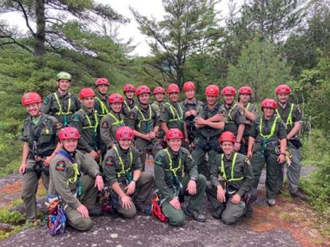
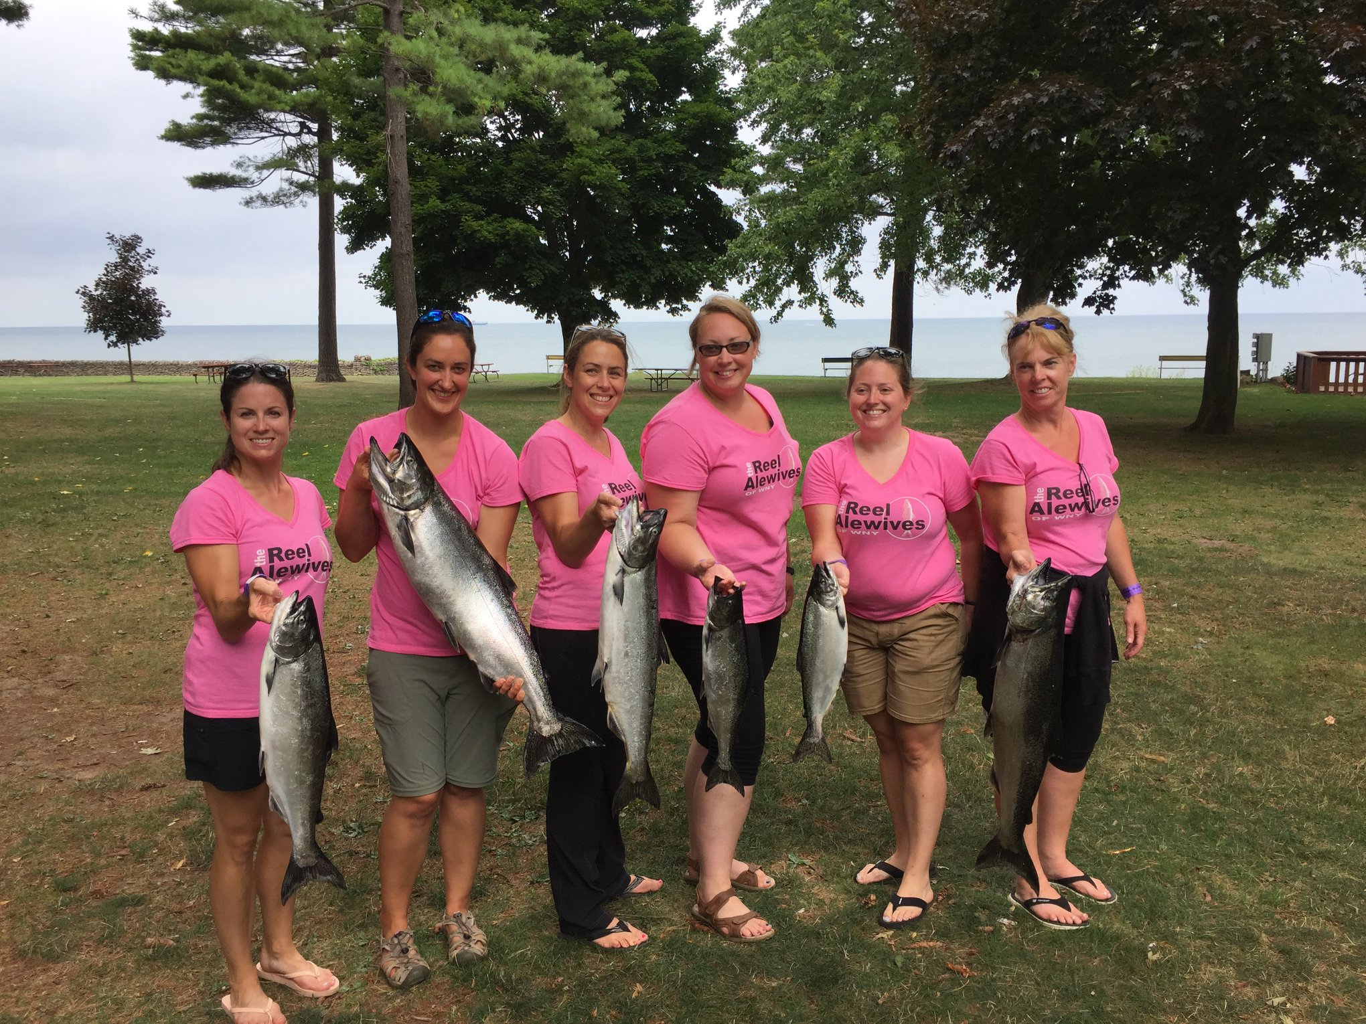
Amazing People

Slide 7
Priorities

Slide 8
Climate Leadership
Carbon Neutral Economy by 2050
Reduce disproportionate air quality & climate change burdens
Equitably distribute state climate investments
Notes:
The Climate Act, which took effect on January 1, 2020, set ambitious clean energy and GHG emission reduction targets for the State of New York, including:
• 85% reduction in GHG emissions from 1990s levels by 2050;
• 100% zero-emission electricity by 2040;
• 70% renewable energy by 2030;
• 9,000 megawatts (MW) of offshore wind by 2035;
• 3,000 MW of energy storage by 2030;
• 6,000 MW of solar by 2025; and
185 trillion British thermal units (Btu) of enduse energy savings.
The Climate Action Council also convened a Climate Justice Working Group to help establish criteria to define “Disadvantaged Communities.” As part of the Climate Act’s focus on climate justice, Disadvantaged Communities are required to receive 40% of the overall benefits of state spending on clean energy and energy efficiency programs and at least 35% of the benefits of these investments.

Slide 9
Climate Scoping Document Highlights
Transportation
Buildings
Electricity
Industry
Agriculture & Forestry
Waste
Land Use
Local Government
Adaptation & Resilience
Cap & Invest

Slide 10
Next Steps

Slide 11
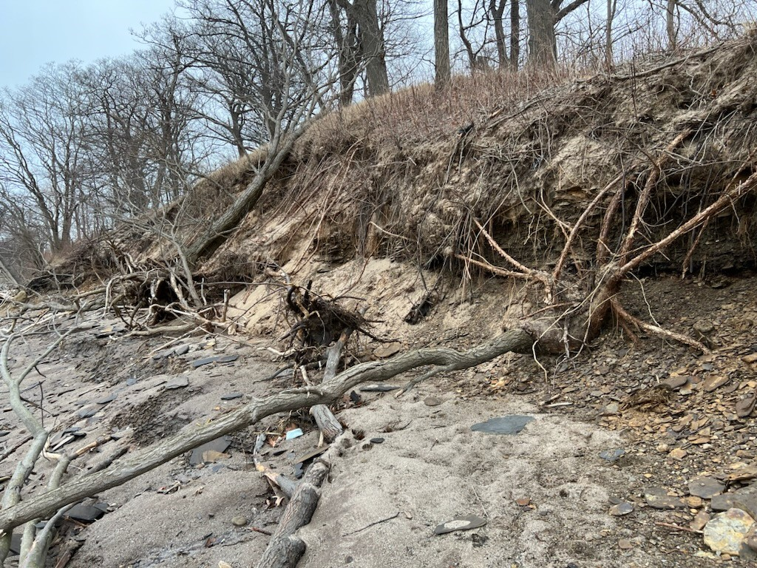
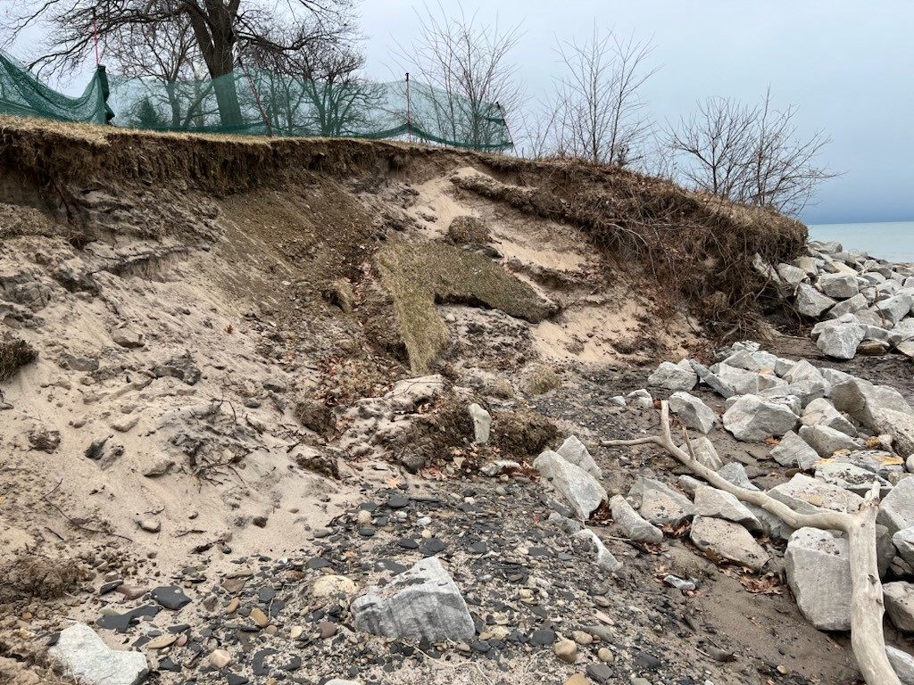

Slide 12
Ecosystem Integrity & Resilience
Flood Resilience
Coastal Erosion Hazard Areas
Increased Wetland Protection
Invasive Species Management

Slide 13
Public & Environmental Health
Emerging Contaminants
PFAS
Pharmaceuticals
Microplastics
Waste Management
Hazardous
Radioactive
Legacy Clean Up
Niagara River Area of Concern
Occidental
Tonawanda
Scajaquada
Bethlehem
18 Mile Creek Area of Concern

Slide 14
Diversity, Equity, Inclusion & Justice
Environmental Justice & Disadvantaged Communities

Slide 15
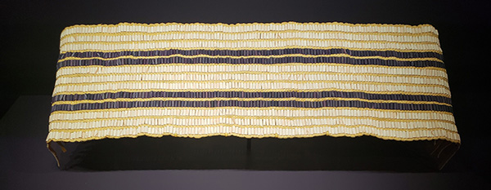
Office of Indian Nation Affairs & Traditional Ecological Knowledge
Notes:
This Wampum Belt is a replica of Gaswenta, or Two Row, which illustrates the relationship between Indigenous and Euro-American settlers. We are to travel the river of life together, side by side, offering help but never interfering
The Office of Indian Nation Affairs works to address environmental concerns, cultural resources, and advance shared knowledge through consultation with State and Federally recognized Indian Nations. DEC announced the creation of a new Office of Indian Nation Affairs in August 2022. The office combines cultural affairs, historic preservation, and consultation with Indian Nations into one team to focus DEC's consultation and engagement with Indian Nations in New York. Consultation and engagement with New York's nine state and federally recognized Indian Nations is a priority for DEC and the creation of the new office builds upon the relationships and long history DEC has had with Indigenous Nations.
Together with the Office of Environmental Justice, the Office of Indian Nation Affairs works across the agency to bolster the commitment to meaningful government-to-government relations with Indian Nations through Commissioner's Policy 42 (PDF) which governs consultation. The mission of the office is to enhance and deepen existing engagement with the Indigenous Nations in New York through improved consultation, building shared knowledge, and communications and outreach. The Office addresses:
Government-to-government consultation with State- and federally recognized Nations on environmental issues.
Protection of cultural and historical resources.
Development and advancement of shared knowledge and understanding via research and further developing working relations.
Traditional Ecological Knowledge (TEK) refers to the body of knowledge, belief, and practice that has been passed down through traditional songs, stories, and beliefs. In New York, the Haudenosaunee culture promotes teachings and values to manage natural resources in a way that preserves and protects them for seven future generations. Because TEK relates to the relationship of living beings with their environment, it is consistent with sustainability, EBM, and complements many of the actions and strategies included in the GLAA. Opportunities to integrate TEK into project decision-making, educational programming, and environmental messaging will be pursued in consultation and collaboration with Indian Nation partners.
https://www.bia.gov/sites/default/files/dup/assets/bia/wstreg/Guidance_Document_on_TEK_Pursuant_to_the_Great_Lakes_Water_Quality_Agreement.pdf

Slide 16
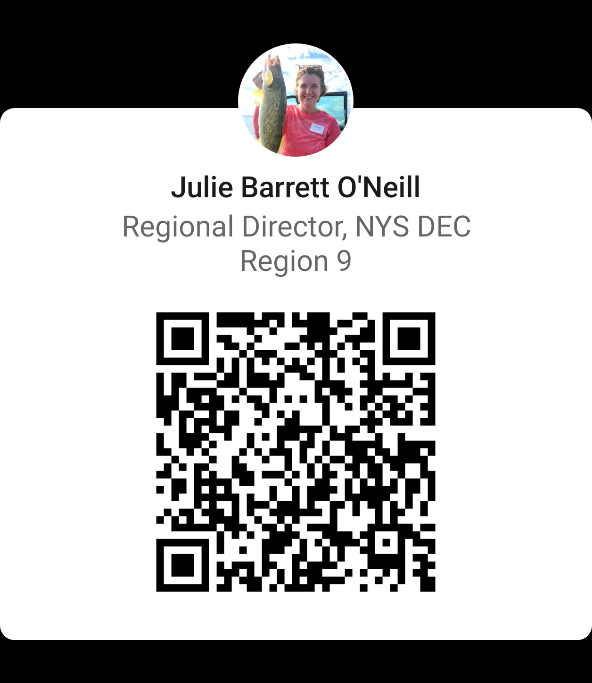
Thank You
Julie M. Barrett O’Neill
Reginal Director
julie.barrett-oneill@dec.ny.gov
716-851-7204
Connect with us: Facebook: www.facebook.com/NYSDEC Twitter: twitter.com/NYSDEC Flickr: www.flickr.com/photos/nysdec

