Slide 1
Many Aspects of GHG Reporting – Linde Example by Dave Copeland
October 7, 2021

Slide 2
Linde Corporate Heritage

Slide 3
Who is Linde
Linde is a leading global industrial gas and engineering company with 2020 sales of $27 billion
The company employees approximately 75,000 people globally and serves a diverse group of industries across more than 100 countries
Member of Dow Jones Sustainability Worlds Index
a) Only company in the chemical sector to be admitted in the DJSI World for eighteen consecutive years.
b) It identifies the top 10 percent of companies in each sector among the largest 2,500 companies in the S&P Global Broad Market Index.
Member of 2021 Bloomberg Gender Equality Index (GEI)
Members are selected based on a rigorous assessment of their disclosure and performance scores in 74 metrics across five key areas: leadership & talent pipeline; equal pay; inclusive culture; policies and brand.
One of the World’s Most Ethical Companies by Ethisphere Institute
One of only two companies recognized in the Chemicals category

Slide 4
GHG Reporting- Expectations from Stakeholders is Rising
Initially
Voluntarily
Rated on are you reporting completely and transparently
Interim
More stakeholders asking about it
Some type of goals should be set – more intensity and efficiency goals
Evolving to
Stakeholders requiring it
Absolute Goals
Migrating more into financial reporting aspects and all liabilities associated with it

Slide 5
GHG Reporting – Guidelines to follow
Global Reporting Initiative (GRI)
Responsible Care Management System® (RCMS®),
Task Force on Climate-related Financial Disclosures (TCFD) standards
Greenhouse Gas (GHG) protocol (2015 version) by the World Resources Institute (WRI) and the World Business Council for Sustainable Development (WBCSD)
Sustainability Accounting Standards Board (SASB)
In addition, consider the requirements of main investor indices and ratings and their underlying evaluation processes.

Slide 6
GHG Reporting Principles
Relevance
Consistency
Transparency
Accuracy
Completeness

Slide 7
GHG Emissions Scopes 1, 2 and 3
2020 Reported numbers:
Scope 1: 16.2 million
Scope 2: 21.0 million
Scope 3: 14.4 million

Slide 8
Scope 1 and 2

Slide 9
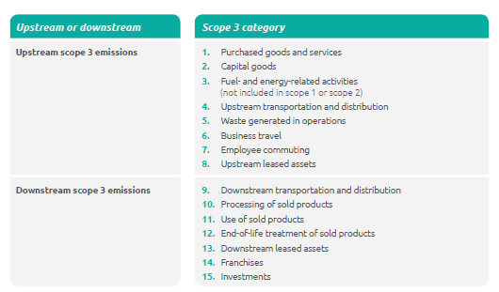
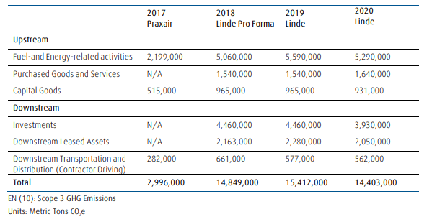
Linde so far reports on 6 out of 15 Scope 3 categories (due to relevance)
Scope 3 categories acc. To GHG protocol:
Scope 3 categories reported by Linde:

Slide 10
UB SD project - Linde Technology Center - Tonawanda
Carbon Reduction Challenge: Final Report
Linde Team: Adam Hopper, Seamus McGillion, Matthew O’Brien
GLY 479/579: Carbon Reduction Challenge
University at Buffalo, SUNY
May 11, 2021

Slide 11
SD Targets 2018-2028

Slide 12
Targets 2018-2028

Slide 13
Baseline Year
Key aspects when picking a baseline year
- Representative
Year of good and complete data
Nothing unusual (e.g. 2020 and covid, year of big merger, etc…)

Slide 14
Intensity Targets
Other common intensity metrics
GHG/amount of product
a) mass of O2 & N2 vs H2
b) industrial gases bulk vs coating business vs health care
GHG/employees
a) Direct employees vs contractors
b) High employee part of business (e.g. engineering) vs low employee part (ind. gas plant)

Slide 15
Energy Aspects
Electrical Emission Factors
Location Based
Market based
i) US EPA egrid - www.epa.gov/egrid
ii) International Energy Agency (IEA) Factors - www.ies.org
Mixture of both (use location when you have it and market as default)
Market based renewable trend issues
- Do you do by country or region?
- Do you hold it steady (use base year factors) over target period or use most current value
Data lag in emission factors - ??? – do you readjust to account for lag?
Renewable Energy
i) Passive vs Active
ii) Renewable vs Low Carbon (e.g., do you include nuclear?)
iii) Hydropower (is it green, blue or something else?)

Slide 16
Data Integrity and Quality
Comply in all material respects with applicable regulations and codes of practice
Provide data that is accurate in all material respects, complete, relevant and balanced
Provide data that is not misleading under the circumstances in which it is disclosed
Provide data and commentaries that fairly represent in all material respects the results of our operations
Report data that reflects positive and negative aspects to enable stakeholders to make a reasoned assessment of overall performance
Provide comparability of data so that issues and information can be selected, compiled, and reported consistently.

Slide 17
Scope of Reporting and Organizational Boundary
To identify which entities and facilities should be included and excluded from environmental reporting it is critical to define the organizational boundaries of environmental reporting.
Equity Share
Financial Control
Operational Control
Talk with your financial accountants

Slide 18
De-minimis
<5% of total for any category
Is it “must meet all” or just “any given category”?
Example of De-minimis categories and criteria for site reporting:
Electricity consumption | 1500 MWh
Thermal energy | 1500 MWh
Natural gas | 1500 MWh
Total waste handling | 5 Tonnes
Hazardous waste | 500 Kg
Volatile Organic Compounds (VOCs) | 1 Tonnes
Other GHG Carbon Dioxide Equivalent (CO₂ eq) | 1 Tonnes
Note these values could vary a lot based on your situation – it’s a function on what your inventory is

Slide 19
Reporting Process
Reporting Period
i) Data will be collected annually.
ii) The reporting period is the fiscal year from 1st January to 31st December
Estimation Methods
i) Must keep records how it is done
ii) Try and stay consistent
Data Freezing
i) At some point you need a deadline
Collection, aggregation, consolidation and reporting
Data Collection system
Verification/Signoff/Audit
i) Verification – somebody is looking at data and can say it looks good
ii) Signoff – somebody is taking ownership of data and saying its good
iii) Audit – third party review of the data

Slide 20
Common Issues
Zero
Is it “no emissions” or is it “no data”
Units used
English units or SI
Kg or tonnes
Is “MTD” is this thousand tons per day, million tons per day or metric tonnes
Converting btu to kw to compare fuel to electricity
1 kw = 3,412 btu or if want equivalent electrical
1 kw = 10,0000 btu (this accounts for efficiency/thermal loss to convert fuel to electric)

Slide 21
Correcting Past Data
Is the change relevant?
- Is the change significant?
Is it an “out and out mistake” or “just better data”?
Calculation methodology changes
Emission factor changes
Document the changes and be transparent.
Minor changes – depending how difficult or easy it is to make the change you may opt to make no corrections or to just go ahead and make the change. Generally, these do not impact end result either way
Large changes – if you find past mistakes that are significant and very relevant you generally have no choice but to correct the change.
Intermediate changes - ??????? These are the tough decisions to make
- Once you make the decision to make past restatements you may want to not just make the change that triggered the restatement but also include all the other more minor changes too. Keep a running list as you come across potential changes.

Slide 22
Trend interpretation
Data Variability
Trying to measure trends in 0.1% range but data itself may vary 1-5%
Expectations of what trends are
Don’t assume data must be wrong if trend is not what you expected
Don’t expect improvements if you are doing nothing to make improvements (definition of insanity)

Slide 23
PE Test Questions - True or False
1) In GHG Reporting being transparent on how you do it is one of the biggest keys.
2) For GHG Reporting, expectations from Stakeholders is waning and all the effort around doing GHG reporting maybe a waste of time.
3) Location based emission factors are factors specifically from your facility’s energy supplier and Market based factors are using regional or country level emission factors that represent the average grid for your area.
4) Deminimis values should make up less than 1% of your total inventory
5) Generally speaking, Scope 1 emissions are those GHG directly being emitted from your site, Scope 2 is from the electricity and steam you use at your site, and Scope 3 are those upstream and downstream GHG impacts your activities have

