Slide 1
New York State Solid Waste Management Plan
David Vitale, P.E.
Division Director, Division of Materials Management
Niagara Frontier Section of the Air & Waste Management Association
Thursday, March 21, 2024

Slide 2
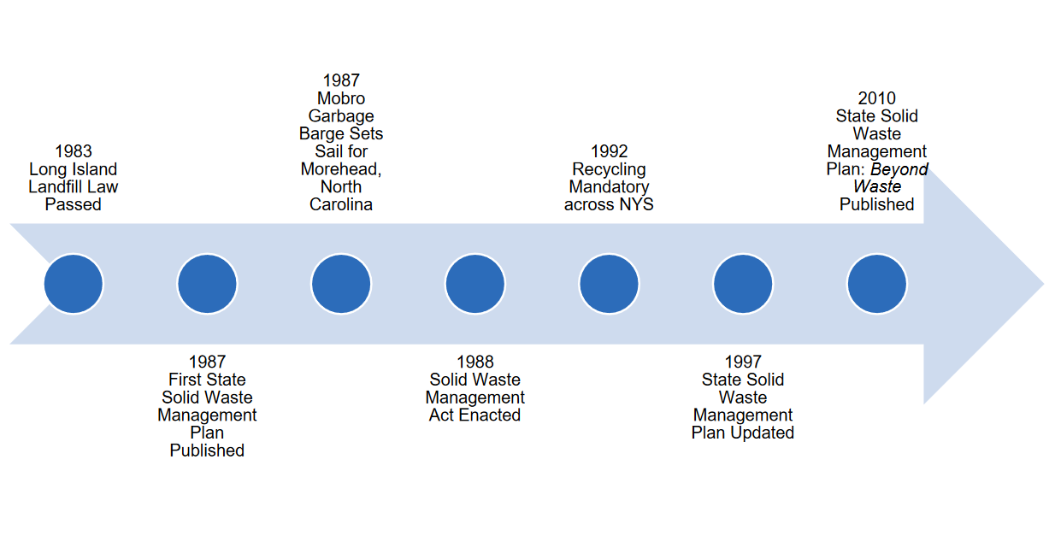
History of State Solid Waste Management Planning

Slide 3
New York State Solid Waste Management Plan: Building the Circular Economy Through Sustainable Materials Management (2023 – 2032)

Slide 4
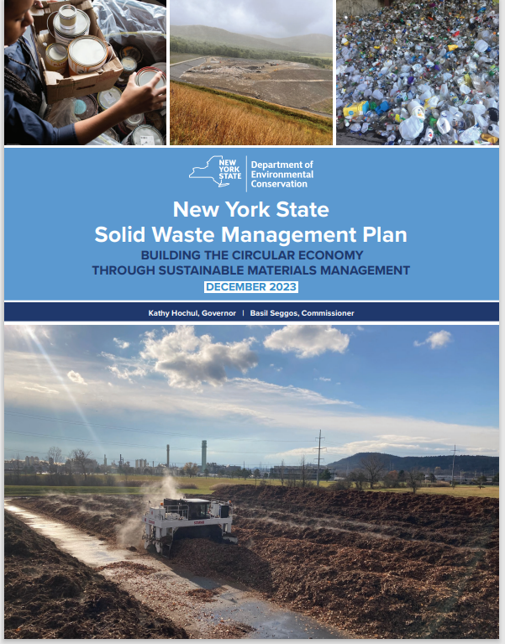
Table of Contents
Glossary of Terms
Message From the Commissioner
Executive Summary
Introduction
Background on Waste Management in NYS
Issues, Challenges, and Opportunities
Values and Vision
The Future of Materials Management in NYS
Waste Projections and Goals 2023-2050
Conclusions
Appendices

Slide 5
Appendices
A. New York State Plan History
B. Accomplishments since 2010
C. New York State Waste Generation and Waste Imported
D. Solid Waste Management Facilities and Transporters
E. Regional Solid Waste Management and Planning Unit Summaries
F. Local Government Materials Management – Facts and Figures
G. Disadvantaged Communities and Potential Environmental Justice Area Impacts
H. Projections and Waste Characterization
I. New York State Materials Management Laws and Relevant Regulations

Slide 6
New York State’s Solid Waste Plan
Provides high level data and action agenda articulating goals to inform local solid waste management plans.
Fosters development of a robust sustainable materials economy.
Ensures the safe management of materials to protect public health and the environment.
Promotes full public participation, and advance fairness and environmental justice.

Slide 7
Circular Economy
Shift away from the linear “take, make, toss” model
A circular economy is a model of production and consumption that involves sharing, leasing, reusing, repairing, refurbishing, and recycling existing material and products for as long as possible

Slide 8
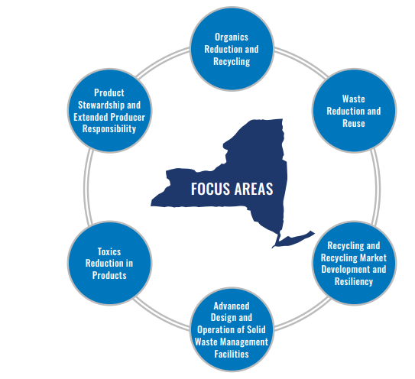
Plan Focus Areas
Waste Reduction and Reuse
Recycling and Recycling Market Development and Resiliency
Product Stewardship and Extended Producer Responsibility
Organics Reduction and Recycling
Toxics Reduction in Products
Advanced Design and Operation of Solid Waste Management Facilities and Related Activities

Slide 9
Vision
Landfilling and combustion is reduced by 85% by 2050
The circular economy is realized
Collaboration and innovation are commonplace
“Waste” is a concept of the past
Climate change mitigation is fully implemented
Shared responsibility is a given
Equitable, inclusive, and accessible waste reduction and reuse efforts are widespread
Responsible and resilient markets thrive

Slide 10
Climate Leadership and Community Protection Act (CLCPA)
Effective on January 1, 2020.
Final Scoping Plan released December 2022
Among other things, the CLCPA:
Directs DEC to establish GHG emission limits
Requires a 40% reduction in statewide GHG emissions from 1990 levels by 2030 and an 85% reduction by 2050
The Waste Sector is a sizable contributor to GHG emissions responsible for 12% of statewide GHG emissions

Slide 11
Issues, Challenges, and Opportunities

Slide 12
Issues, Challenges and Opportunities
Climate
Throw-away culture
Global markets
Information sharing and technology
Equity issues
Ecosystem impacts
Emerging contaminants sampling and research

Slide 13
Background on Waste Management in New York State

Slide 14
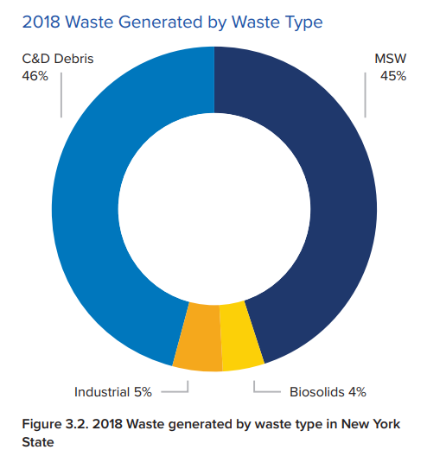
2018 Waste Generated by Type in New York
Total waste stream generation was 42.2 million tons in 2018.
Recycling rate increased
36% in 2008
43% in 2018

Slide 15
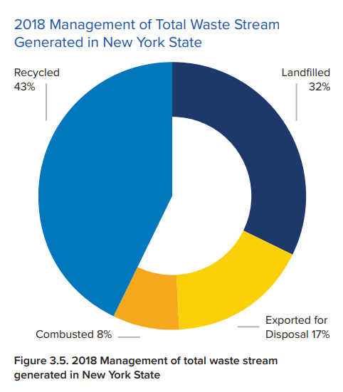

Slide 16
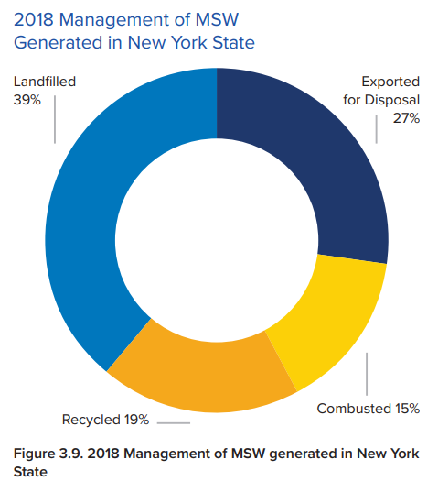
MSW Recycling Rate
20% in 2008
19% in 2018

Slide 17
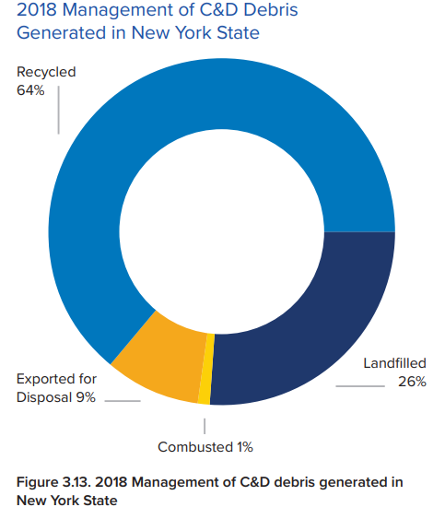
C&D Recycling Rate
55% in 2008
64% in 2018

Slide 18
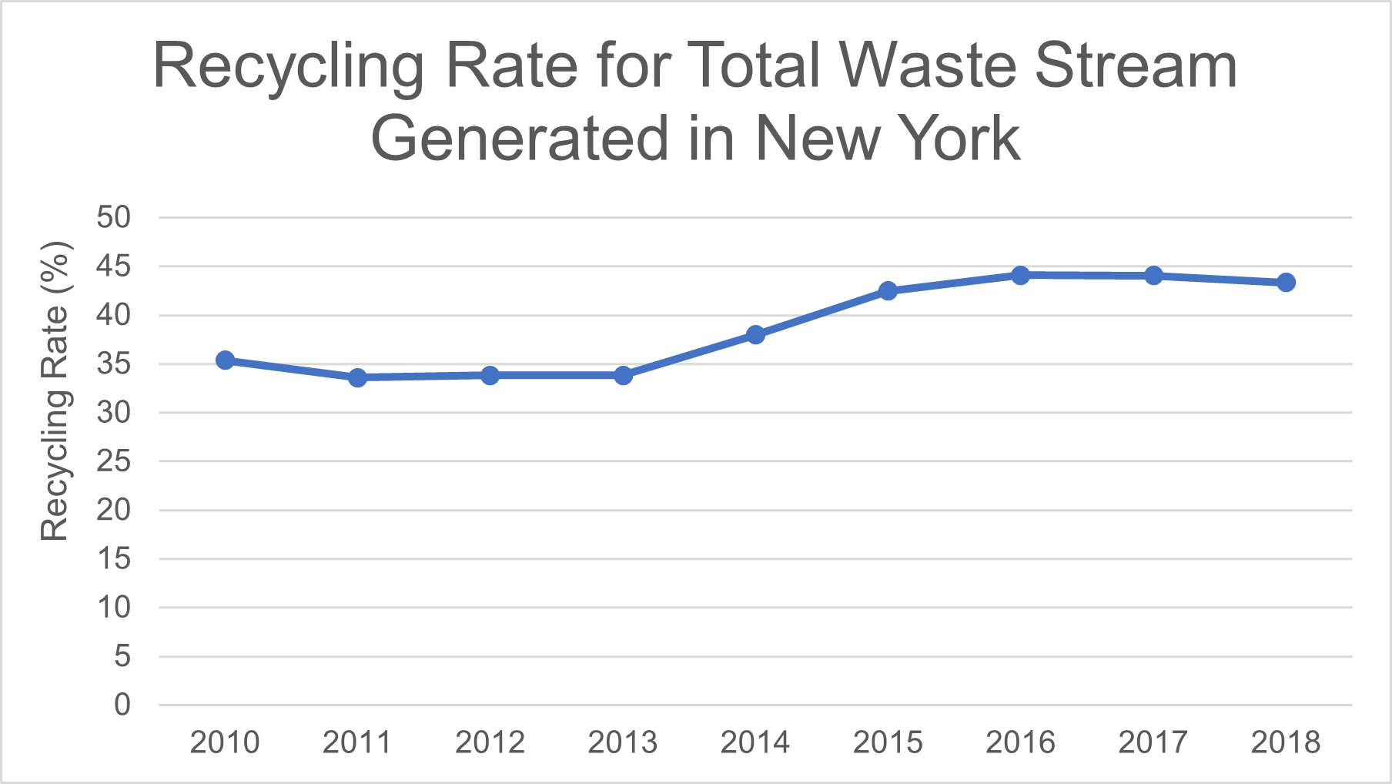

Slide 19
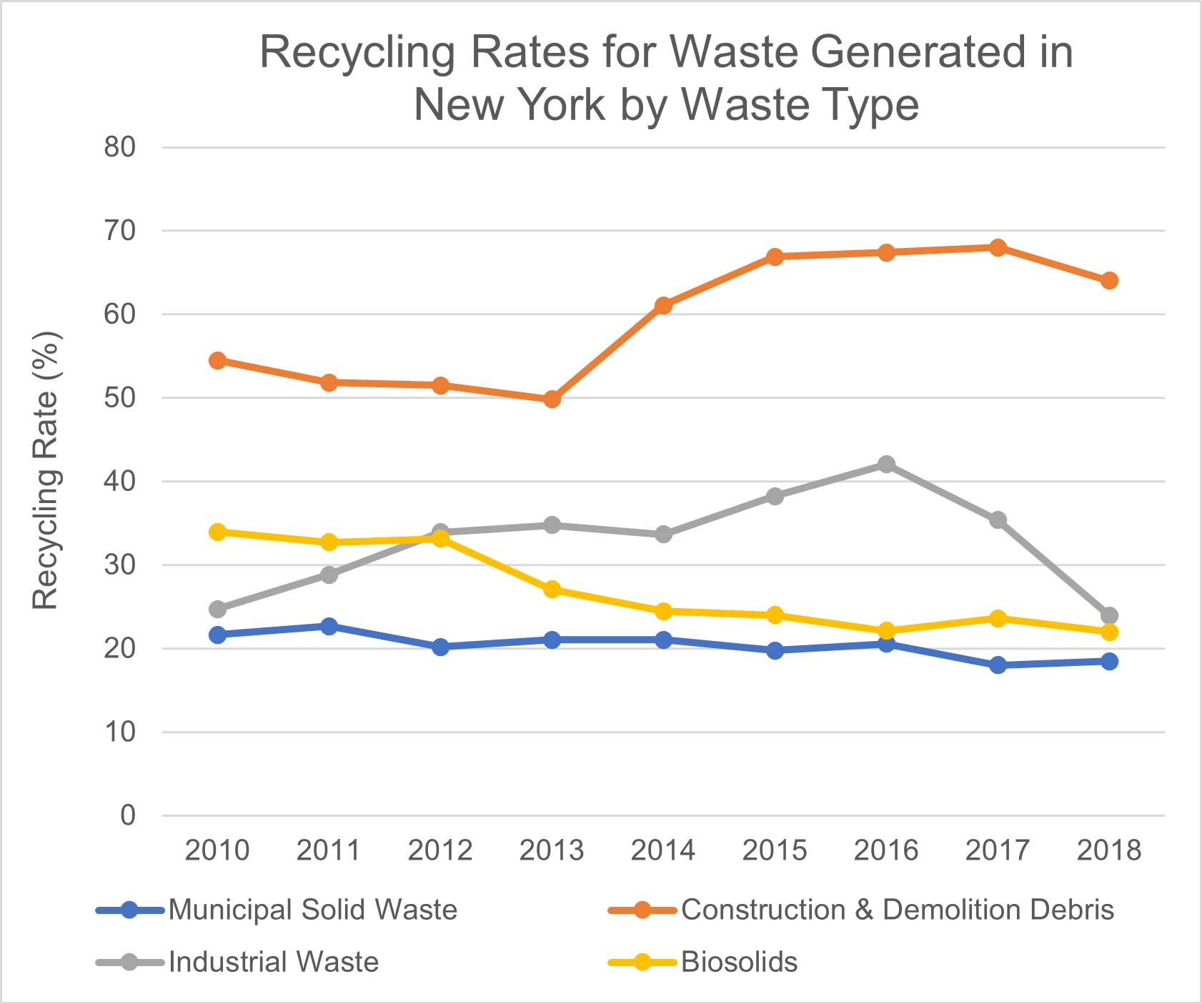

Slide 20
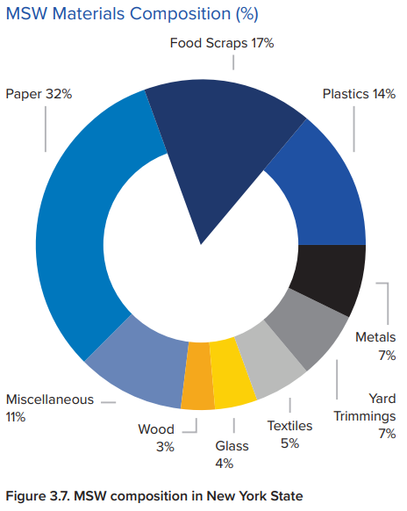

Slide 21
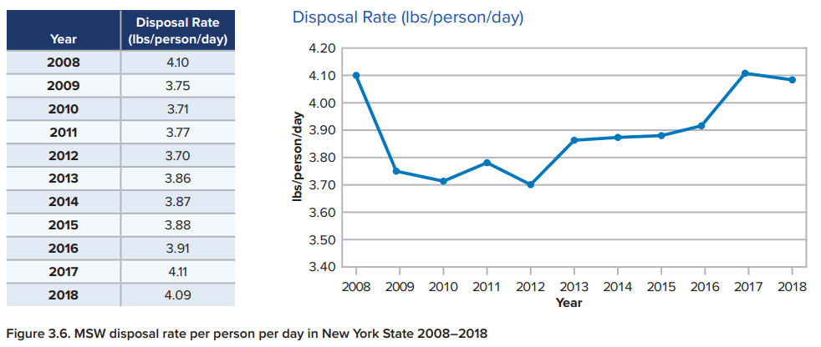
The state remained essentially at the same disposal rate of pounds of MSW per person per day in 2018 (4.09) as in 2008 (4.10).

Slide 22
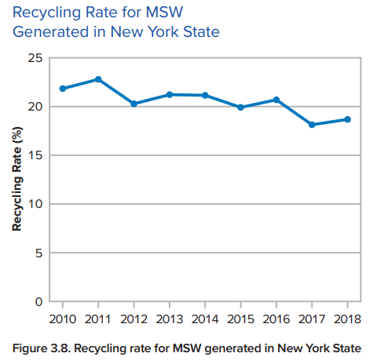

Slide 23
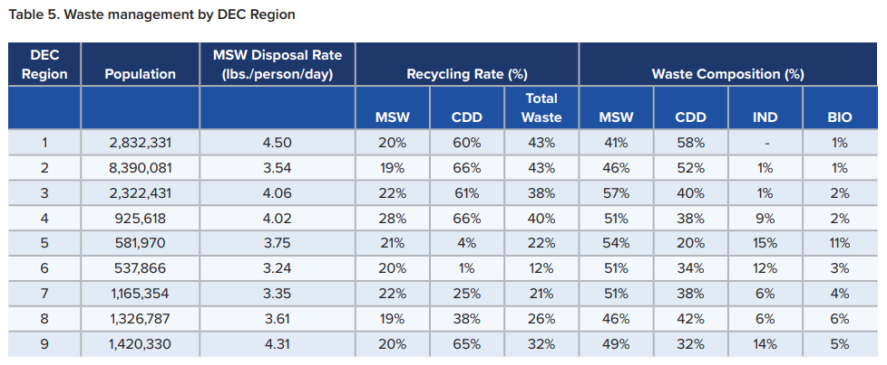
Regional Waste Management Variability

Slide 24
Residential Waste Collection

Slide 25
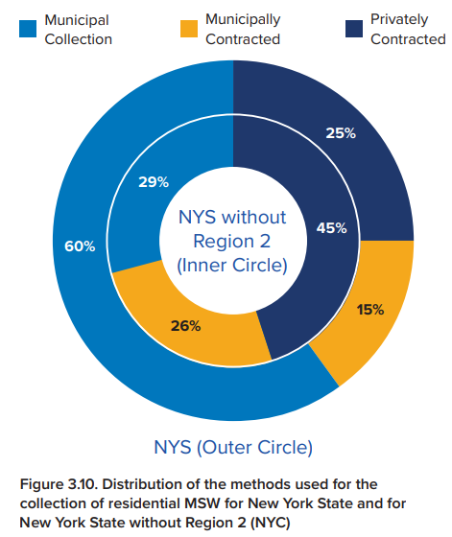
Collection of Residential Waste
New York City
NYC represents about 44% of the state's population and provides unique level of municipal service to multi-residential residences.
Statewide (minus New York City)
45% of residents subscribe directly for collection services with private waste collectors.
29% of residents receive direct municipal curbside collection services.
26% of residents are served by municipalities contracting private waste collection services on behalf of residents.

Slide 26
Solid Waste Management Facilities

Slide 27
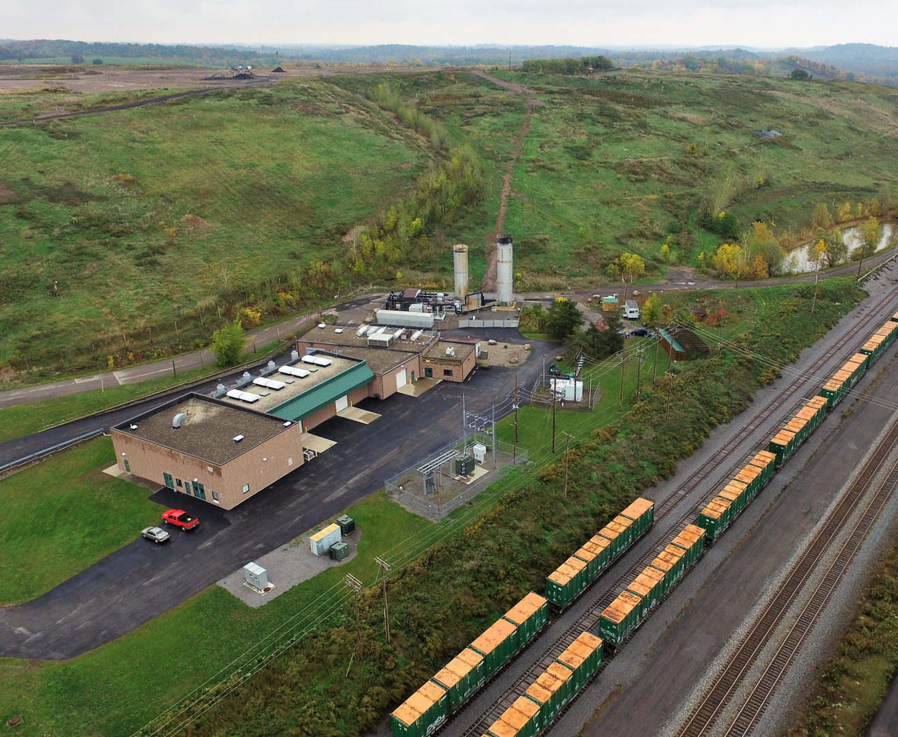
Disposal Capacity
25 MSW landfills
Combined capacity ranges from 16-25 years
19 years capacity if full permitted capacity used by each landfill
Notes:
Pic is high acres and their train line w NYC MSW

Slide 28
Disposal Facilities
Landfills
19 of 25 active landfills are owned by municipalities.
By capacity, privately owned and operated landfills and privately operated / municipally owned landfills account for 82% of working MSW landfill capacity in 2018.
MWCs
1 of the 10 MWCs owned and operated by a municipality.
By capacity, 98% of working MWC capacity in 2018 owned or operated by private companies.

Slide 29
Impact of Waste Management on PEJAs and DACs
PEJAs: Potential Environmental Justice Areas
DACs: Disadvantaged Communities

Slide 30
Identification of PEJAs and DACs
Potential Environmental Justice Areas (PEJA)
At least 52.42% of the population in an urban area reported to be members of minority groups; or
At least 26.28% of the population in a rural area reported to be members of minority groups; or
At least 22.82% of the population in an urban or rural area had household incomes below federal poverty level
Disadvantaged Communities (DAC)
Located within census block groups that meet the HUD 50% AMI threshold, that are also located within a PEJA
Located within New York State Opportunity Zones (low-income census tract with an individual poverty rate of at least 20 percent and median family income no greater than 80 percent of the area median)

Slide 31
Impact of Waste Management on PEJAs and DACs - Statewide
From a population perspective
46% of the population lives in a PEJA
36% of the population lives in a DAC
Based on the total number of all solid waste management facilities
25% of solid waste management facilities are located in a PEJA
33% are located in a DAC
Based on the facility throughput
37% of the total waste stream was managed at facilities located in a PEJA
57% of the total waste stream was managed at facilities located in a DAC

Slide 32
Impact of Waste Management on PEJAs and DACs – New York City
From a population perspective
72% of the city’s population lives in a PEJA
50% of the city’s population lives in a DAC
Based on the total number of all solid waste management facilities
77% of solid waste management facilities are located in a PEJA
83% are located in a DAC
Based on the facility throughput
66% of the total waste stream was managed at facilities located in a PEJA
88% of the total waste stream was managed at facilities located in a DAC

Slide 33
Solid Waste Management Facilities in DACs & Quantity of Waste Handled
For more information, see Appendix G of the SSWMP
Throughput and type of the facility is important to consider when looking at this data

Slide 34
Solid Waste Management Facilities in PEJAs & Quantity of Waste Handled
For more information, see Appendix G of the SSWMP
Throughput and type of the facility is important to consider when looking at this data

Slide 35
Future of Materials Management in NYS

Slide 37
Action Items
175 action items spread across 31 goals
33 action items require legislative action
Action items are aligned with the recommendations in the CLCPA Final Scoping Plan

Slide 38
Focus Area 1: Waste Reduction and Reuse
Increase reduction, reuse, and repair opportunities for New York State residents (Right to Repair legislation, K-12 curriculum and sharing tables, and outreach and education on reuse and refill)
Support reduction and reuse in the commercial and industrial sectors through education, engagement, and policy
Support refill and reuse solutions for foodservice
Advance circularity in furniture
Enhance secondary markets for textile goods
Study the issue of unsold retail goods and work to prevent disposal
‘Rethink Waste’ campaign

Slide 39
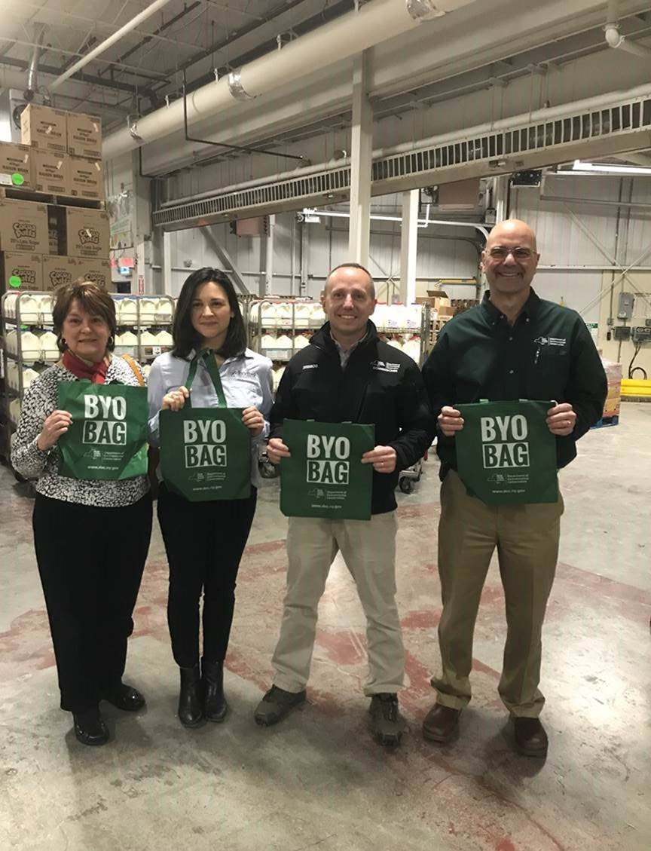
Focus Area 1: Waste Reduction and Reuse (cont’d)
Foster community resiliency by developing programs and supporting proposals and initiatives that prevent and reduce waste, and promote reuse.
Support legislative proposals restricting and reducing single-use plastics
Support legislative proposals enhancing the implementation of the New York State Bag Waste Reduction Law
Advance community-level reuse and repair programs
Continue to assist with technical assistance to local communities on prevention, reduction, and reuse

Slide 40
Focus Area 2: Recycling and Recycling Market Development and Resiliency
Support proposals, such as EPR for paper and packaging, that motivate products to reduce the amount of material entering households
Increase research collaborations to improve residential recycling education and promote improved recycling strategies for all sectors
Partner with K-12 schools, colleges, and universities to educate, engage, and empower students

Slide 41
Focus Area 2: Recycling and Recycling Market Development and Resiliency (cont’d)
Reduce waste disposal through innovative policy approaches
Support pathways for increased textile and furniture circularity
Support efforts to build capacity for processing secondary materials commodities collected for recycling
Encourage the development and expansion of recycling markets by demonstrating the state’s ability to “lead by example”

Slide 42
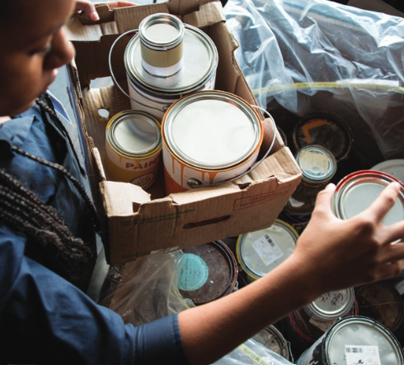
Focus Area 3: Product Stewardship and Extended Producer Responsibility
Support broad packaging and paper product legislation to include all types of products by all generators
Work to improve the state’s existing products stewardship and EPR programs (e-waste, rechargeable batteries, mercury thermostat, postconsumer paint, pharmaceuticals, carpet)
Promote the development and passage of EPR framework legislation and EPR legislation for priority products

Slide 43
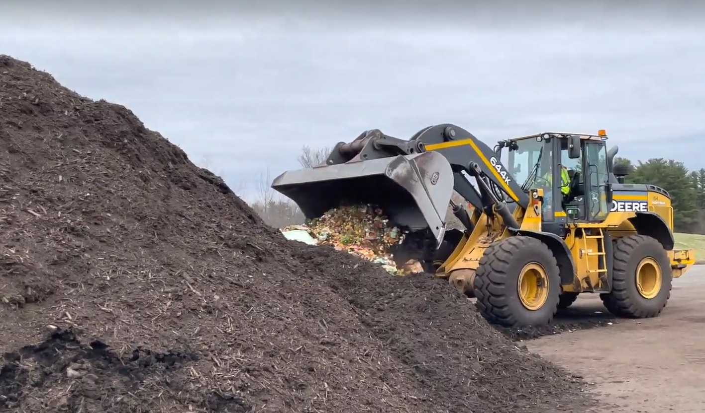
Focus Area 4: Organics Reduction and Recycling
Support expansion of the Food Donation & Food Scraps Recycling law
Support and grow the organics recycling industry (guidance, trainings, financial assistance)
Empower residents to compost at home or through community programs
Expand markets for use of compost, digestate and other end products
Engage the farming and agriculture community (composting on-site, compost use, land application, animal feed, etc.)

Slide 44
Focus Area 5: Toxics Reduction in Products
Leverage partnerships to expand knowledge of harmful chemicals in products to promote their reduction
Work with partners to better understand the presence of toxic chemicals such as PFAS and identify preferable alternatives
Support legislation, policy, and initiatives that reduce the presence of toxic materials and contaminants in products
Support initiatives that ban materials and chemicals that are a growing concern for people and the environment

Slide 45
Focus Area 6: Advanced Design and Operation of Solid Waste Management Facilities and Related Activities
Keep regulations up to date and incorporate climate impact criteria
Encourage reuse of C&D debris, including excavated material
Provide technical assistance to facilities to improve operations
Support requirements for municipalities to develop and implement local solid waste management plans
Enhance efforts to address waste tires

Slide 46
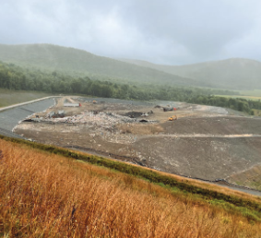
Focus Area 6: Advanced Design and Operation of Solid Waste Management Facilities and Related Activities (Cont’d)
Minimize GHG emissions from facilities (methane monitoring technologies & leak reductions)
Support new funding for municipal landfill closure and landfill gas management grant program
Continue Inactive Landfill Investigation program and support efforts to solidify wastes that contain PFAS compounds prior to disposal

Slide 47
Transformative Legislative Action is Needed
Developing EPR for paper and packaging, and framework legislation that allows the addition of other products
Expand and amend the existing Food Donation & Food Scraps Recycling Law (include smaller businesses and institutions, eliminate the mileage limit to an organics recycling facility)
Require a per ton disposal disincentive surcharge on all waste disposed in NYS and all waste generated in NYS being sent for disposal out-of-state to provide financial support for reduction, reuse and recycling projects

Slide 48
Waste Projections and Goals 2023-2050

Slide 49
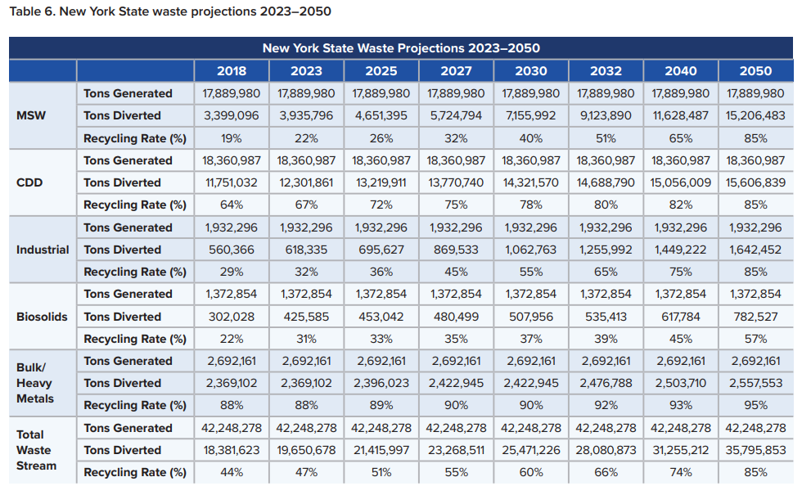

Slide 50
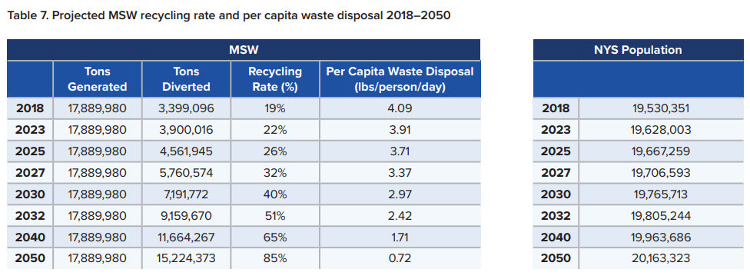

Slide 51
Solid Waste Management Plan Promotional Video
Promotional video created to encourage the general public to read the Plan. Informs them of the broader goals and objectives.
Available on DEC’s YouTube page at https://youtu.be/9GitZIotcjI
Notes:
This promotional video was created to accompany outreach on the State Plan/can be used as an outreach tool. The video is upbeat and celebratory; it encourages members of the general public who may otherwise not read the Plan to take a look.

Slide 52
Thank You
For more information on the New York State Solid Waste Management Plan: https://dec.ny.gov/environmental-protection/waste-management/solid-waste-management-planning/nys
Questions and comments can be emailed to NYSSolidWastePlan@dec.ny.gov

